Slide 1
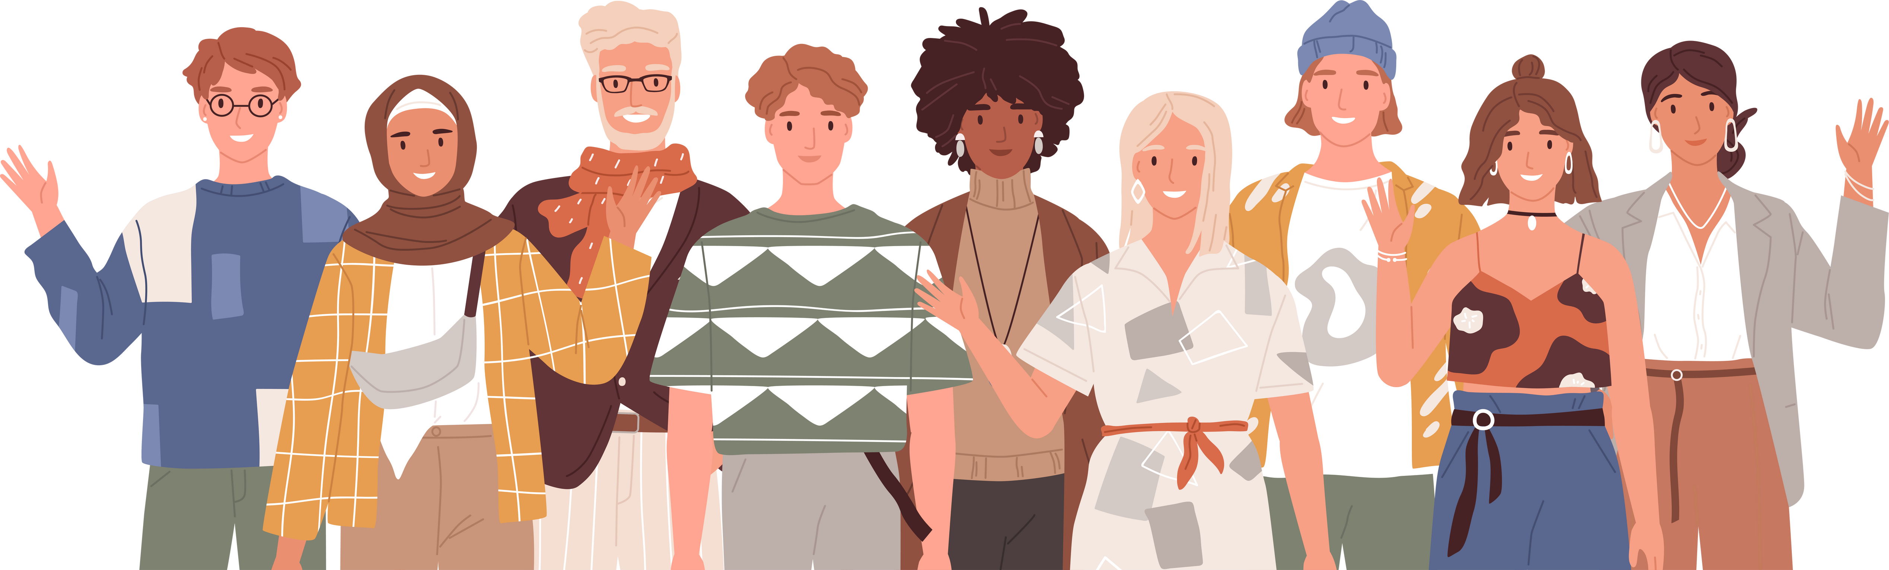

Pearson Level 3 Alternative Academic Qualification BTEC National in
HEALTH & SOCIAL CARE
(Extended Certificate)
www.tutor2u.net/hsc

Slide 2
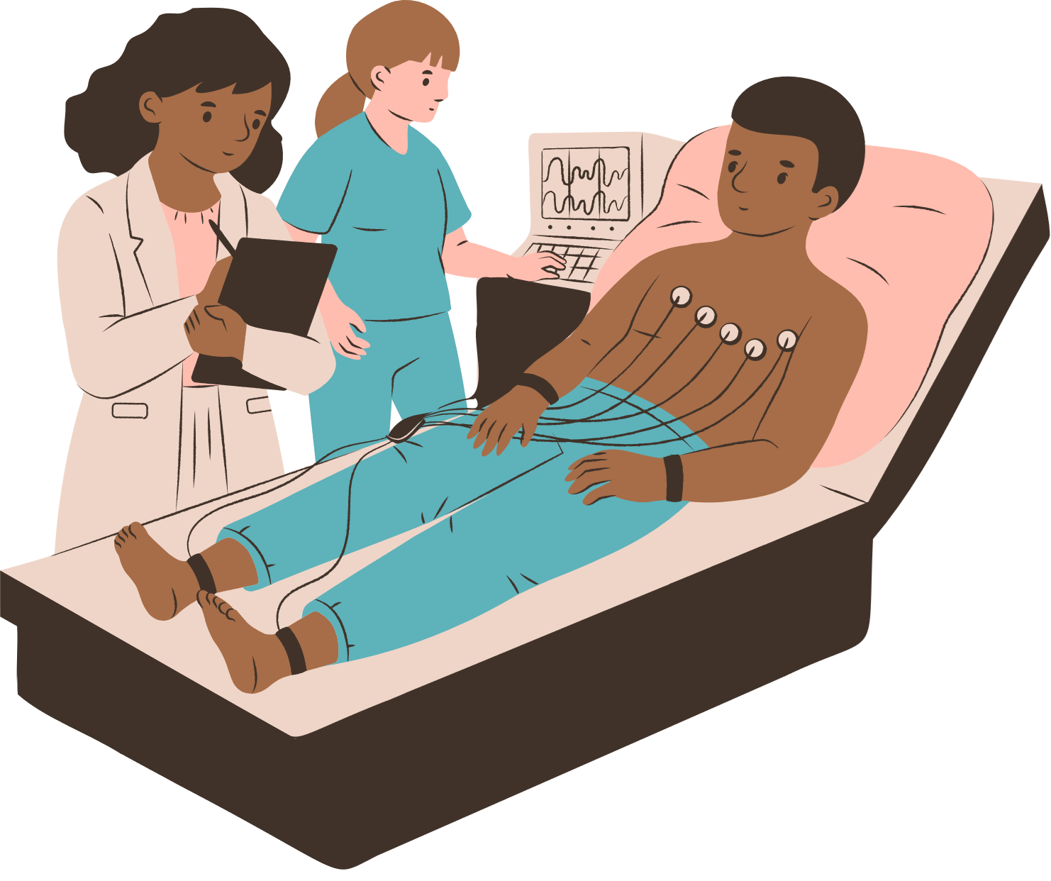

Unit 2
HUMAN BIOLOGY
& HEALTH
TASTER LESSON
www.tutor2u.net/hsc

Slide 3
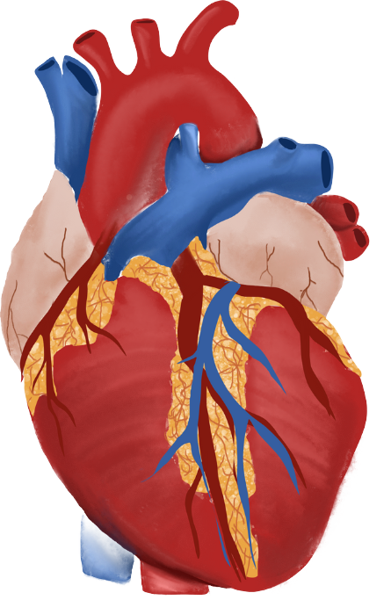
Unit 2 Human Biology & Health
Starter Activity
  Body System Match-Up: Take 5 minutes to:
  Match the organ images to the correct labels
  Match the labelled organs to the correct body systems
www.tutor2u.net/hsc
Notes:
Files included to print images and labels. Print one full set per group of students.
Note: Organs not to scale!

Slide 4
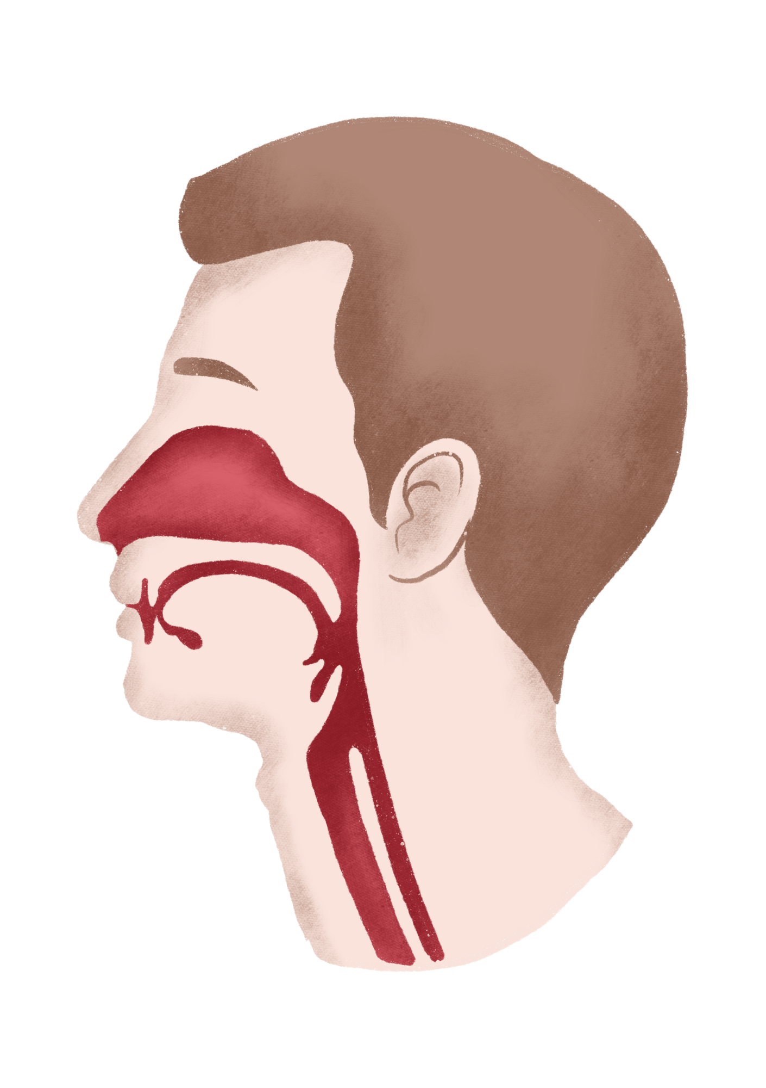
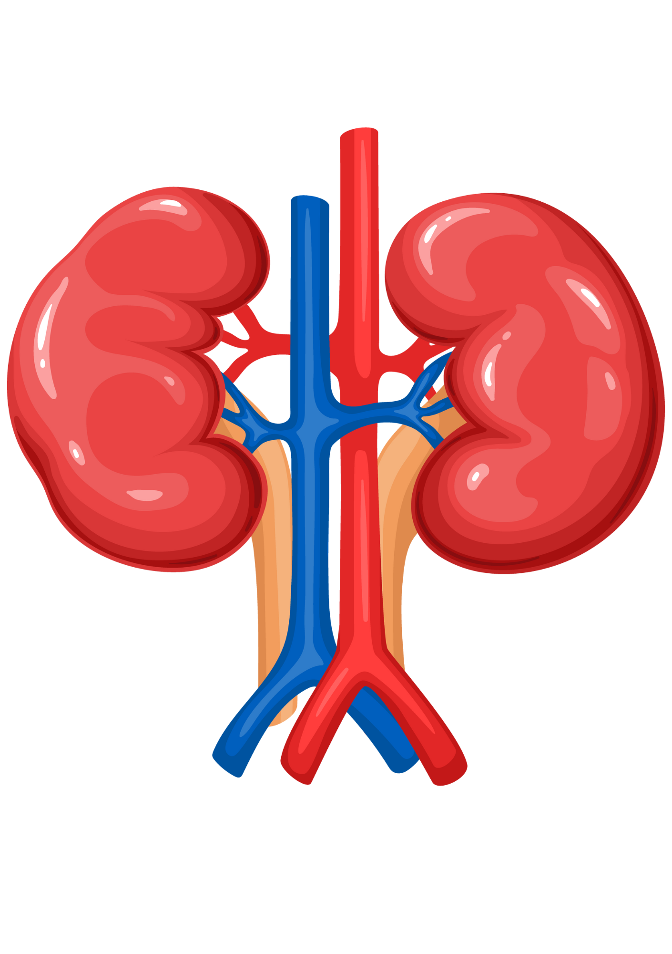
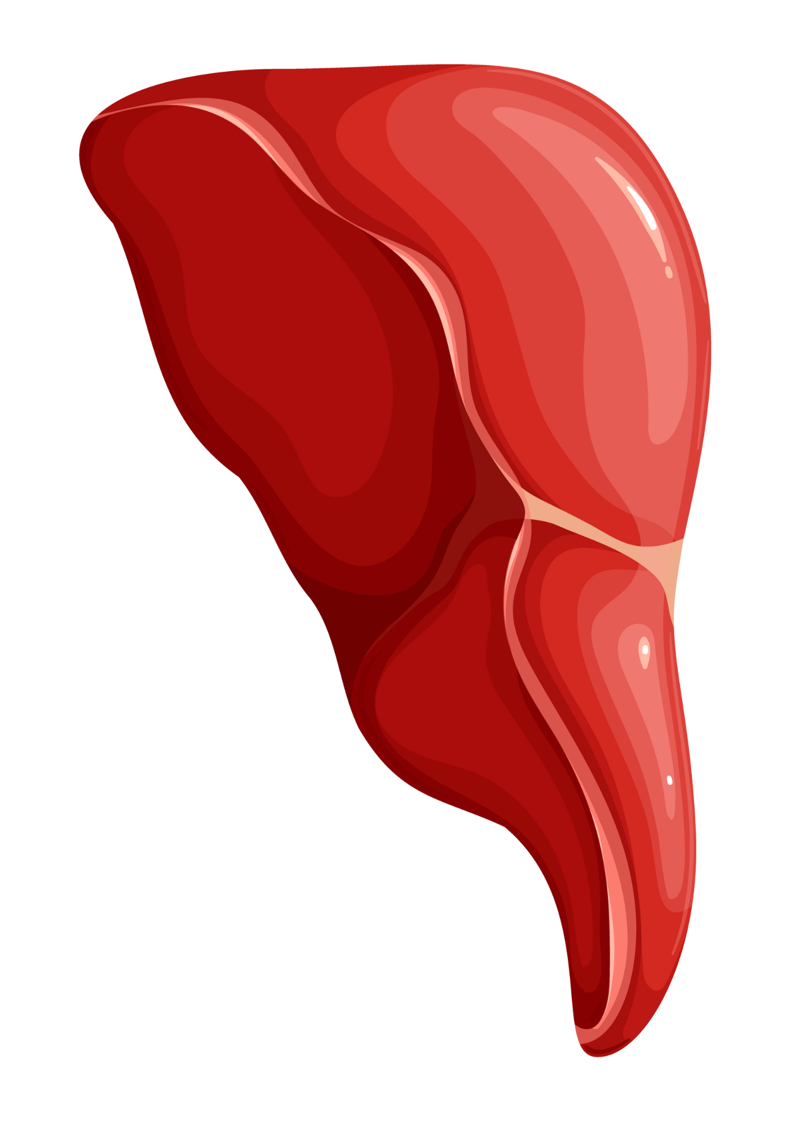
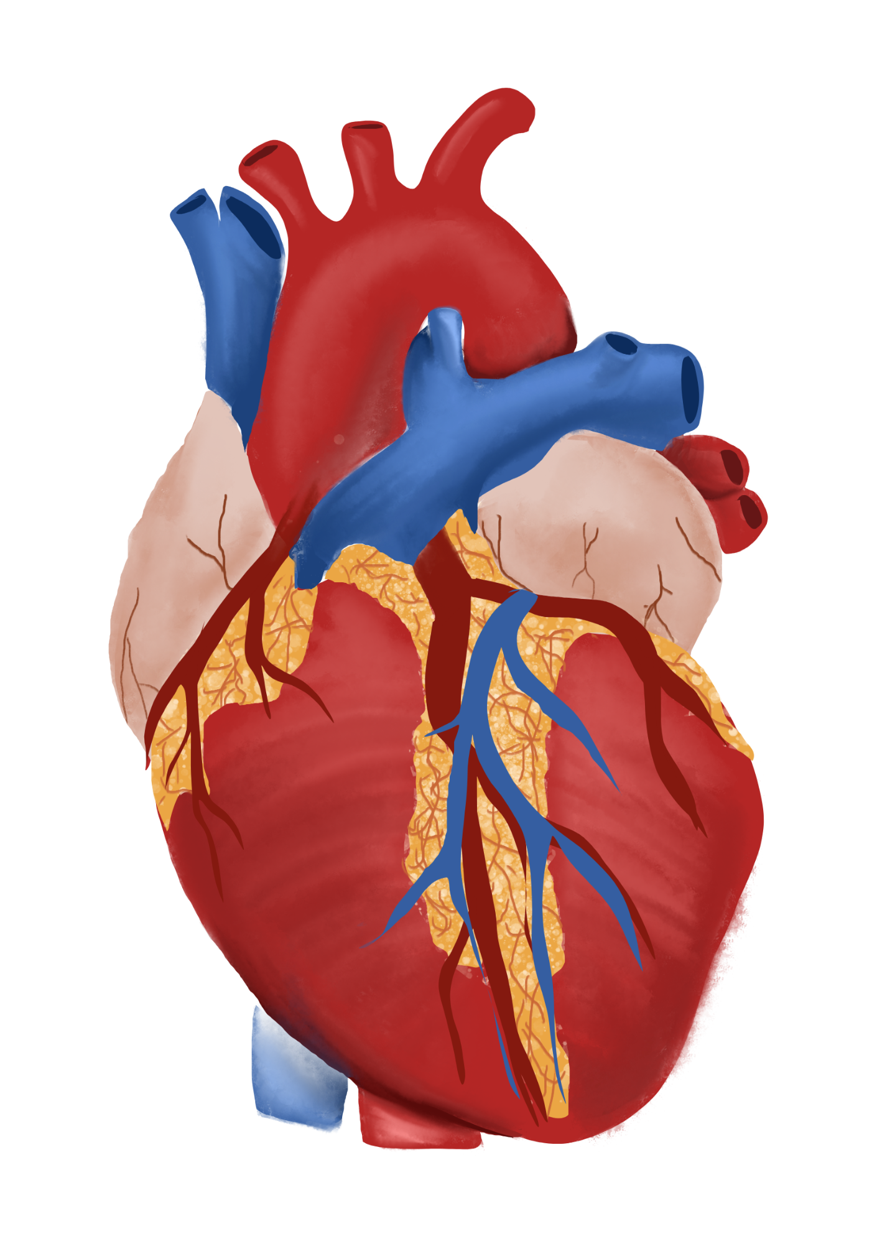
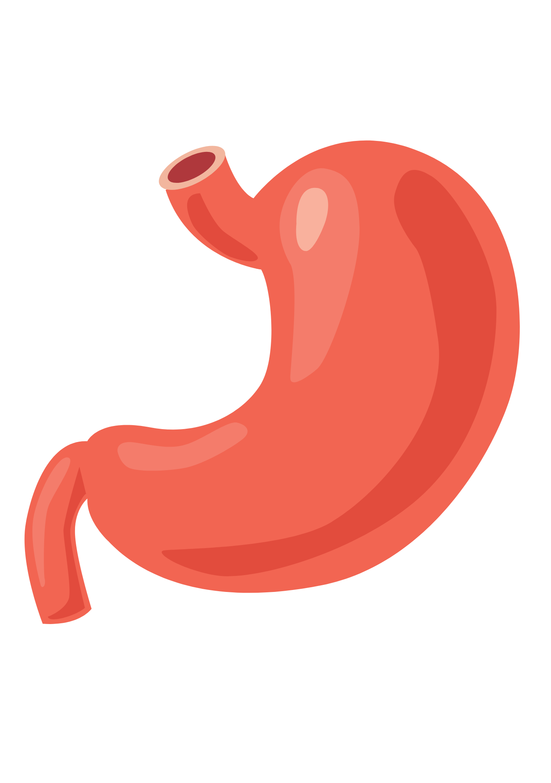
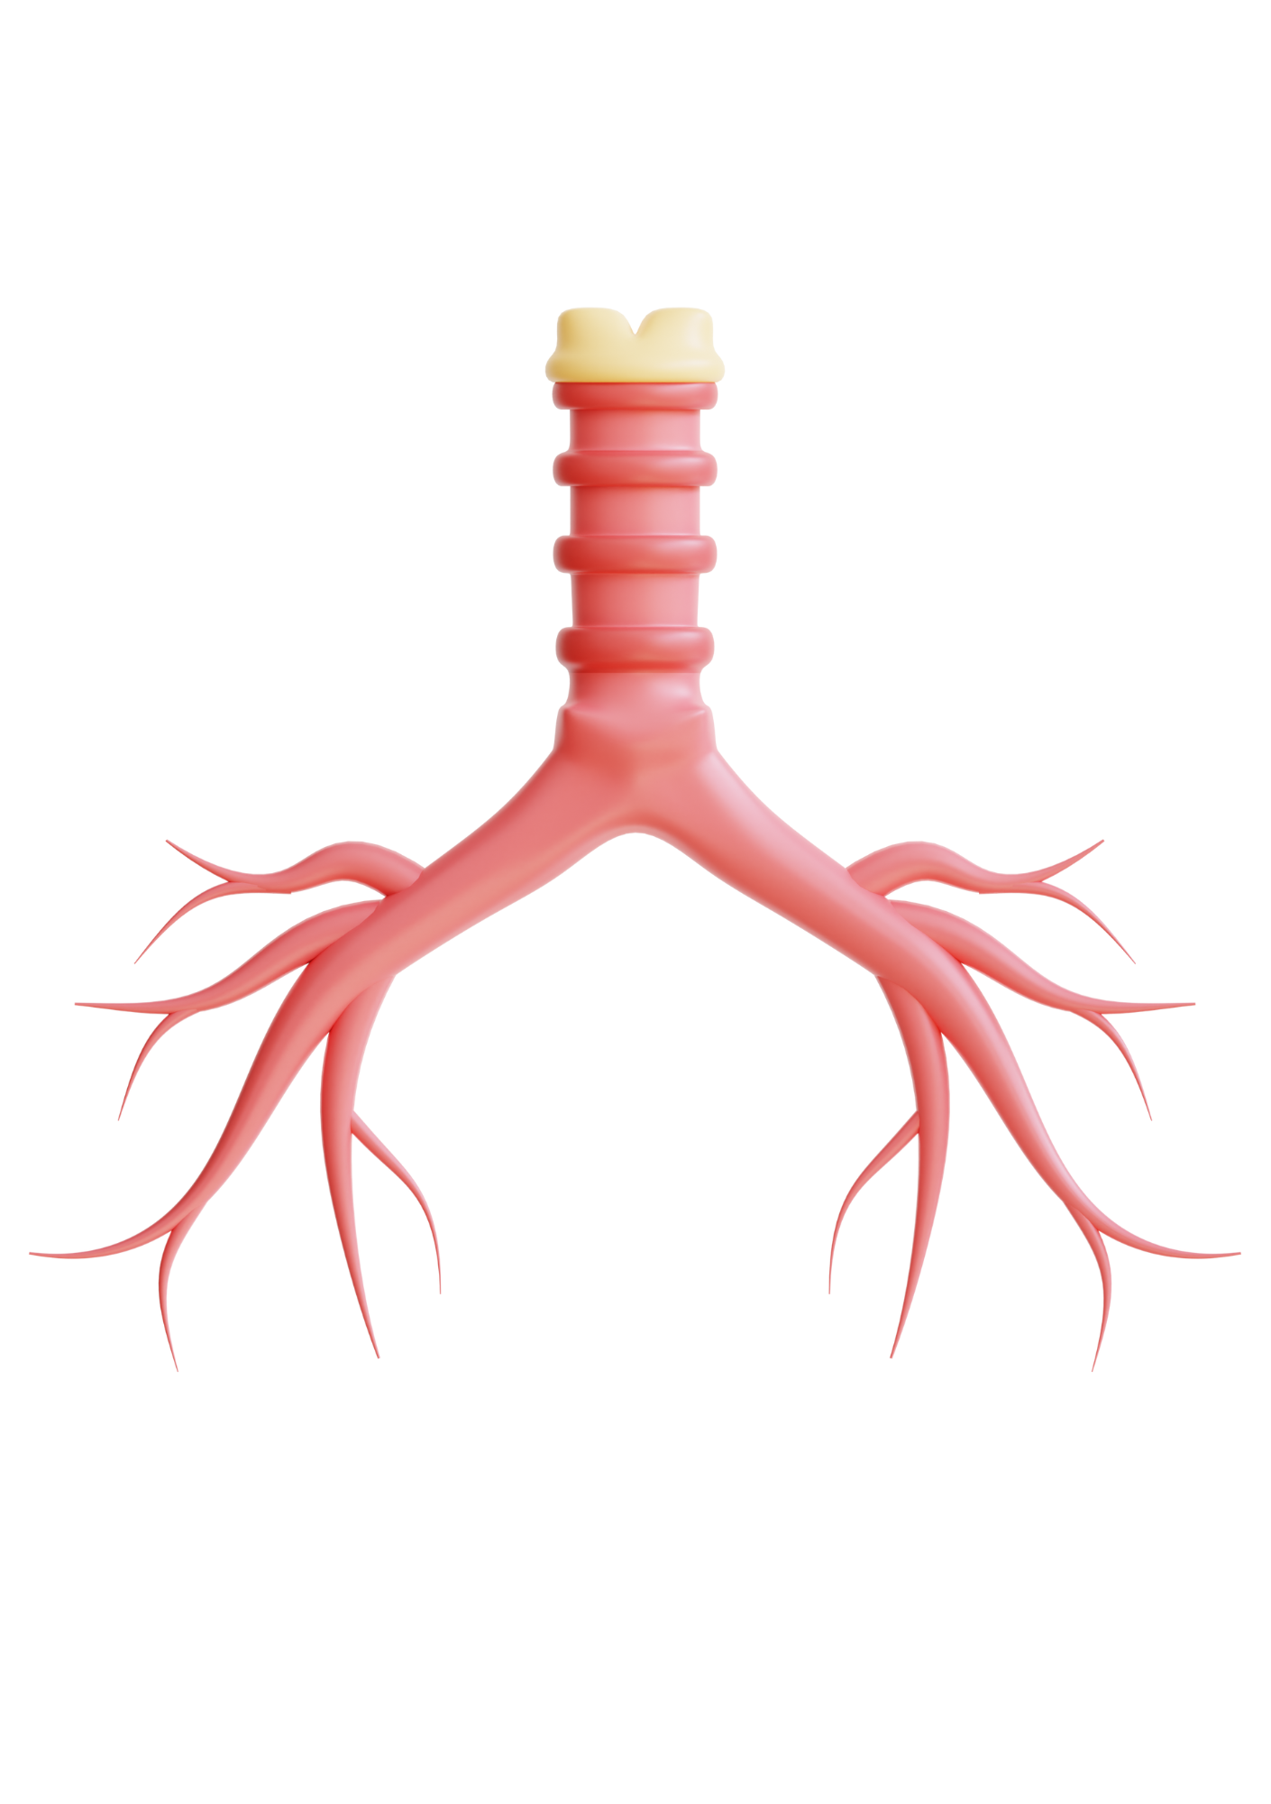
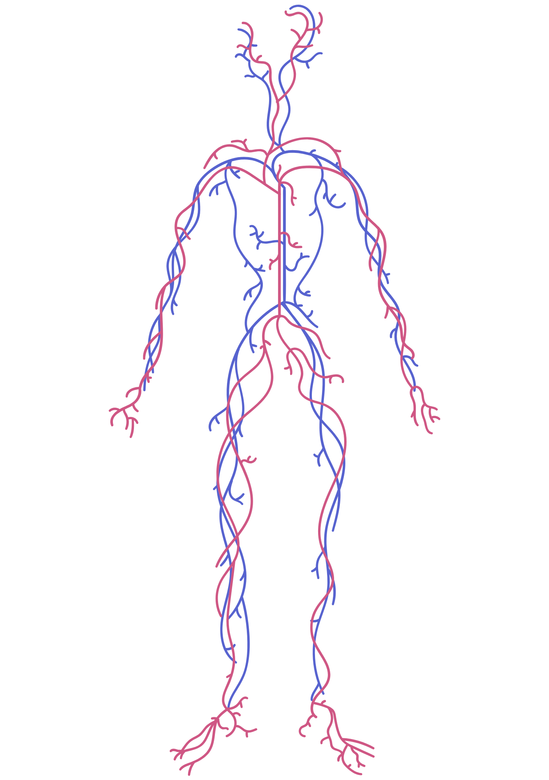
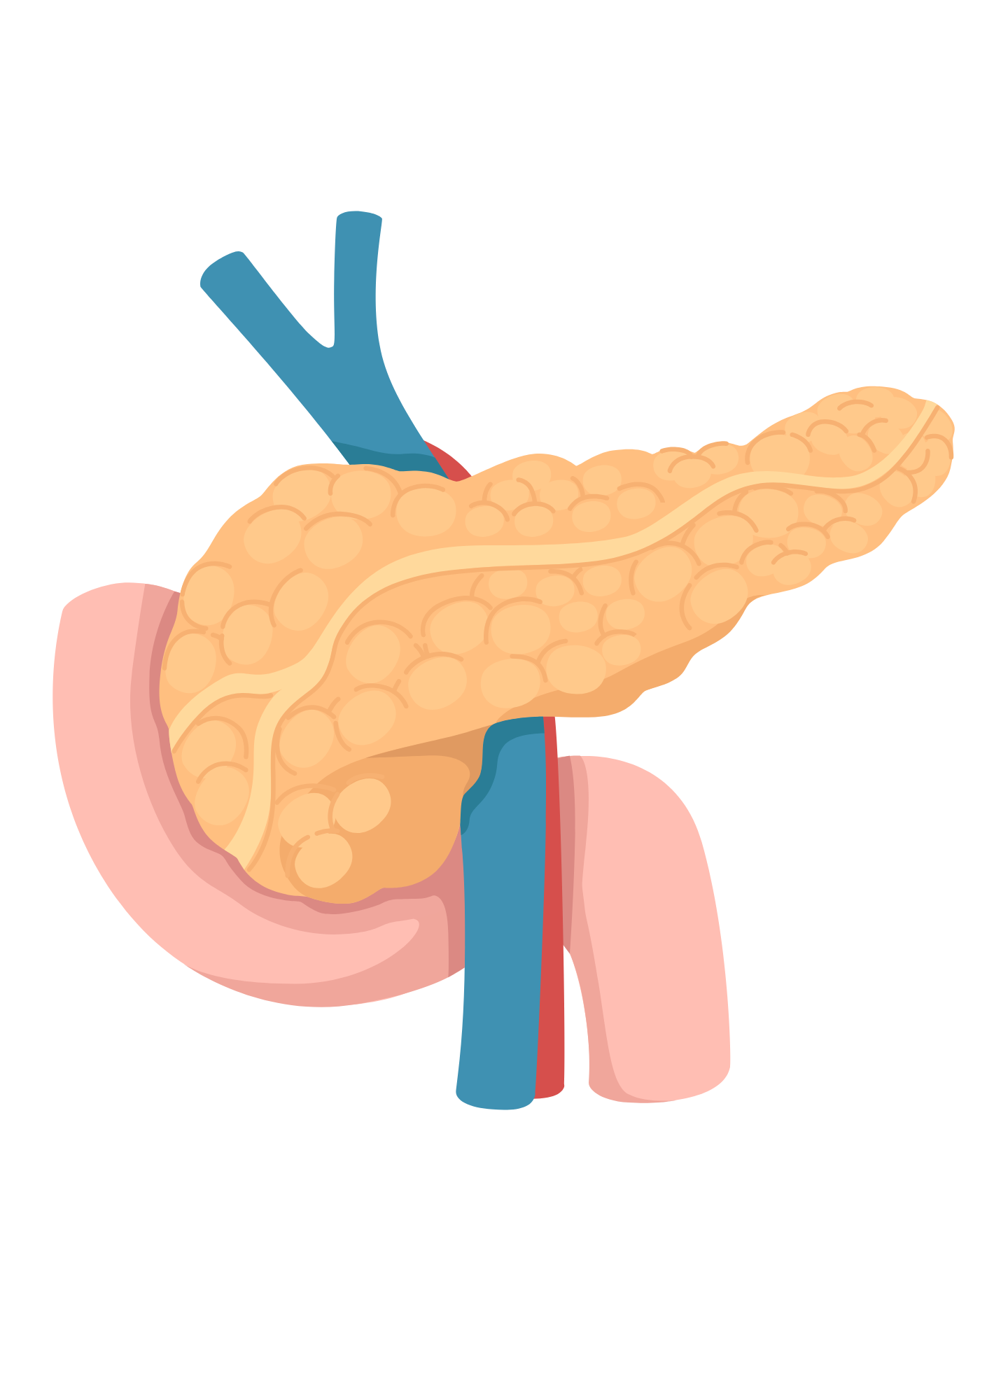
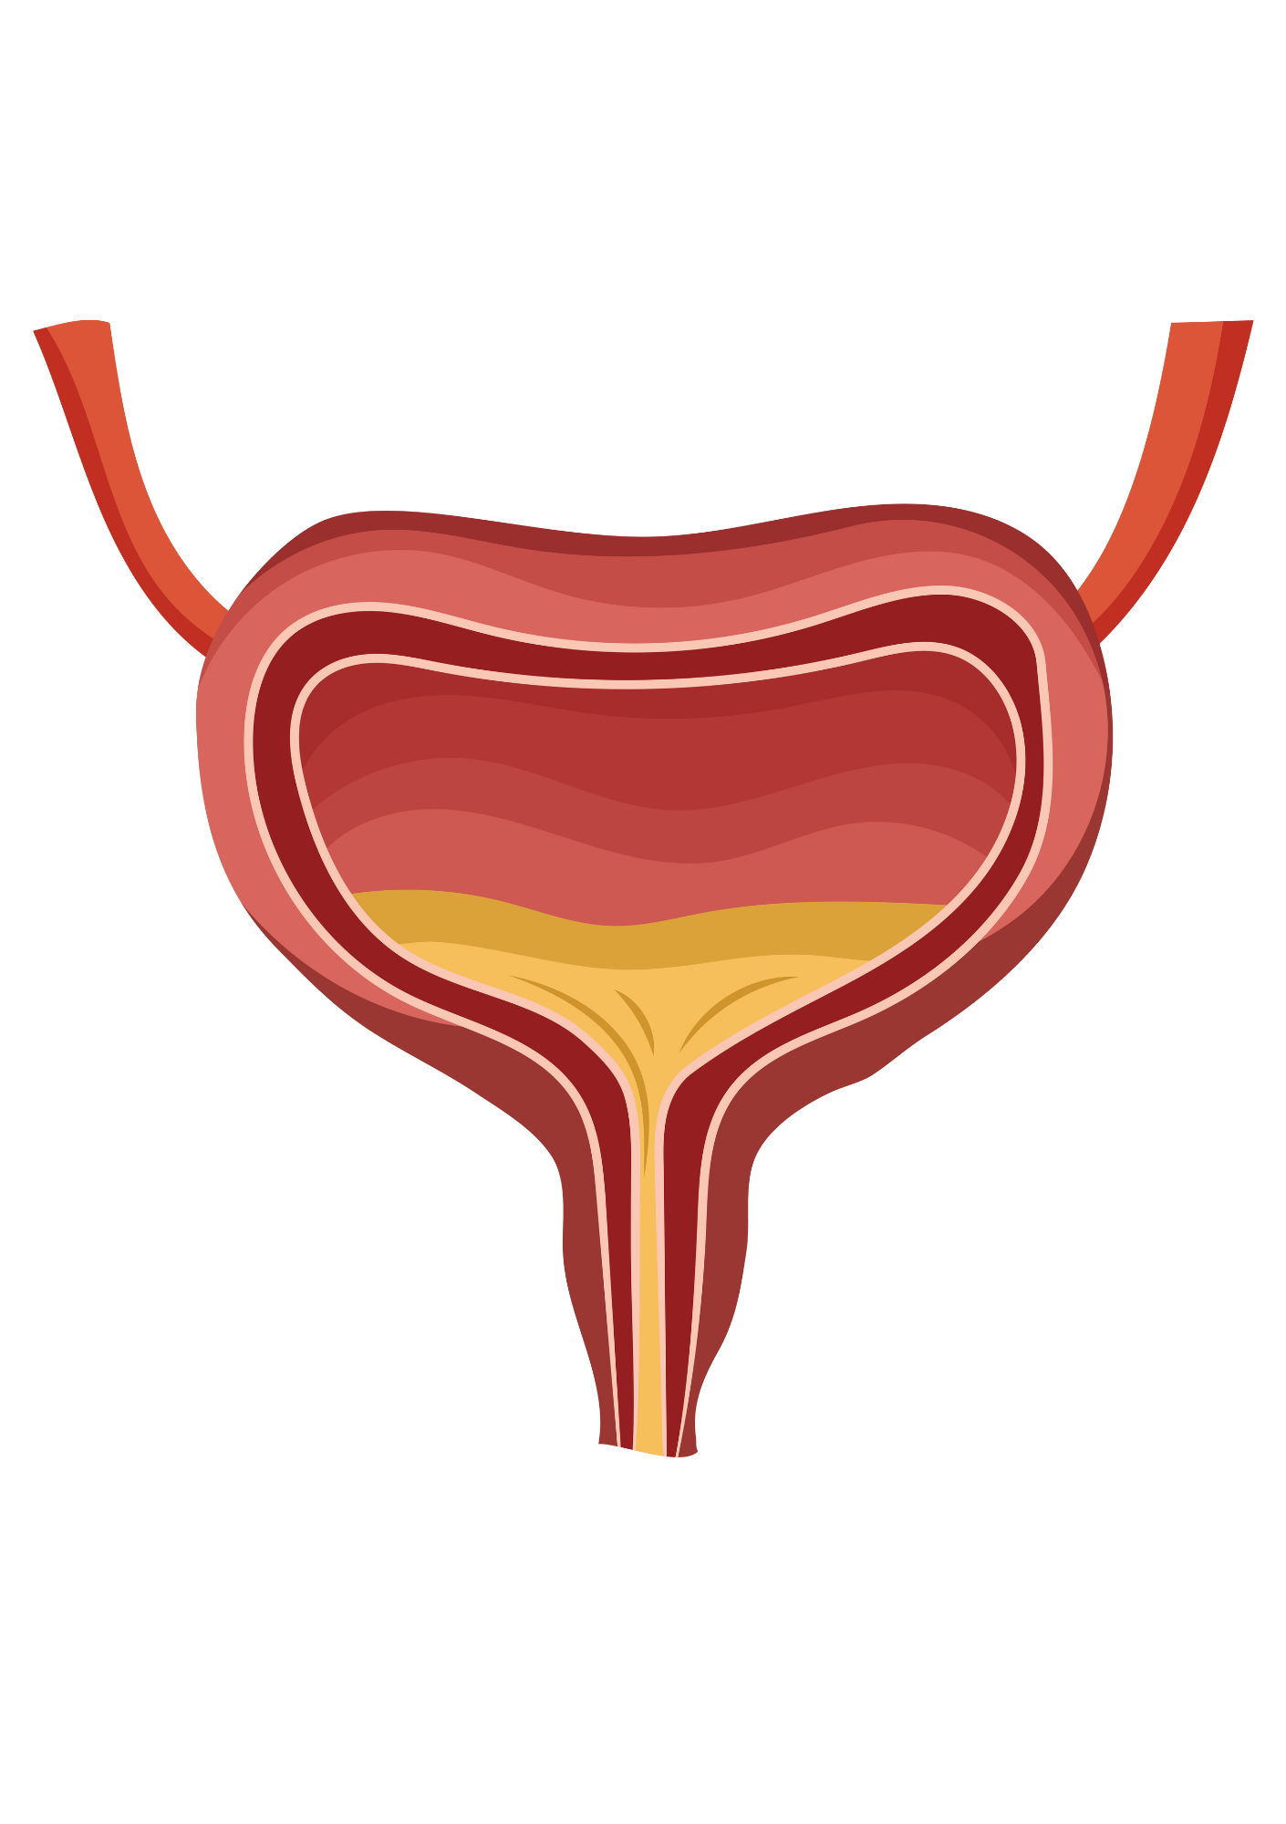
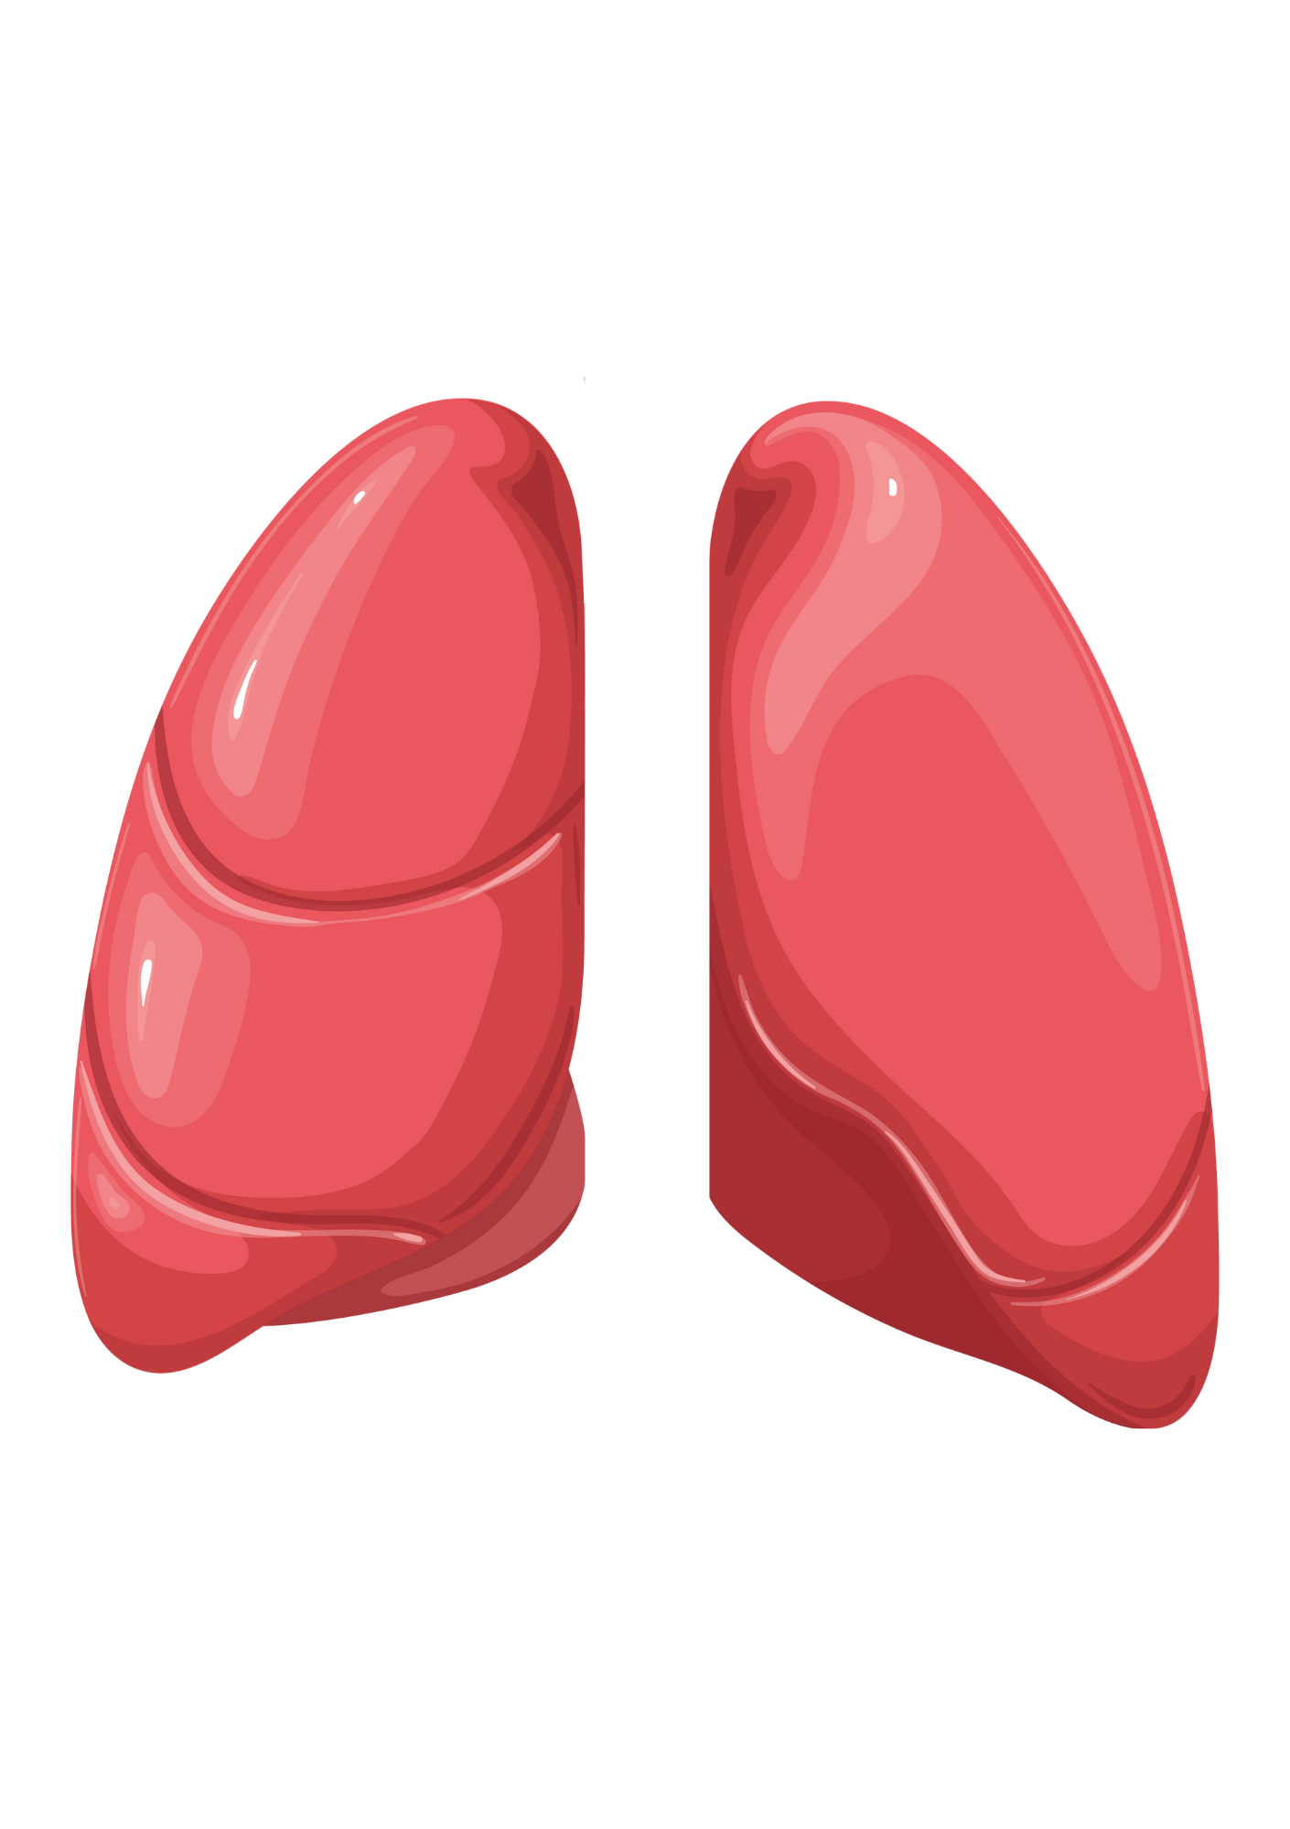
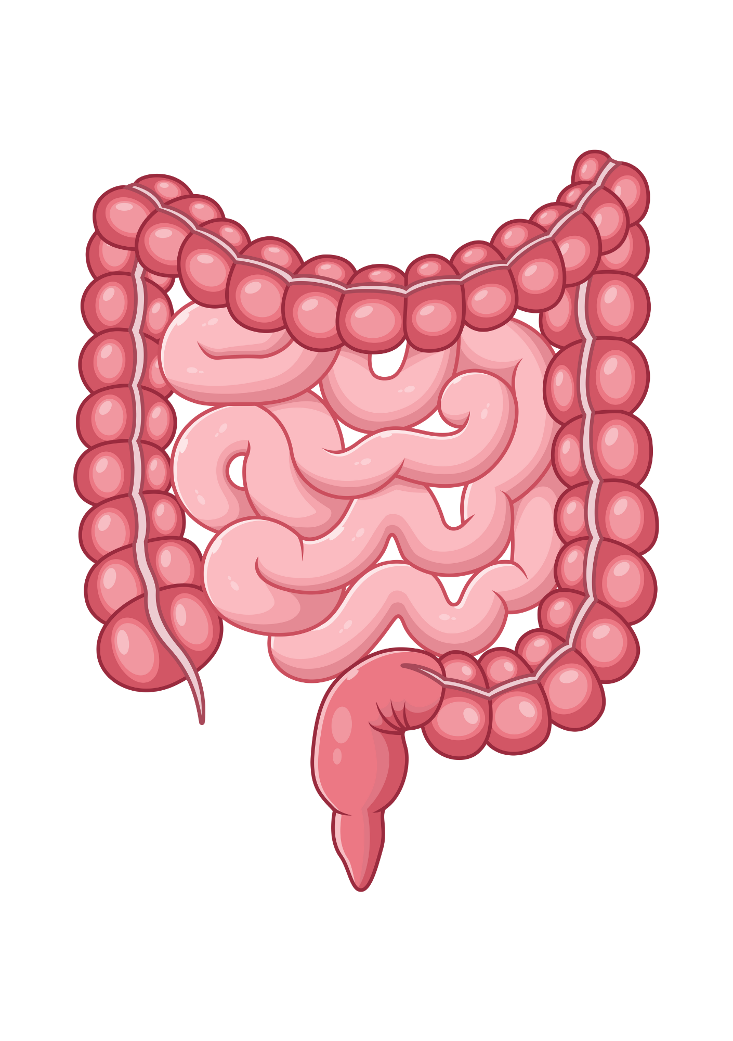
Unit 2 Human Biology & Health
CARDIOVASCULAR SYSTEM | DIGESTIVE SYSTEM | RESPIRATORY SYSTEM | RENAL SYSTEM
Liver
Upper Airways
Kidneys
Heart
Stomach
Trachea and Bronchi
Pancreas
Bladder
Arteries and Veins
Lungs
Small and Large Intestines
www.tutor2u.net/hsc
Notes:
Answers for starter acivity

Slide 5
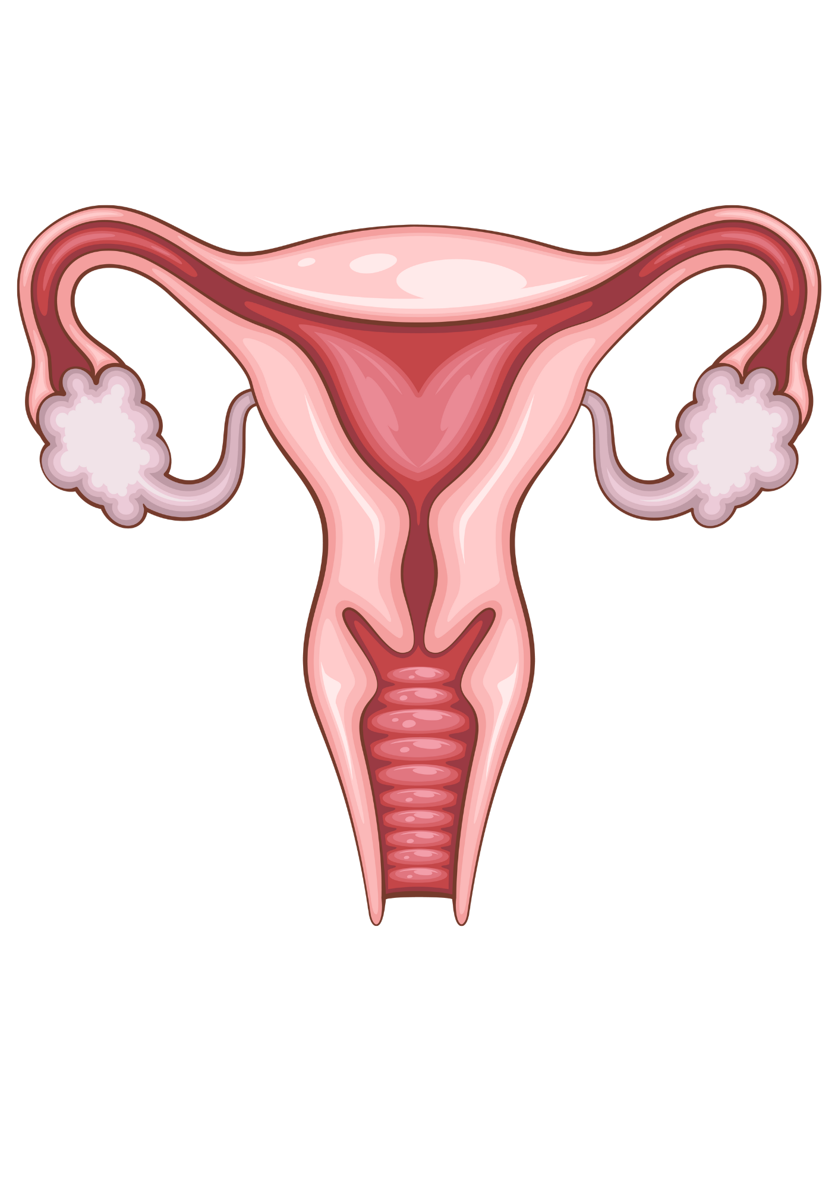
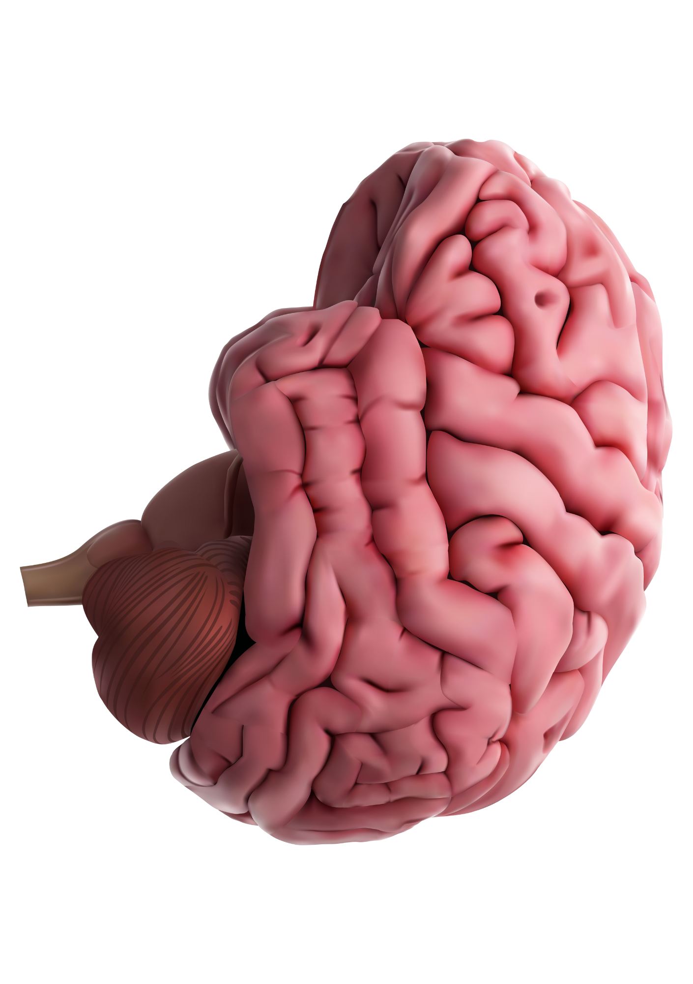
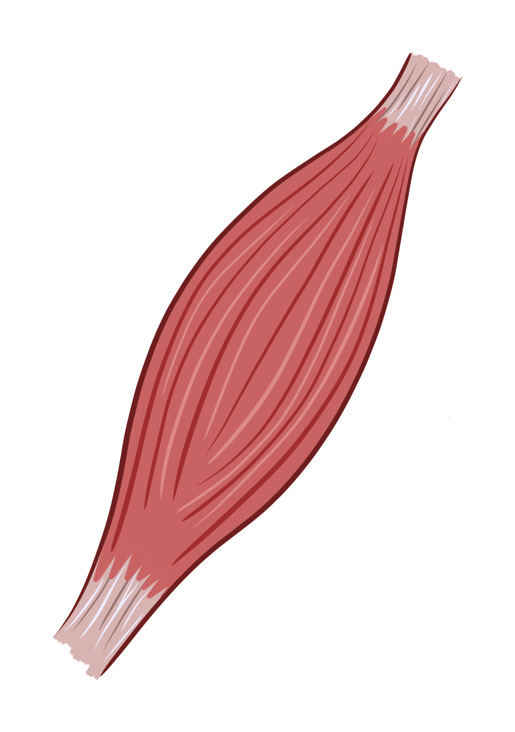
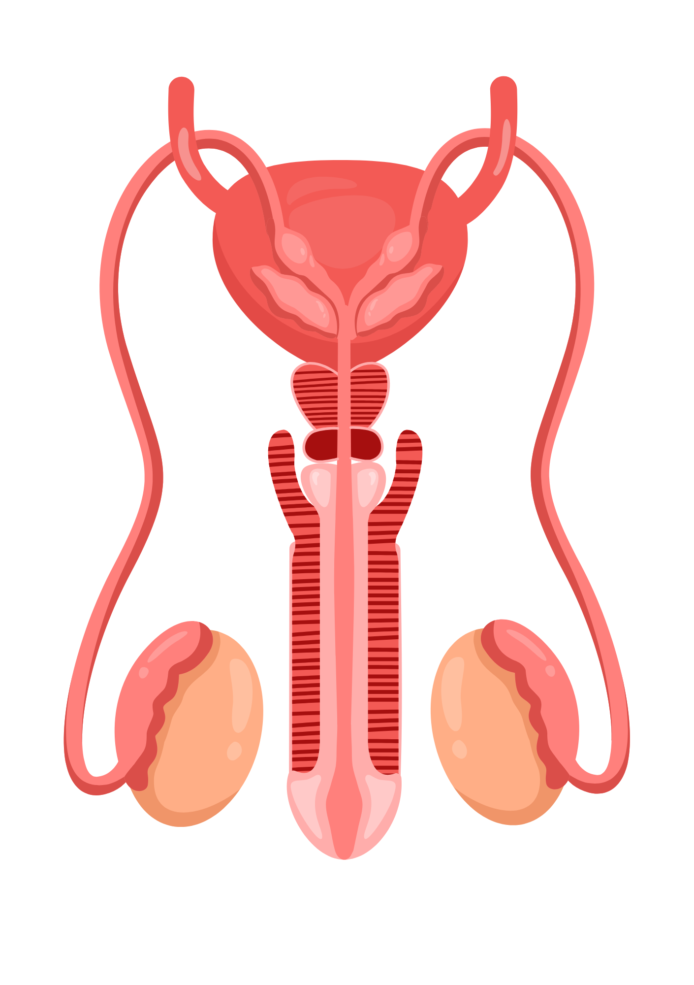
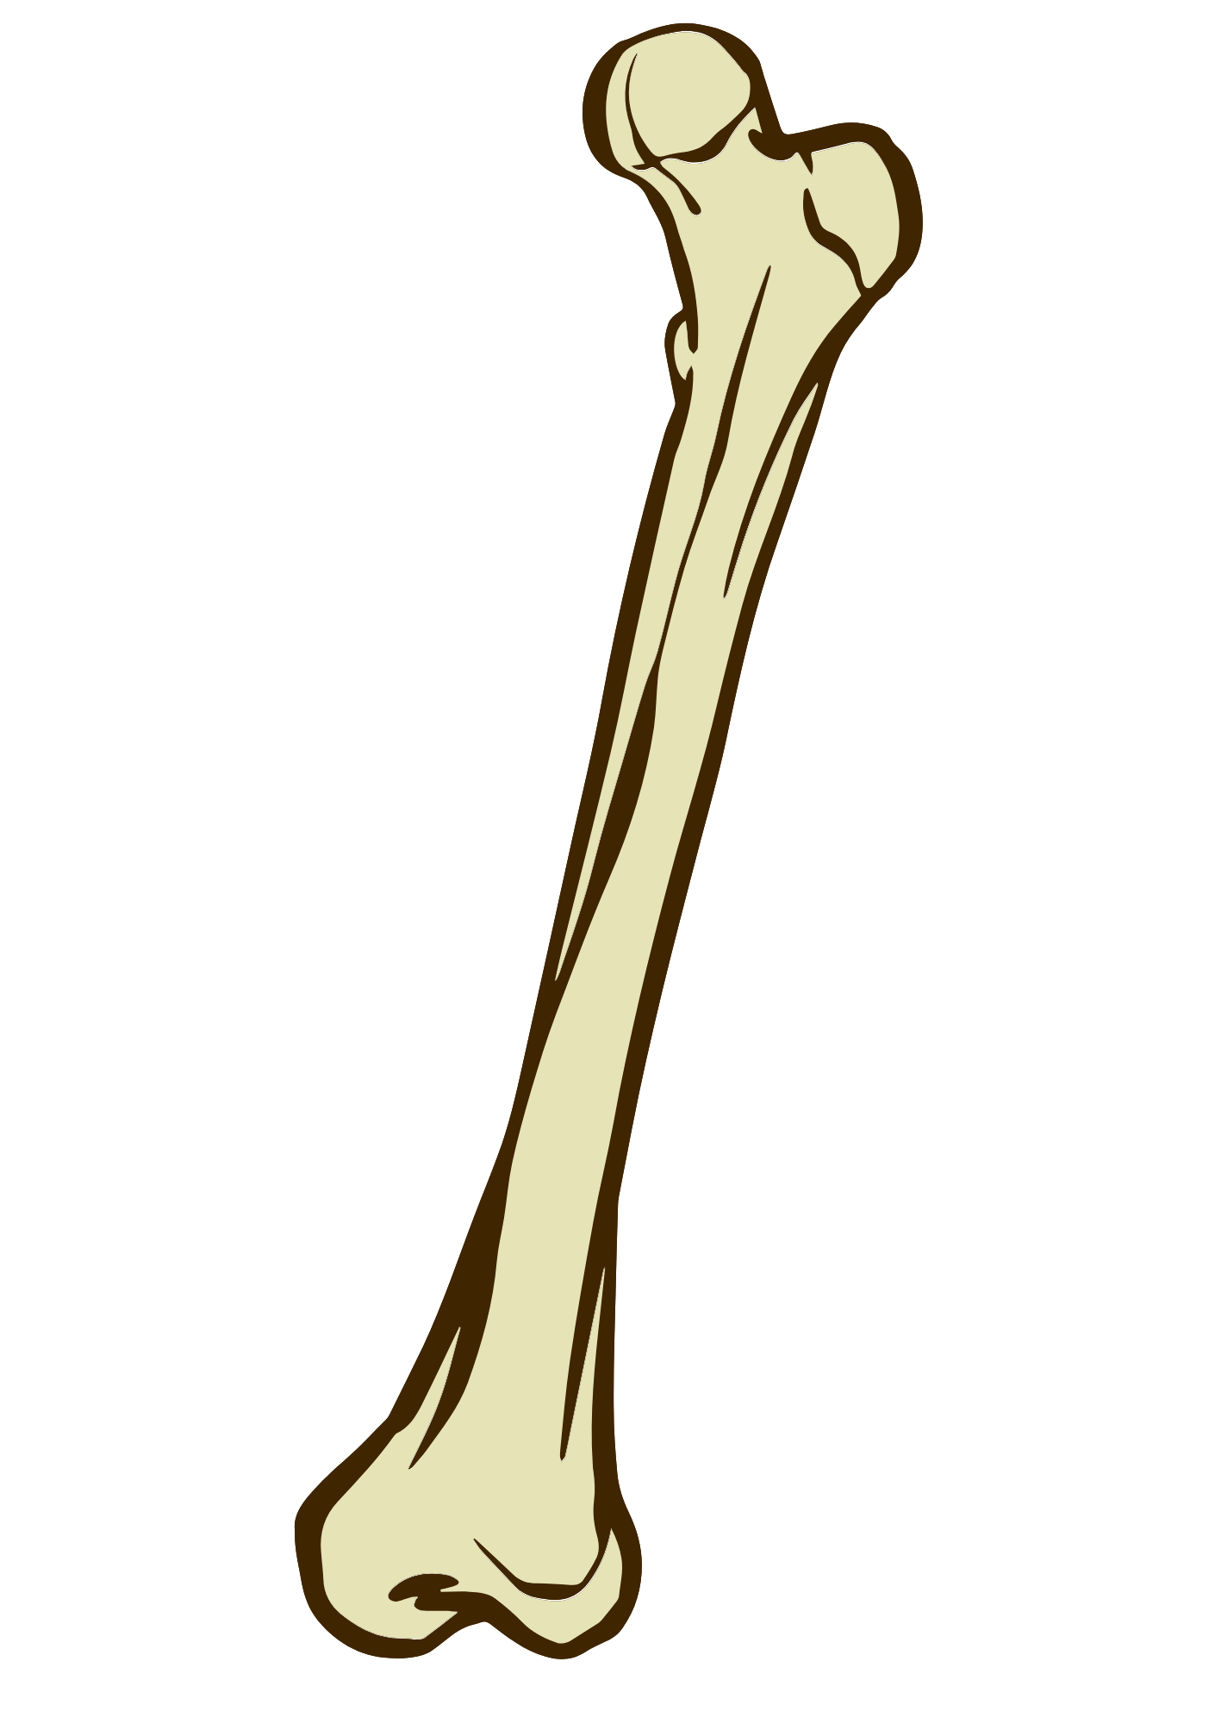
Unit 2 Human Biology & Health
REPRODUCTIVE SYSTEM | NERVOUS SYSTEM | MUSCULOSKELETAL SYSTEM
Muscle
Uterus and Ovaries
Brain
Penis and Testes
Femur
www.tutor2u.net/hsc
Notes:
Answers for starter activity

Slide 6
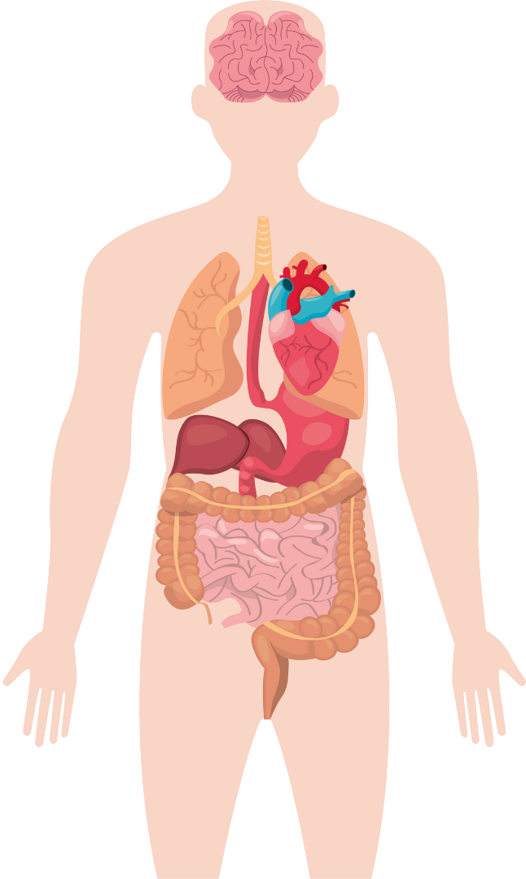

Unit 2 Human Biology & Health
Lesson Aims
Experience a taste of Health & Social Care as a subject
Gain insight into Unit 2 Human Biology & Health
Consider career possibilities with a qualification in Health & Social Care
Prepare for your summer project
www.tutor2u.net/hsc

Slide 7
Unit 2 Human Biology & Health
Human Biology & Health
5 Minute Discussion
    What happens when a body system doesn’t work properly?
    Which body systems do you think work together the most?
www.tutor2u.net/hsc
Notes:
Notes
What happens when a body system doesn’t work properly?
If a body system malfunctions or is affected by disease, it may not work as it should.
Examples:
Respiratory system (lungs) → Breathing problems (e.g., asthma, pneumonia).
Circulatory system (heart and blood vessels) → Poor blood flow, high blood pressure, heart attacks.
Digestive system (stomach and intestines) → Trouble digesting food, stomach pain, diarrhoea.
Nervous system (brain, nerves, spinal cord) → Memory loss, difficulty moving, nerve pain.
Skeletal system (bones and joints) → Weak bones, fractures, arthritis.
Encourage students to think of common illnesses and how they affect each system.
Which body systems do you think work together the most?
The body systems are interconnected, meaning they rely on each other to function properly.
Some examples of closely linked systems:
Circulatory & Respiratory: The lungs (respiratory) supply oxygen to the blood (circulatory) and remove carbon dioxide.
Digestive & Circulatory: Nutrients from food are absorbed in the digestive system and transported by the circulatory system.
Nervous & Muscular: The brain and nerves control muscle movement.
Skeletal & Muscular: Bones and muscles work together for movement and support.
Endocrine & Reproductive: Hormones regulate puberty, menstrual cycles, and fertility.
Encourage students to think about real-life examples (e.g., how exercise affects multiple systems).

Slide 8
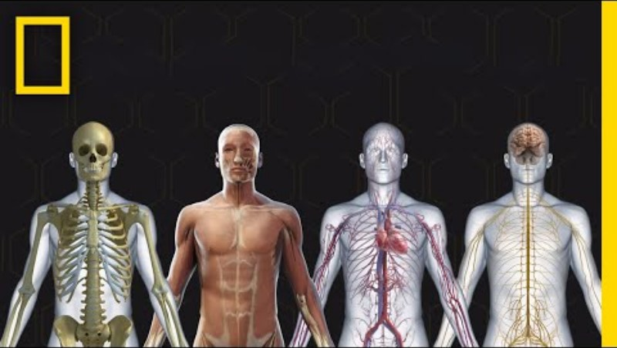
Unit 2 Human Biology & Health
Interconnected Body Systems
Human Body 101
  As you watch the video think about:
  Which body system interests you the most and why?
  How does lifestyle impact these systems?
www.tutor2u.net/hsc
Notes:
Ask students to feedback on their thoughts.

Slide 9


Unit 2 Human Biology & Health
Health Crisis Challenge
Case Study A: Javid
Case Study B: Meredith
  Javid is 23 years old. He has had asthma since childhood. Javid lives on a busy road in central Manchester. He doesn’t exercise regularly. Javid is experiencing breathlessness, chest tightness and his lips are going blue. He is having an asthma attack.
  Meredith is 52 years old. She was diagnosed with coronary heart disease after experiencing chest pain and high blood pressure. Meredith eats a lot of processed and high-fat foods, and she smokes. She works in a call centre and sits at her desk all day.
Questions:
What body system is affected? | What might have caused the issue?
How could lifestyle choices improve or worsen the condition?
www.tutor2u.net/hsc
Notes:
Split your class into groups and allocate each group either case study A or B.
Give them time to discuss, make notes and then present their thoughts to the whole class.
Case Study A: Javid (Asthma Attack)
Body system affected: Respiratory system (lungs and airways).
Possible causes: Asthma attack could have been triggered by exposure to air pollution (busy road); his asthma could have worsened due tolack of exercise (reduced lung capacity).
Lifestyle factors:
Worsen: Continued exposure to pollution, lack of fitness.
Improve: Avoiding triggers, regular exercise to strengthen lungs, staying indoors during high pollution periods.
Case Study B: Meredith (Coronary Heart Disease)
Body system affected: Cardiovascular system (heart and blood vessels).
Possible causes: High-fat diet, smoking, sedentary lifestyle, high blood pressure.
Lifestyle factors:
Worsen: Poor diet, smoking, lack of movement.
Improve: Healthier diet, quitting smoking, increasing physical activity (e.g. walking).
Encourage students to connect symptoms with causes and think about realistic lifestyle changes that could help each person

Slide 10
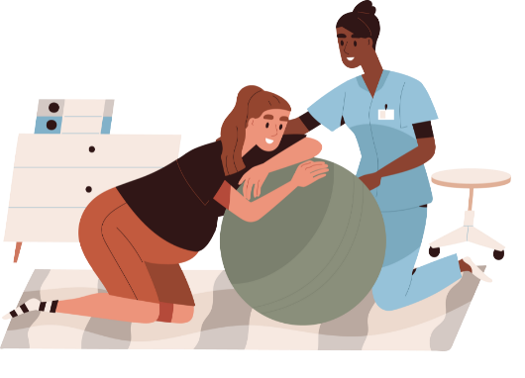
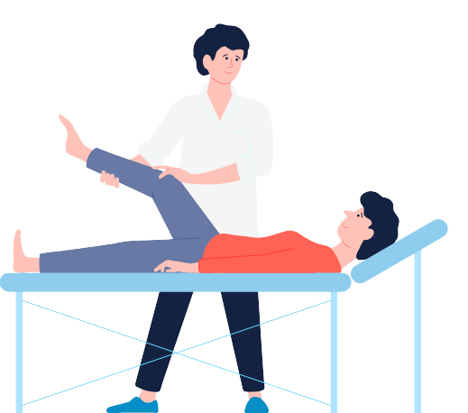
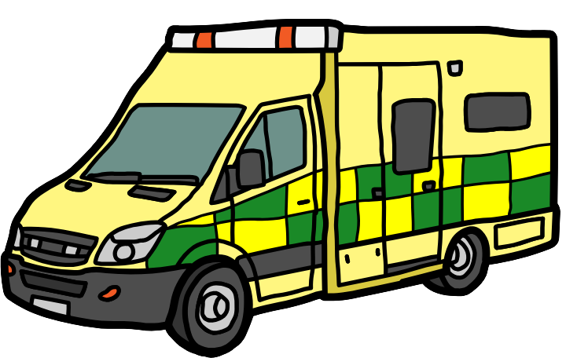
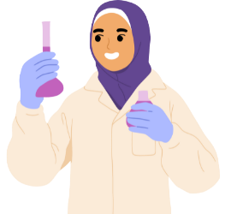
Unit 2 Human Biology & Health
Health & Social Care Careers
  Think - Pair - Share
What careers are connected to understanding human biology and health?
How can knowledge of human biology be applied in real-life situations?
www.tutor2u.net/hsc
Notes:
Highlight potential careers such as nursing, midwifery, paramedic science, biomedical sciences, physiotherapy.
Encourage students to consider Health & Social Care as a subject choice in Year 12

Slide 11

Unit 2 Human Biology & Health
Independent Learning
  Select one of your personal health behaviours to track over a period of one week.
  For example, water intake, sleep patterns, exercise, screen time.
  Prepare a short reflection on how this behaviour affects at least two body systems and suggest one improvement.
www.tutor2u.net/hsc

Slide 12


