Slide 1

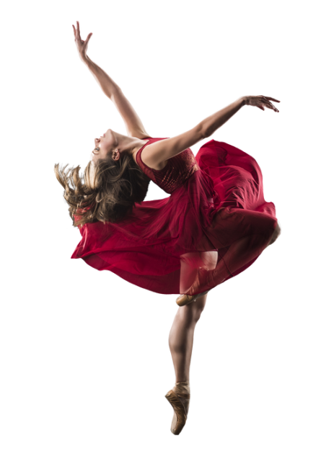
Unit 13 Dance Technique
Cambridge Technical Extended Diploma in Performing arts
(Musical Theatre Route)

Slide 2
Introduction to unit 13
To be accomplished in your trade it is necessary to follow the background journey that many other great dancers have followed through endurance and perfectionism to allow your body to be able to do what it will be required to do as a professional. This unit will inspire you to understand the value, process and importance of Dance Technique and will encourage you to develop technical and performance skills in a minimum of two dance styles. It will focus your discipline and a commitment to regular practice whilst allowing for the development of your creativity and self-expression. The unit also acknowledges the wide variety of dance styles, techniques and genres and provides you with an opportunity to develop existing skills or to explore new techniques that will demonstrate the versatility of performers required in the industry today. This unit will reinforce your understanding and application of correct technique that can be used as a dancer, choreographer or teacher and encourages the appreciation of style and the demands of performance.

Slide 3
Aim of the unit
Whether you are considering a career in dance as a performer, teacher or choreographer or intend to pursue dance simply for enjoyment you should have a sound understanding of technique as it forms the foundations of dance language. Whatever style of dance you work in whether it is contemporary, tap, hip hop, or ballet to name but a few, there will be many commonalities: a dedicated learning process leading to expertise, the development of practice leading to performance and a shared movement language of technical and performance skills. To make full use of the following tasks you should work to become as familiar as possible with the specifics of your own chosen dance style. Knowledge, understanding and a real appreciation of your style as well as discipline and a commitment to regular practice is crucial to developing technical expertise.

Slide 4
Learning outcomes that are assessed for this unit of work:
Learning Outcomes | PASS | MERIT | DISTINCTION
1. Be able to demonstrate the relationship between dance and music | P1: Perform dance with rhythm and time structures | M1: Perform dance with rhythm and time structures with a sense of musicality in performance
2. Be able to demonstrate technique and the correct etiquette | P2: Perform dance using basic techniques and correct etiquette of a specific dance genre in class
3. Understand the terminology of a specific dance genre | P3: Identify key terms and vocabulary specific to a dance genre and be able to respond to them
4. Be able to demonstrate key features and styles of a specific dance genre | P4: Perform dance with stylistic qualities that are appropriate to the dance genre | M2: Perform key features with accuracy and developed dynamics demonstrating correct technique in placement and position | D1: Perform dance sequences with highly accurate techniques and stylistic performance qualities, specific to the genre

Slide 5
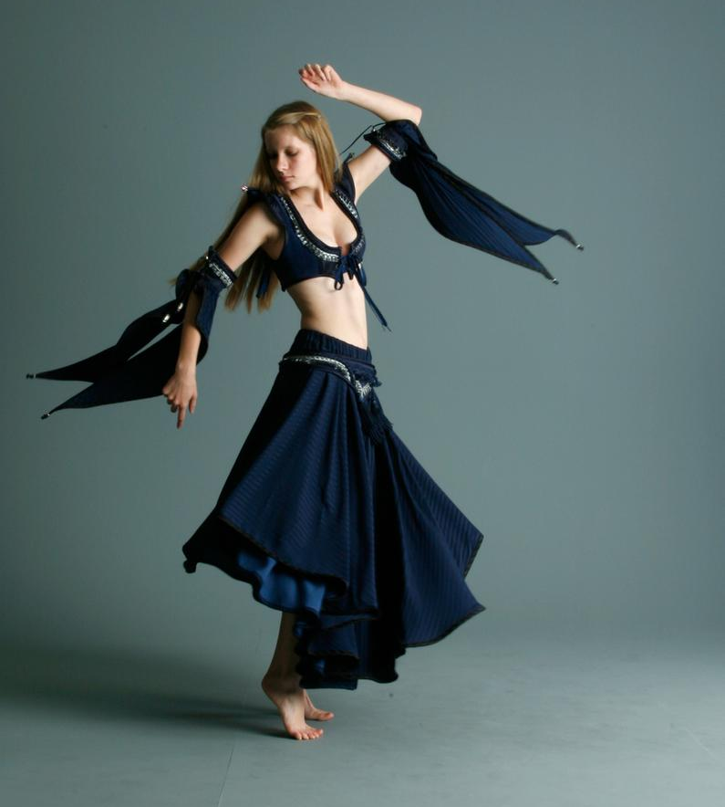
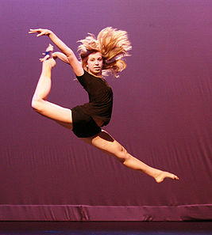
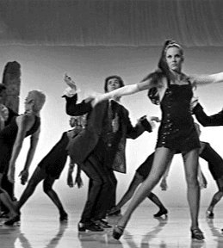

Choreography task
Over the summer I would like you to choreograph a solo to perform in your own chosen style. It should be a minute in length. You will be asked to perform your solo in your first week.
Use YouTube and watch some professional dance performances for inspiration!
I will look forward to seeing them in September!

