Slide 1

Bridge the Gap
TASKS

Slide 2
Dear Y11 student,
Well-done on completing all of your exams. To make sure you are ready and prepared for your A-levels please work through the following tasks in the bridging work
The 4 units you will study in the first year of A level Chemistry are:
Module 1 – Development of practical skills in chemistry
Module 2 – Foundations in chemistry
Module 3 – Periodic table and energy
Module 4 – Core organic chemistry
You can find out more about the A level specification using the link below:
https://www.ocr.org.uk/Images/171750-specification-accredited-as-level-gce-chemistry-a-h032.pdf

Slide 3
Between now and the start of Sixth Form in September, you should aim to complete the pack of tasks below. After completing this pack you will have refreshed your knowledge and understanding of the basic concepts of Chemistry that you covered during your GCSE programme so you will be more confident tackling the Advanced course.

Slide 4
Assessment Objectives
You should be able to:
write balanced chemical equations for reactions
carry out mole calculations to work out relative atomic mass, molar volumes, concentrations
describe the arrangement of particles in the atom
describe the trends of reactions of groups in the periodic table
identify oxidation and reduction reactions
recognise simple organic molecules and be able to draw structures of alkanes and alkenes
describe chemical reactions as endothermic or exothermic and draw energy level diagrams
explain the difference between ionic and covalent bonding and draw dot and cross diagrams

Slide 5
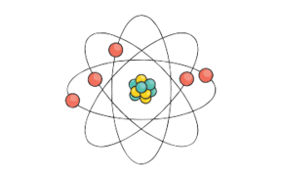
Atomic structure and bonding

Slide 6
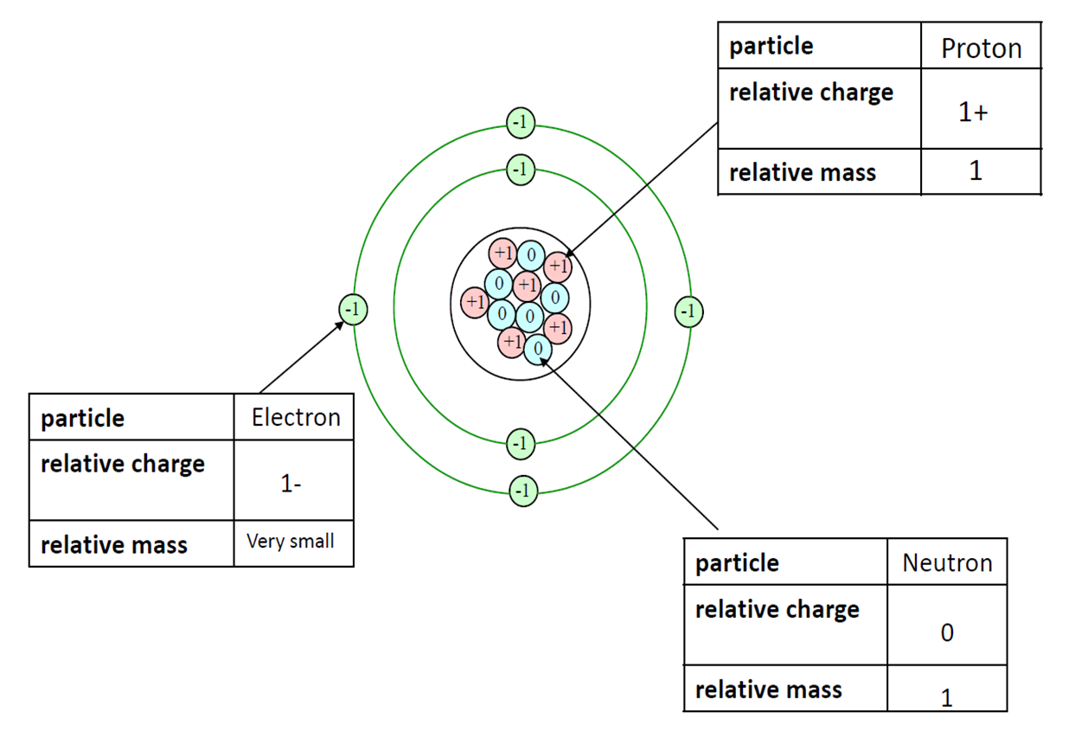
Atomic structure
What is the mass and charge of a: proton electron neutron

Slide 7
ATOMIC STRUCTURE
4
Atomic mass number
He
the number of protons and
neutrons in an atom
Atomic number
2
the number of protons in an atom
number of electrons = number of protons

Slide 8
Electronic configuration

Slide 9
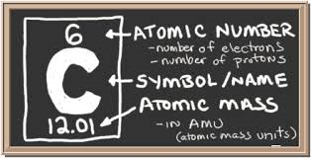
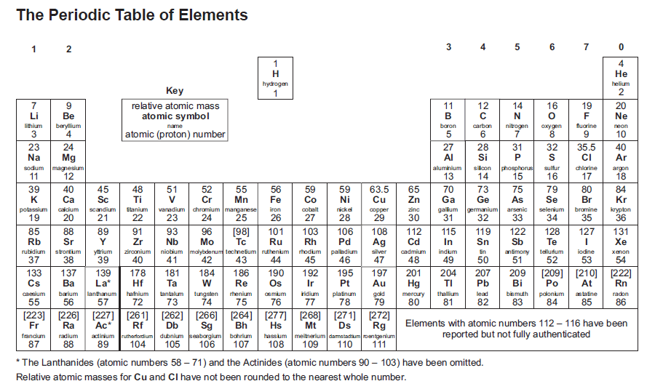

Slide 10
Task 1 - Atomic Structure & Periodic Table
Write a definition for the terms atomic number and mass number.
Write down full electronic configurations for the first 20 elements.
Draw the electronic configuration of Lithium, Chlorine and Neon.
Relate the electronic configurations to the position of the element in the Periodic table in terms of group and period.
You will need to use a Periodic table to help you with this task
RESOURCES
https://www.chemguide.co.uk/

Slide 11
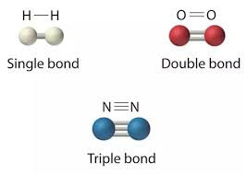
Covalent bonding
2 or more non-metal atoms
Share electrons to give each a full outer shell of electrons
1 pair of shared electrons = a single bond
2 pairs = a double bond
3 pairs = a triple bond

Slide 12
Dot and cross diagrams
Water, H₂O:
Step 1: Draw the atoms with their outer shell:
Step 2: Put the atoms together and check they all have a full outer shell:
H
O
H
O
H
H
Oxygen, O₂:
O
O
O
O

Slide 13
Drawing dot and cross diagrams:
H₂
Cl₂
HCl
O₂
N₂
H₂O
NH₃
CH₄

Slide 14
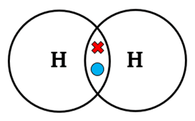
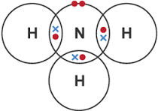
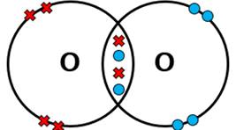
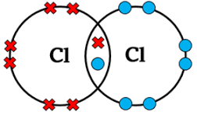
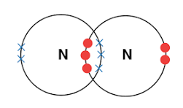
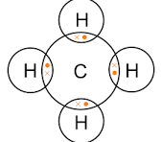
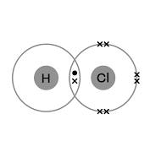
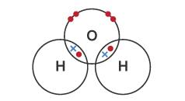

Slide 15
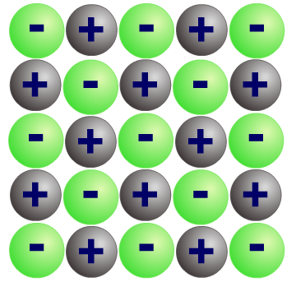
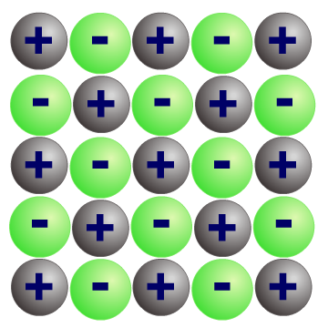
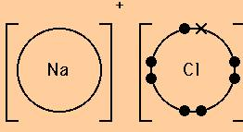
What is ionic bonding?
These compounds are usually formed by a reaction between a metal and a non-metal.
The metal and non-metal atoms have incomplete outer electron shells and so are unstable.
Electrons are transferred from each metal atom to each non-metal atom. The metal and the non-metal atoms form ions with completely full outer shells and become stable.
The positive and negative ions are strongly attracted to each other. This electrostatic attraction is called ionic bonding.
Notes:
Ionic compounds are crystals, solids that consists of a lattice of ions held together by the force of attraction between ions – electrostatic attraction. Method of joining is an ionic bond to form an ionic compound

Slide 16
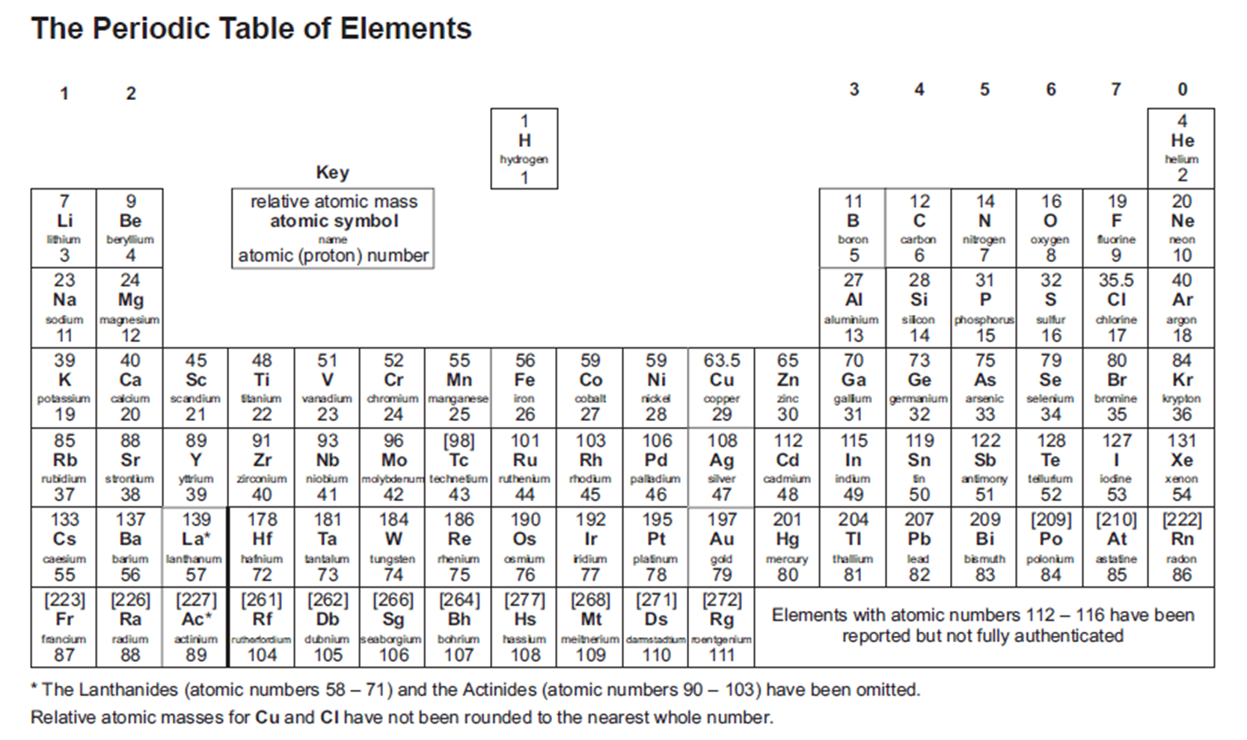
Calculating the formula of ionic compounds
Potassium Nitride
Magnesium Oxide
Calcium Iodide
Aluminium Oxide
Calcium Nitride

Slide 17
Potassium Nitride K₃N
Magnesium Oxide MgO
Calcium Iodide CaI₂
Aluminium Oxide Al₂O₃
Calcium Nitride Ca₃N₂

Slide 18
Dot and cross diagrams
-
Magnesium chloride:
2+
Cl
Cl
+
Mg
Mg
-
Cl
Cl
MgCl₂
Calcium oxide:
2+
2-
Ca
+
O
Ca
O
CaO

Slide 19
Draw the dot and cross diagram for LiO

Slide 20
Draw the dot and cross diagram for K₂O

Slide 21
Task 2 – Chemical bonding
Write definitions for ionic and covalent bonding.
Draw dot and cross diagrams for the ionic compounds sodium chloride, magnesium oxide and aluminium fluoride.
Draw dot and cross diagrams for a hydrogen molecule, a chlorine molecule, carbon dioxide and ethene.
RESOURCES
https://www.chemguide.co.uk/

