Slide 1
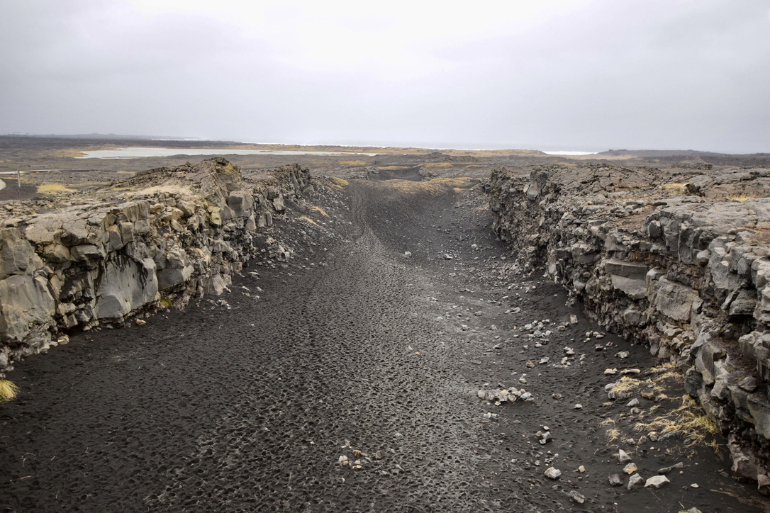




Slide 2


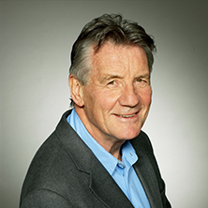
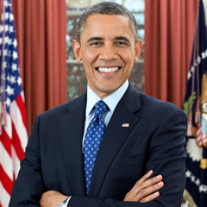

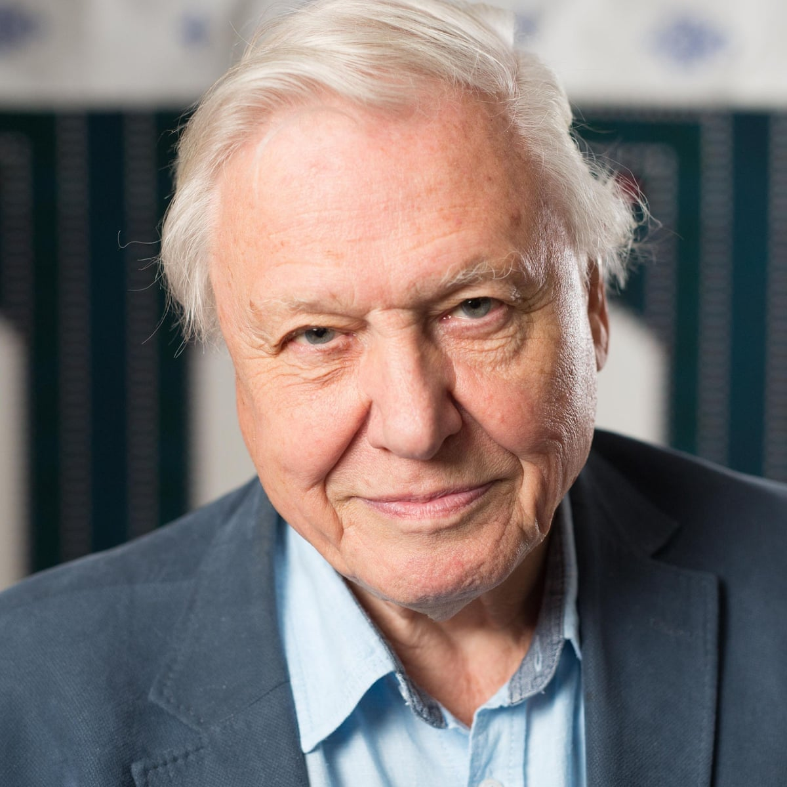
2
Well done, you made a great choice. Of course, as a geography graduate (yep I studied geography at Uni) I would say that wouldn’t I!
Well, don’t just take my word for it. According to the former president of the Royal Geographical Society, Michael Palin, “Geography is not only up-to-date and relevant, it is one of the most exciting, adventurous and valuable subjects to study today. So many of the world's current problems boil down to geography and need the geographers of the future to help us understand them.”
Former US President, Barack Obama, recognises the importance of geography too! He said "The study of geography is about more than just memorizing places on a map. It's about understanding the complexity of our world, appreciating the diversity of cultures that exists across continents. And in the end, it's about using all that knowledge to help bridge divides and bring people together."
In our rapidly changing world, we need people like you to study geography more than ever. The adopted godfather of geography, David Attenborough agrees! He said “The truth is: the natural world is changing. And we are totally dependent on that world. It provides our food, water and air. It is the most precious thing we have, and we need to defend it.”
An essential outcome of studying geography is being able to apply knowledge and understanding to new settings. Thinking like a geographer is an amazing ability as Dr Rita Gardner points out “Geography prepares young people with the knowledge, skills and understanding to make sense of their world and to face the challenges that will shape our societies and environments at the local, national and global scales.”
With the skills and knowledge of a geographer you can make a difference to the world we live in. Welcome to team geography.
“One of the most exciting, adventurous and valuable subjects today”
“Helps bridge divides and brings people together”
“Geography prepares young people with the knowledge, skills and understanding to make sense of their world”
“(the world) is the most precious thing we have, and we need to defend it”

Slide 3


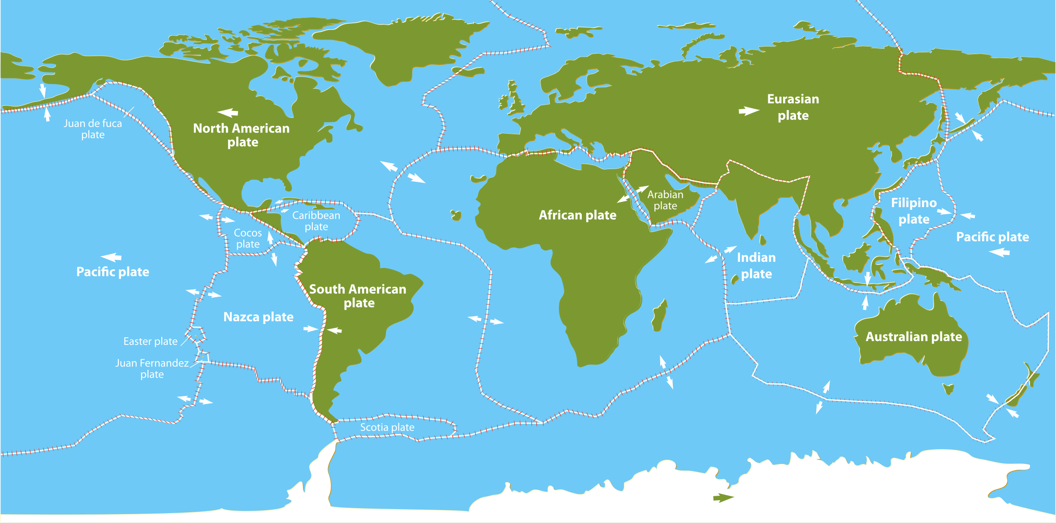









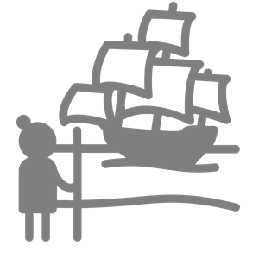



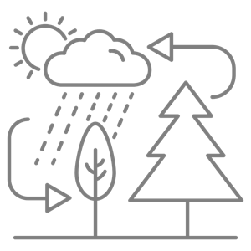


3
As a further education (FE) student you’re going to find studying a little different to what you experienced at GCSE level. You are going to be expected to take more responsibility for your learning! Whether or not you’re studying geography post-16 this project will help you to develop skills that can be used across FE courses (and you get to learn about two amazing volcanic eruptions that have happened lately!).
Fagradalsfjall
La Soufrière
In this assignment you are going to research two volcanic eruptions that have occurred in 2021. To get started, take a look at the videos below to see what you’re going to be studying.
Volcano 1 – Fagradalsfjall, Iceland
Volcano 2 – La Soufrière, St Vincent
https://tinyurl.com/fagrad1
https://tinyurl.com/fagrad2
https://tinyurl.com/lasouf1
https://tinyurl.com/lasouf2
Human Geography
Things that are to do with people.
Physical Geography
Things that are to do with the natural environment.
population
urban
environments
economic
development
culture
history
geomorphology
hydrology
natural
resources
ecosystems
relief
climate

Slide 4




4
When studying at FE you will be expected to do wider reading. This means reading extra articles/books etc. in addition to your text books that link to your courses. Making organised notes when doing this can really help develop your knowledge and understanding. One really useful note taking technique is Cornell Notes.
You are going to use the Cornell Notes method of recording information from the volcano resource booklet you’ve been given. To do this, you are going to research how to use Cornell Notes using the resources below.
Cornell Notes
1. Watch the two videos about taking Cornell Notes on Internet Geography:
www.internetgeography.net/cornell-notes
Use the link above or scan the QR code
2. Divide up the page on the right to prepare it for recording Cornell Notes.
3. Annotate the page on the right to show how Cornell Notes should be completed.
4. Turn over the page and look at the example Cornell Notes that have been started. Using the webpage below complete the notes (I got up to paragraph 3 so start from 4).
www.alevelgeography.com/structure-of-the-earth
Use the link above or scan the QR code
Human Geography
Things that are to do with people.
Physical Geography
Things that are to do with the natural environment.
population
urban
environments
economic
development
culture
history
geomorphology
hydrology
natural
resources
ecosystems
relief
climate

Slide 5

5
Structure of the Earth
Keywords
Crust – oceanic > around 5km
- continental > average around 30km (up to 100km large mountain ranges)
Continental crust
Mohorovicic Discontinuity (Moho)
Asthenosphere
Lithosphere
inner core
outer core
mantle
crust
Moho – boundary between the crust and mantle
Mantle – dense (due to temp and pressure) – semi-
solid rock – 2900km thick
- iron / magnesium / calcium
Upper Mantle – Asthenosphere Lithosphere
100 to 300 km down
Semi molten (flows slowly)
Rigid layer between crust and asthenosphere
Questions
What are the characteristics of the Moho?
Summary

Slide 6

6
In recent months volcanoes have been in the news with the eruptions in Iceland, near Mount Fagradalssfjall and the La Soufrière volcano on the Caribbean island of Saint Vincent. Volcanoes are covered in most A level Geography specs, so it is really useful for you to keep up with the news and study these recent events.
You have been provided with a resource booklet that discusses the eruption of the two volcanoes. Read the two articles and complete Cornell Notes for each article. Pages have been provided in this booklet for you to complete the activity.
Human Geography
Things that are to do with people.
Physical Geography
Things that are to do with the natural environment.
population
urban
environments
economic
development
culture
history
geomorphology
hydrology
natural
resources
ecosystems
relief
climate

Slide 7
7

Slide 8
8

Slide 9
9

Slide 10
10

Slide 11
11

Slide 12
12

Slide 13

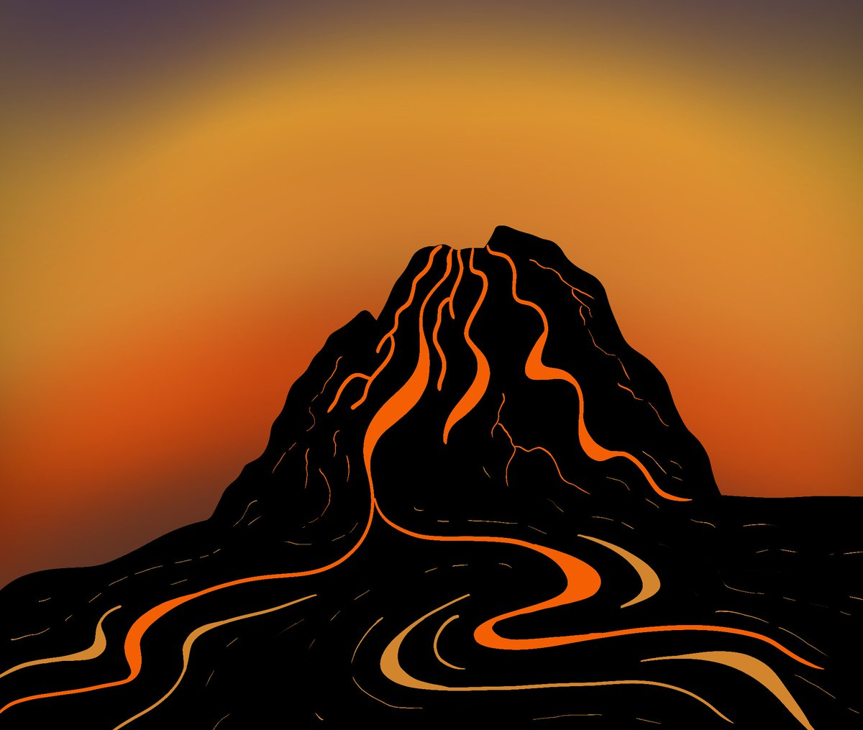
13
You should now be in the position of having several pages of notes covering each volcanic eruption. The challenge now is transforming the information you have gathered into knowledge. This is where mind maps can help! A mind map can help organise information and help illustrate how things are interrelated. The guide below illustrates how to create a mind map.
Step 1
Start with a central concept. Write this in the middle of a piece of plain paper that is orientated landscape.
Fagradalsfjall
Fagradalsfjall
Step 2
Draw a reasonably sized (coloured) memorable image that represents the topic you are going to be mapping.
Fagradalsfjall
Step 3
Draw branches from the central theme. Using a different colour for each branch is useful. Write key words along these branches that represent what information will be included on this branch.
What? When? Where? Why?
What?
Fagradalsfjall
Step 4
Draw additional branches that extend from your main branches. Add appropriate images where you can. Keep expanding the mind map.
When?
What? When? Where? Why?
Where?
Why?
Mind Mapping Rules
Use symbols
Keywords on lines
Lines of different colour, size, styles
Upper and lower case to emphasise
Vary colours
Key headings
lists
Use the A3 templates you’ve been given to organise your information and produce a mind map to show the main features of each eruption.
Human Geography
Things that are to do with people.
Physical Geography
Things that are to do with the natural environment.
population
urban
environments
economic
development
culture
history
geomorphology
hydrology
natural
resources
ecosystems
relief
climate

Slide 14

14
Being able to compare and contrast is a useful skill to have when studying at a higher level. A useful tool to do this is a Venn Diagram. Venn Diagrams show the relations between multiple sets of information. The guide below illustrates how to use a Venn Diagram to compare and contrast two things.
Creating a Venn Diagram
Draw two circles that overlap (as shown below)
Identify the things you are comparing and contrasting
In the area below item one, identify everything that only applies to item one
In the area below item two, identify everything that only applies to item two.
In the area where the circles cross over, identify everything the two items have in common
Item 1
Item 2
Unique to item 1
Common features
of item 1 and 2
Unique to item 2
Use the A3 template you’ve been given to create a Venn Diagram to compare and contrast the two eruptions you have been studying.
Human Geography
Things that are to do with people.
Physical Geography
Things that are to do with the natural environment.
population
urban
environments
economic
development
culture
history
geomorphology
hydrology
natural
resources
ecosystems
relief
climate

Slide 15

15
In preparation for completing some questions based on your learning, you are going to spend some time revising the two case studies. To do this, you are going to try a different approach to revision called the Leitner Box. The Leitner Box was developed by a German scientist called Sebastian Leitner and is a really effective, easy to develop practice and recall system. The approach involves using flash cards to learn and recall information. To begin with, you will need to develop a bank of flash cards covering the main aspects of the two volcanic case studies. Follow the guide below to create your flash cards. Flashcards should be used to test your knowledge, not just as a way to condense your notes further.
1.
2.
Ensure that the flashcards have a question or key term on one side and the answer or definition on the other.
- The flashcard must work the memory.
- If flashcards only contain notes then no retrieval practice will be happening.
Ensure the right questions and knowledge are on the cards.
3.
Keep the information as short as possible. You are condensing the information you have.
4.
Write clearly. You should be able to read what you wrote at a very quick glance.
Leitner recommends that when we have a large amount of information to learn on flash cards we tend to focus on those we already know and avoid the ones we find difficult. To avoid this, create four sections in your storage box (or what ever way you are storing your cards).
Box 1
Here you put the cards for frequent practice. This is the stuff that needs regular review because you’re not remembering it. Spend around 40% of your time on these. When you are confident and fully recall a card, move it to box 2.
Box 2
Around 30% of your time is spent here. These are cards that have only just moved out of box 1, or cards containing information that still trips you up. If you’re not remembering it, move it up to box 1 or down to box 3 if you’ve regularly recalling it.
Box 3
Spend around 20% of your time here. These are the cards you can almost always recall. You feel confident about the content, even though some might be complex. If you make any mistakes in recall, move the card up to box 2.
Box 4
You’ll start with only a few cards here. This is the material you feel is easy to recall. You always get it right, therefore you only spend 10% of your time checking the cards here. However, it is key that nothing ever leaves this box as you know it so well.
Test your self with the information on your cards. Have a friend or family member check your ability to recall the information on the cards. Repeat until all cards are in box 4.
Human Geography
Things that are to do with people.
Physical Geography
Things that are to do with the natural environment.
population
urban
environments
economic
development
culture
history
geomorphology
hydrology
natural
resources
ecosystems
relief
climate

Slide 16

16
No one likes a test. However, completing practice questions can really help develop your knowledge as well as your ability to apply this to demonstrate understanding. Over the next couple of pages are a selection of A Level transition questions to have a go at.
State what is meant by the term tephra [2]
________________________________________________________________________________________________________________________________________________
Use Figure 1 to describe how Iceland’s location on the Mid-Atlantic Ridge constructive plate boundary had led to its distinctive tectonic landscape. [4]
________________________________________________________________________________________________________________________________________________________________________________________________________________________________________________________________________________________________________________________________________________________________________________________________
Explain the process of subduction at the oceanic-oceanic crust convergent plate boundary, as shown in Figure 4. [4]
________________________________________________________________________________________________________________________________________________________________________________________________________________________________________________________________________________________________________________________________________________________________________________________________

Slide 17
17
Outline the characteristics of an explosive eruption. [4]
________________________________________________________________________________________________________________________________________________________________________________________________________________________________________________________________________________________________________________________________________________________________________________________________
Outline the main hazards from lava flows [4]
________________________________________________________________________________________________________________________________________________________________________________________________________________________________________________________________________________________________________________________________________________________________________________________________
Suggest why pyroclastic flows can be so hazardous, making reference to the text on the La Soufrière eruption on page 7 of the resource booklet. [3]
________________________________________________________________________________________________________________________________________________________________________________________________________________________________________________________________________________________________________________________________________________________________________________________________

Slide 18
18
Compare and contrast the tectonic settings for Iceland and St Vincent and the Grenadines. [4]
________________________________________________________________________________________________________________________________________________________________________________________________________________________________________________________________________________________________________________________________________________________________________________________________
Suggest why vulnerability to tectonic hazards may vary between Iceland and St Vincent and the Grenadines. [4]
________________________________________________________________________________________________________________________________________________________________________________________________________________________________________________________________________________________________________________________________________________________________________________________________

Slide 19
19
Outline the specific impacts experienced by people in Iceland and St Vincent and the Grenadines - use the following sub-headings: Social/political; Economic; Environmental. [8]
________________________________________________________________________________________________________________________________________________________________________________________________________________________________________________________________________________________________________________________________________________________________________________________________
________________________________________________________________________________________________________________________________________________________________________________________________________________________________________________________________________________________________________________________________________________________________________________________________
________________________________________________________________________________________________________________________________________________________________________________________________________________________________________________________________________________________________________________________________________________________________________________________________

Slide 20

20
You’re going to be so excited by this! You will often be expected to write essays when studying at key stage 5. I know, exciting eh? To get you on the road to effective essay writing you’re going to be guided through an A-level style essay question. The question we’re going to have a go at is:
With reference to the Fagradalsfjall and La Soufrière eruptions, assess the extent to which economic development affects the ability to cope with exposure to tectonic risks. [15]
Exam questions at key stage 5 can be worth up to 20 marks.
Essay Guide
Read the question and BUG it - BOX the command word; UNDERLINE the focus; GLANCE back to check you have answered it properly.
Remind yourself what the command word wants you to do - ASSESS wants you to make an informed judgement.
Start off with a brief introduction - open with your judgement as this then provides you with a focus to base the structure of the rest of your essay on - try to include some key vocabulary early on. If you demonstrate that you understand the key terms mentioned in the question and the command words you are off to a confident start!
Introduce the Fagradalsfjall eruption - discuss the impacts of the eruption along with the management, monitoring and response. You need to make multiple points to support your arguments - and refer back to the link to economic development throughout. Bring in examples from the text - but don’t just copy extracts of information - you need to do something with that information to demonstrate your understanding. Make a counter argument if appropriate.
Then introduce the La Soufrière - and do the same as above, but this time introduce some comparative language such as ‘whereas’, ‘on the other hand’ to link it to the Fagradalsfjall eruption, as well as back to the question.
Remember ‘PEEL - Point -> Evidence -> Explanation -> Link back to the question’ throughout your discussion - this keeps your argument clear throughout, and ensures that you are answering the question.
Remember chains of reasoning - elaborate your explanations with phrases like ‘ this means that….’, ‘ this leads to…’, ‘this results in….’
Finish off with a conclusion - draw together the different points you have made in your essay - make sure you summarise your arguments and reiterate your original judgement and link back to the question (which in this case is about the link between economic development and the ability to cope with tectonic hazards - specifically in the context of Iceland and St Vincent and the Grenadines).
Ready to give it a go? Using the following pages (and the guide above), have a go at writing your first essay. All that is expected is that you give it your best shot!

Slide 21
21
________________________________________________________________________________________________________________________________________________________________________________________________________________________________________________________________________________________________________________________________________________________________________________________________
________________________________________________________________________________________________________________________________________________________________________________________________________________________________________________________________________________________________________________________________________________________________________________________________
________________________________________________________________________________________________________________________________________________________________________________________________________________________________________________________________________________________________________________________________________________________________________________________________________________________________________________________________________________________________________________________________________________________________________________________________________________________________________________

Slide 22
22
________________________________________________________________________________________________________________________________________________________________________________________________________________________________________________________________________________________________________________________________________________________________________________________________
________________________________________________________________________________________________________________________________________________________________________________________________________________________________________________________________________________________________________________________________________________________________________________________________
________________________________________________________________________________________________________________________________________________________________________________________________________________________________________________________________________________________________________________________________________________________________________________________________________________________________________________________________________________________________________________________________________________________________________________________________________________________________________________

Slide 23
23
________________________________________________________________________________________________________________________________________________________________________________________________________________________________________________________________________________________________________________________________________________________________________________________________
________________________________________________________________________________________________________________________________________________________________________________________________________________________________________________________________________________________________________________________________________________________________________________________________
________________________________________________________________________________________________________________________________________________________________________________________________________________________________________________________________________________________________________________________________________________________________________________________________________________________________________________________________________________________________________________________________________________________________________________________________________________________________________________

Slide 24
24
________________________________________________________________________________________________________________________________________________________________________________________________________________________________________________________________________________________________________________________________________________________________________________________________
________________________________________________________________________________________________________________________________________________________________________________________________________________________________________________________________________________________________________________________________________________________________________________________________
________________________________________________________________________________________________________________________________________________________________________________________________________________________________________________________________________________________________________________________________________________________________________________________________________________________________________________________________________________________________________________________________________________________________________________________________________________________________________________

