Slide 1


Acting Techniques
Unit 9

Slide 2
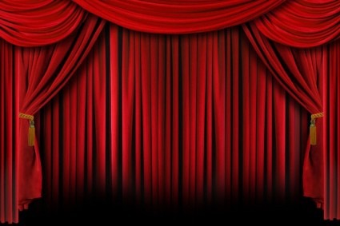
Unit 9 Acting Techniques
Most modern actors have a range of acting techniques that will respond to particular texts or styles of performance. These techniques have been built to enable them to be flexible and adaptive in the many professional contexts they find themselves in; from the heavy demands of Shakespeare or Ibsen through to voice over work, pantomime, role-play or commercials. This unit will encourage you to trace the history of acting technique and to explore how it developed into something that can be learnt and honed. You will explore acting techniques in practical workshops and classes and begin to understand how some texts demand particular ways of performing and how some remain open to the unique approach of the actor.
Learning Objectives
1. Understand the key influences in the development of acting technique
2. Be able to develop a range of acting techniques
3. Be able to apply a specific acting technique in performance
4. Be able to evaluate own acting technique

Slide 3
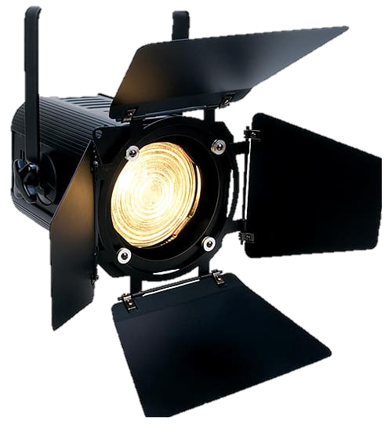
In Acting Techniques, you will be expected to learn lines and perform in front of an audience.
Please prepare a monologue of your choosing (it must be from an existing play). Alternatively, please choose a monologue from the following options. You are expected to perform this off script in your acting lesson.
Female:
Carol
Laura
Male:
Francis
Rosencrantz
Gender neutral:
Mercutio
You MUST make sure you know the following information:
The name of the play
The playwright
The character name
Where are you?
Who are you talking to?
How are you feeling? (Don’t just say happy, justify your feelings e.g. I am angry because my boyfriend broke up with me, but sad because I thought he loved me, but I am trying to bottle it up and put on a brave face)

Slide 4
Male
Male monologues
One Man, Two Guvnors by Richard Bean
FRANCIS
I’ve got two jobs, how did that happen? You got to concentrate ain’t ya, with two jobs. Kaw! I can do it, long as I don’t get confused. But I get confused easily. I don’t get confused that easily. Yes I do. I’m my own worst enemy. Stop being negative. I’m not being negative. I’m being realistic. I’ll screw it up. I always do. Who screws it up? You, you’re the role model for village idiots everywhere. Me?! You’re nothing without me. You’re the cock up! Don’t call me a cock up, you cock up! (He slaps himself.) You slapped me!? Yeah, I did. And I’m glad I did. (He punches himself back.) That hurt. Good. You started it. (A fight breaks out, where he ends up on the floor.)

Slide 5
Male monologues
Rosencrantz & Guildenstern Are Dead by Tom Stoppard
ROSENCRANTZ
Do you ever think of yourself as actually dead, laying in a box with a lid on it? Nor do I really. Seems silly to be depressed by it. I mean, one thinks of it like being alive in a box. One keeps forgetting to take into account that fact that one is dead. Which should make all the difference. Shouldn’t it? I mean, you’d never know you were in a box would you? It would be just like you’re asleep in a box. Not that I’d like to sleep in a box mind you. Not without any air. You’d wake up dead for a start and then where would you be? In a box. That’s the bit I don’t like frankly. That’s why I don’t think of it. Because you’d be helpless wouldn’t you? Stuffed in a box like that. I mean you’d be in there forever. Even taking into account that fact that you’re dead, it isn’t a pleasant thought. Especially if you’re dead really. Ask yourself: if I asked you straight off I’m going to stuff you in this box right now– would you rather be alive or dead? Naturally you’d prefer to be alive. Life in a box is better than no life at all. I expect. You’d have a chance at least. You could lay there thinking well, at least I’m not dead. In a minute somebody’s going to bang on the lid and tell me to come out. (makes knocking sound) Hey you! Whatsyername! Come out of there

Slide 6
Female monologues
Shakers by John Godber
CAROL
I can't help it, I hate it when people just assume that because you do a job like this, you're thick. You know there's some nights I just can't stand it, I can't. I want to stand up on top of the bar and shout: ‘I've got “O” levels, and I've got “A” levels and a Bachelor of Arts degree. So don't condescend to me, don't pretend you feel sorry for me and don't treat me like I can't read or talk or join in any of your conversations because I can.’ I see these teenage-like men and women with their well-cut suits and metal briefcases, discussing the City and the arts and time-shares in Tuscany, and I'm jealous, because I can't work out how they've achieved that success. It's so difficult. You see I want to be a photographer, take portraits. I won a competition in a magazine. It was this photo of a punk sat in a field on an old discarded toilet. It was brilliant. Anyway, after college I had this wonderful idea that I'd go to London with my portfolio. I was confident that I'd get loads of work. But it wasn't like that. The pictures were great they said, but sorry, no vacancies.

Slide 7
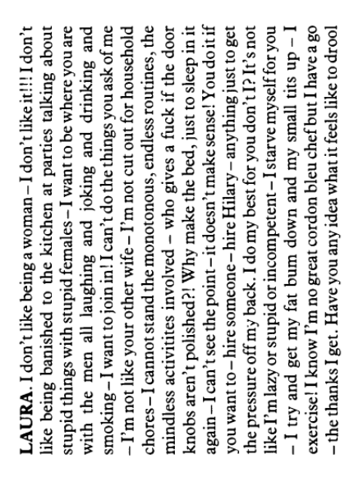
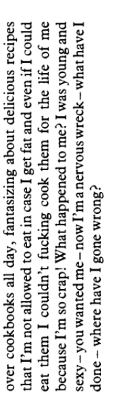
Female monologues
The Woman who cooked her husband by Debbie Isitt

Slide 8
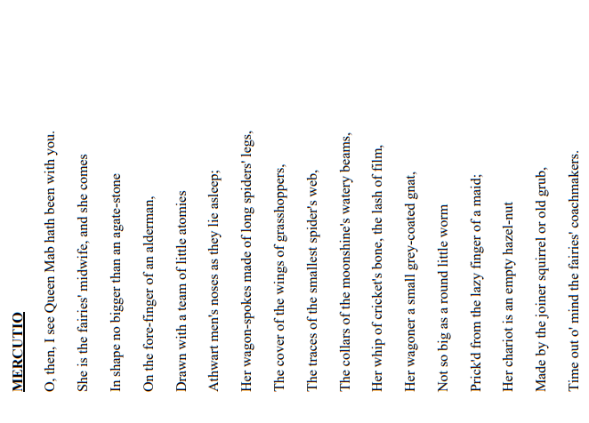
Neutral
Neutral
Romeo and Juliet by William Shakespeare

