Slide 1
Learning goal: To Understand the historical context of Christopher Bruce. To understand how to perform ‘ghost dances’ repertoire.
Unit 3
Influential performance practice
Lesson 1

Slide 2
Learning goal: To Understand the historical context of Christopher Bruce. To understand how to perform ‘ghost dances’ repertoire.
Aims/Purpose
You will learn about genres, styles and periods, social, cultural and historical influences and significant theatrical/performance developments and practitioners. To help understand the demands of performing a piece of repertoire, you will need to be familiar with the context in which the piece was created and the stylistic conventions of the style or genre into which the piece fits. You will become familiar with a range of different styles and periods within their social, cultural and historical contexts and will be able to select, adapt and apply elements of your research into your performance concept and practical performance.
The build-up across this unit will demonstrate an exciting journey that culminates in a practical performance and evaluative task that will be able to assist your future engagement in the arts.

Slide 3
Learning goal: To Understand the historical context of Christopher Bruce. To understand how to perform ‘ghost dances’ repertoire.
Learning outcomes
Course process
Through completion of this unit, you will be able to:
1. Know the historical context of performance material.
2. Understand the work of practitioners.
3. Be able to demonstrate practical ideas in context.
4. Be able to present and evaluate research findings.
8 weeks for research
Work time that is directed by the teacher/tutor and/or independent work.
I can explain the task and give advice ONLY.
2 weeks for assessment
During the Controlled External Assessment time, you will need to work under the supervision of your teacher or tutor.
I cannot comment on or correct the work; practise or rehearse the task with you; prompt you during the filming of the practical demonstration.
Official hand-out date: October half term
Deadline: January

Slide 4
Learning goal: To Understand the historical context of Christopher Bruce. To understand how to perform ‘ghost dances’ repertoire.
assessment
Pre-release material will contain a statement/question in the context of this unit.
Submit a practical demonstration which illustrates two contrasting pieces in response to the statement/question.
Write a report (1000-1500 words) in response to the pre-release question/statement.
You must evaluate the contextualisation process which will include a reasoned argument justified by both research findings and practical outcomes and consistent reference to how research informed the contextualisation process.

Slide 5
Learning goal: To Understand the historical context of Christopher Bruce. To understand how to perform ‘ghost dances’ repertoire.
You need to download the Christopher Bruce booklet.
You will have questions that you need to answer.
You will need to make notes of the information on each slide and write this into your own words in your Christopher Bruce booklet.
Please bring this booklet to your first lesson with myself, Miss Burns.

Slide 6
Timeline Task
Look at the two timelines on the next slide (Dance History and World History) to find connections between them.
Answer the below questions on a separate piece of paper. This can be typed or hand written:
What have been the significant changes in dance and in the way it is presented between now and the 1800s?
What about between now and the 1940s?
What do you think caused these changes in dance?
What about world events and changes; how did these contribute towards the way dance has evolved into how it is seen today?

Slide 7
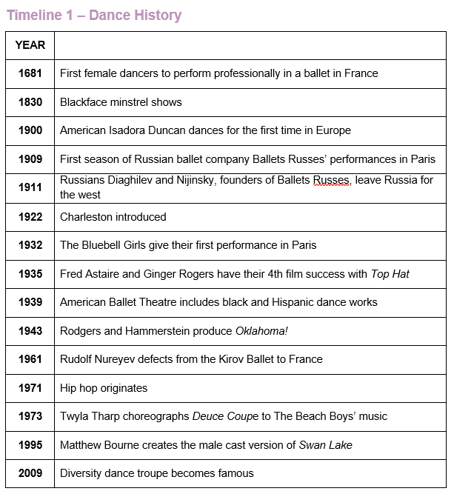
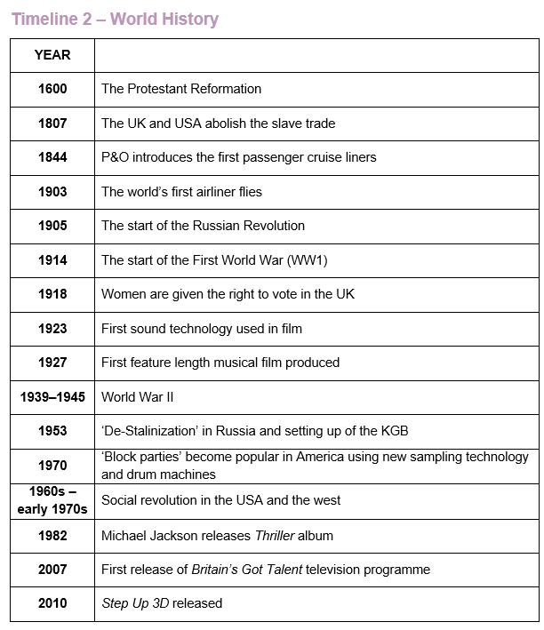

Slide 8
Learning goal: To Understand the historical context of Christopher Bruce. To understand how to perform ‘ghost dances’ repertoire.
Christopher Bruce
Christopher Bruce CBE is a British choreographer and performer.
He was Artistic Director of the Rambert Dance Company until 2002.
He has created many works for Rambert and for Nederlands Dans Theater, Houston Ballet and Cullberg Ballet and has had a long-term association with the English National Ballet and the Houston Ballet.
His works include Cruel Garden, Ghost Dances, Sergeant Early’s Dream, Swansong, Moonshine and Rooster.
Bruce was appointed a CBE for a lifetime’s service to dance because he was one of Britain’s leading choreographers.

Slide 9
Learning goal: To Understand the historical context of Christopher Bruce. To understand how to perform ‘ghost dances’ repertoire.
Early Life
Born in 1945, Scarborough.
Trained at the Rambert School under legendary founder Marie Rambert.
Joined the School’s company in 1963 and was recognised as an ‘extraordinarily powerful dancer’ dancing in famous works such as Tetley’s ‘Pierrot Lunaire’ and ‘Cruel Garden’.

Slide 10
Learning goal: To Understand the historical context of Christopher Bruce. To understand how to perform ‘ghost dances’ repertoire.
Appointed first associate director of Rambert Dance Company (1975-1979).
Artistic Director 1994-2002.
Bruce continued to create works for Rambert Dance Company after leaving in 2002.
Associate choreographer for London Festival Ballet 1986-1991.
Permanent dance creator for Houston Ballet 1989-1998.
Later Career

Slide 11

Learning goal: To Understand the historical context of Christopher Bruce. To understand how to perform ‘ghost dances’ repertoire.
Global choreographer
Bruce has created works for:
Royal Ballet
Scottish Ballet
Nederlands Dans Theater
Cullberg Ballet
Cologne Tanzforum
Bruce’s work has enjoyed worldwide popularity with eye catching ballets and a clear influence from the current modern canon of dance, with a preference of style of Jiri Kylian.
Narrative in style without being overly simplistic.
Regular use of folk dance elements.
Effective, economical and highly expressive works.

Slide 12
Learning goal: To Understand the historical context of Christopher Bruce. To understand how to perform ‘ghost dances’ repertoire.
Jiri Kylian
His early works were non-narrative, dramatic dances, which featured a balletic style pushed to extreme limits with subtle references to folk.
His work addresses the body’s ability to speak without betraying itself.
Kylián’s work is very sensual because his choreography is about the inside, and about the body as an instrument of inner movement, naked in its ability to perform it.
Bruce’s Style influences

Slide 13
Learning goal: To Understand the historical context of Christopher Bruce. To understand how to perform ‘ghost dances’ repertoire.
Marie Rambert
As a dancer and then a choreographer with Rambert from the late 1960s to the mid-1980s, he was encouraged by the company’s founder Dame Marie Rambert.
Although ballet trained, he was also strongly influenced by the technique of Martha Graham, where movement has an earthy, grounded quality.
His dance origins therefore go back to pioneers in both classical and contemporary dance.
Bruce’s Style influences

Slide 14
Learning goal: To Understand the historical context of Christopher Bruce. To understand how to perform ‘ghost dances’ repertoire.
Marie Rambert
Marie Rambert was born in Warsaw in 1888.
1904- saw the work of Isadora Duncan-considered becoming a professional dancer.
1910- she went to Jaques-Dalcroze’s School of Eurhythmics in Geneva. She helped Nijinsky teach his cast the complicated rhythms of Stravinsky’s Rite of Spring.
She joined the Ballets Russes in 1912 to teach eurhythmics, assist Nijinsky and dance in those ballets for which she was suitable. She remained with the Company for a year.
At the outbreak of the First World War, she moved to Britain and supported herself by teaching dance and eurhythmics in schools and private homes in London.
She continued to study and prepared new productions which, when performed, met with considerable public and critical success.

Slide 15
Learning goal: To Understand the historical context of Christopher Bruce. To understand how to perform ‘ghost dances’ repertoire.
Marie Rambert
Marie Rambert formed Britain’s first ballet company and forty years later was instrumental in the birth of Britain’s first modern dance company.
No other director, with the exception of Diaghilev, has had a greater effect on the creative forces in ballet, not only in Britain but all over the world.
Her adopted country honoured her with a CBE in the Coronation Honours of the British Empire in 1954, and she was appointed a Dame in 1962.

Slide 16
Learning goal: To Understand the historical context of Christopher Bruce. To understand how to perform ‘ghost dances’ repertoire.
Jiri kylian
Jirí Kylián is a choreographer, resident at Nederlands Dans Theatre.
In an interview with Harkarvy (1994) Kylián says:
"I like my work to go in different directions. I think our task as choreographers is to search the extremities of our souls. " (Kylián in Harkarvy, 1994).
"I prefer to think I didn’t have a style. I like to change my ways from ballet to ballet, but of course, you cannot avoid your own handwriting" (Kylián cited in Kisselgoff, 1979).

Slide 17
Learning goal: To Understand the historical context of Christopher Bruce. To understand how to perform ‘ghost dances’ repertoire.
Politics and dance
Bruce’s works are inclusive with a social dimension that focuses on the POLITICAL.
Received awards from Amnesty International for his ‘artistic activism’ against all forms of oppression.
Bruce turns inner conviction into an artistic message, remaining abstract, independent and looking beyond simple solutions.
It is “first and foremost about the dance, then the political statement”.
Can you think of any professional works that include a political statement?

Slide 18
Learning goal: To Understand the historical context of Christopher Bruce. To understand how to perform ‘ghost dances’ repertoire.
Ghost dances
Click photo to watch YouTube video
It had an enormous impact when it was first staged. No one had seen anything like it and its message – that death comes, but people rise up again and again – was powerful and moving.
It was inspired by a letter he received from the human rights activist Joan Jara, whose husband Victor, a Chilean singer, poet and theatre director had been tortured and killed in the Pinochet coup which seized power in Chile in 1973.
Danced to the traditional folk music, it uses Day of the Dead images – the skeleton exposed on the front of the body – to suggest the ferocious oppression that led to thousands of people being murdered across South America at the time.
Identify:
Influences.
Style(s).
Costumes.
Choreography.
Key movements.
Musicality.
How does this this work influence its audience members?

