Slide 1
UNIT 26: Singing Technique

Slide 2

What is Unit 26?
Unit 26 is SINGING TECHNIQUE
In this unit, you will:
Develop your vocal skills
Learn about what technique actually is and how to rehearse certain areas of technique
Build your solo repertoire through conducting solo workshops
Develop an understanding of different musical genres and styles
Take part in regular ensemble singing
Learn to read notation and become more comfortable with sheet music

Slide 3
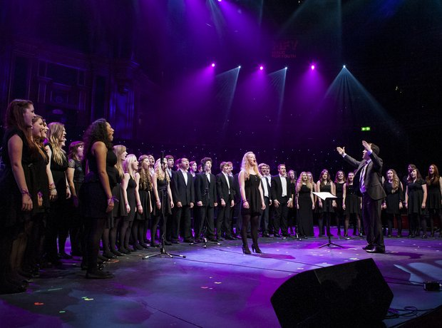
STRENGTHS & WEAKNESSES
TASK: Create a profile on your singing experience
What is your vocal part? (Soprano, Alto, Tenor, Bass)
What are your strengths in singing?
What are your weaknesses in singing?
What is your experience in singing? Do you have lessons? Are you involved in an AmDram company? Have you done any shows? What parts have you played? How was this experience?

Slide 4

THROUGHOUT THE COURSE, YOU WILL BE BUILDING UP YOUR REPERTOIRE.
TASK: Prepare a Musical Theatre song to perform in your first week at Thomas Telford School.
(This will act as a baseline performance that you can develop upon throughout the year)

