Slide 1
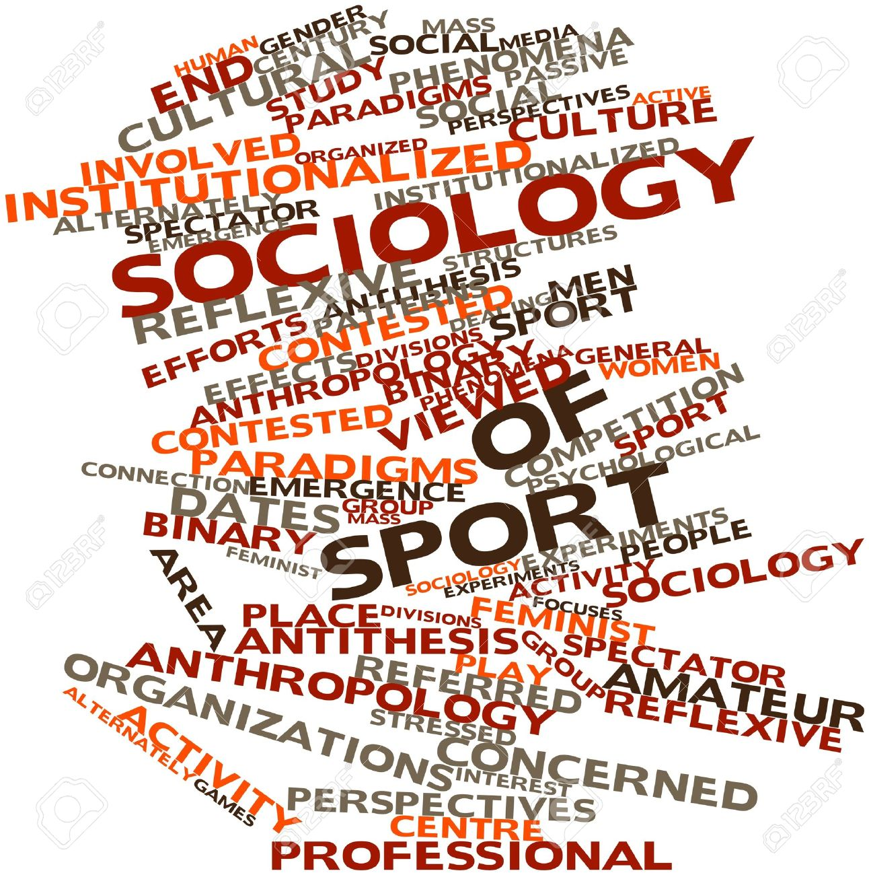
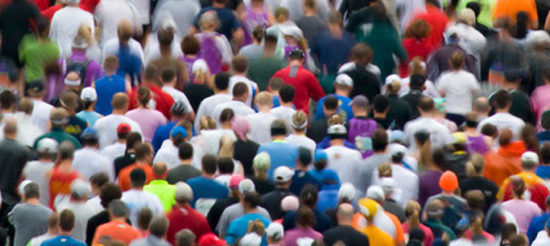

The Sociology of Sport
A-Level PE – Year 1 – Sport and Society

Slide 2
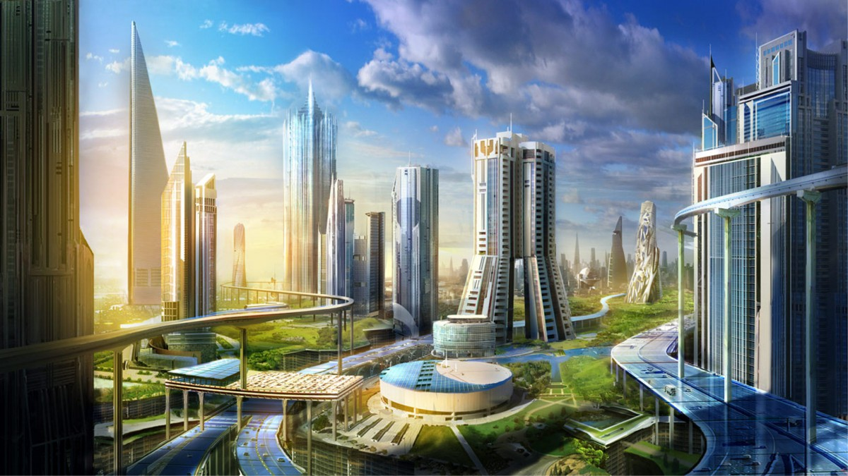
Starter Activity
Describe your perfect society!
What would it look like??
Now think about what structures you would need to put in place in order for it to work..
E.g. Government, Police, Businesses etc.
What problems might you face??

Slide 3
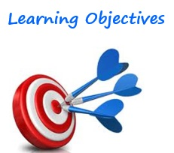
Topic Objectives
What will we cover?
What do you need to be able to do?
What is sociology?
How do we use it to study sport?
The key concepts to do with sport & society
How they apply to equal opportunities in sport
What is social action theory?
Define the key terms
Explain how they relate to the study of sport
Apply social action theory to social issues in physical activity and sport
Analyse the impact of the key concepts on sporting participation

Slide 4


What is sociology?
Sociology aims to answer 2 key questions:
How do people live in groups within society & therefore interact with others?
How does human behaviour become controlled? i.e. via family members, friends, schools etc.
How might this apply to sport?

Slide 5
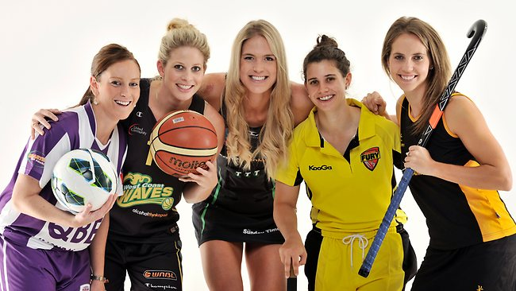
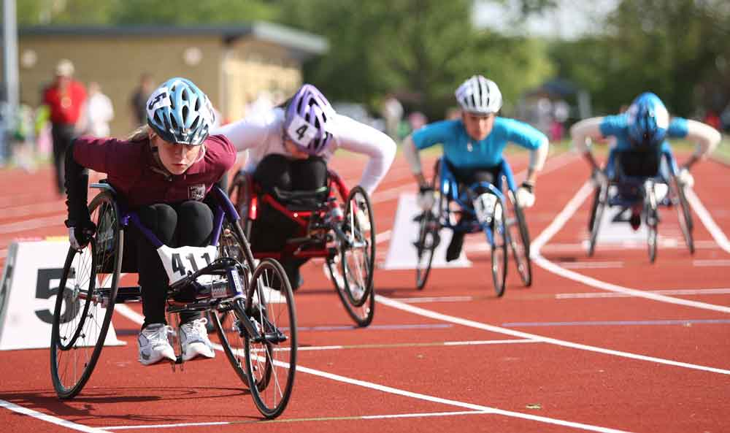
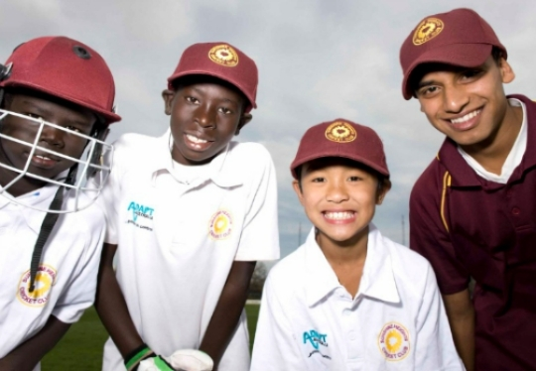
The sociology of sport
Considers the relationship between sport and society
Examines the social processes occurring within sport
Looks at how inequalities in sport can be overcome e.g.….
Women
Individuals with a disability
Ethnic minority groups

Slide 6

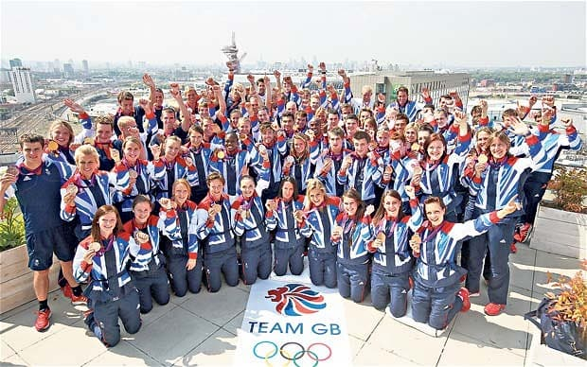
Society
Definition = An organised group of people associated for some specific purpose or with a shared common interest.
How does this apply to sport?
Success in sport on a global scale is often viewed as an important measure of the relative status of a society or nation in the world.
Success in sport can often boost national identity and national pride.
e.g. in Britain through Team GB’s 3rd position on the medal table at London 2012

Slide 7
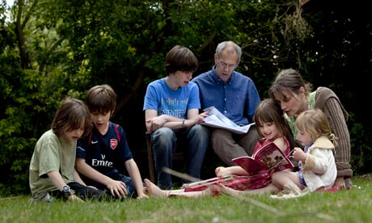
Socialisation
Definition = a lifelong process where members of a society learn its norms, values, ideas, practices and roles in order to take their place in that society.
Divided into 2 parts:
Primary socialisation
Takes place during the early years of childhood
Mainly within the immediate family
Involves the internalisation of a society’s key values
Secondary socialisation
Occurs during the later years
Other influences affect the socialisation process e.g. peer groups, schools.

Slide 8
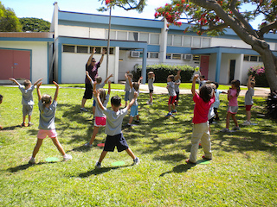
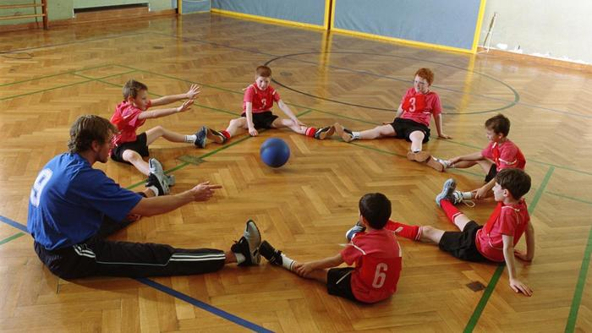
Independent Work
Think about and write down the various purposes of Physical Education during the secondary socialisation process
- What skills/values do children develop as a result of their PE experiences in secondary school?

Slide 9
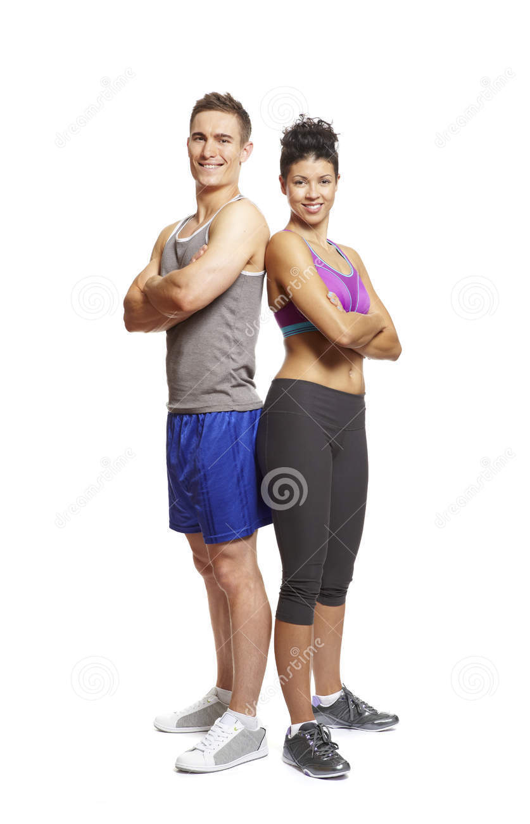

Starter Activity
Sport England’s Active People Survey discovered that 40.6 per cent of men compared to 30.7 per cent of women took part in sport at least once a week.
Why is this??

Slide 10
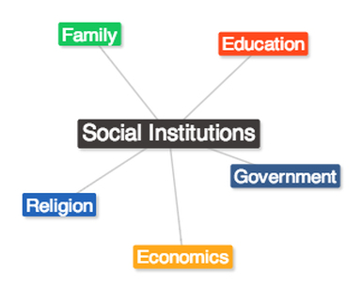
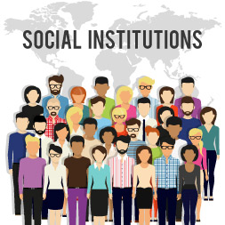
Social Control
Definition =
a concept that refers to the ways in which people’s thoughts, feelings, appearance and behaviour are regulated in social systems.
Society is made up of various institutions, with the family viewed as the most basic unit. Other examples = education, government.
They work together, ensuring socialisation into society, to maintain order & social control
Sometimes, however, they can become a barrier to an individuals opportunities.
How might this apply to sport?
Notes:
Answers = institutions can stereotype people – restrictions placed on women's participation .. Social control influence perceptions which influences individual choices when choosing what sports to play.

Slide 11
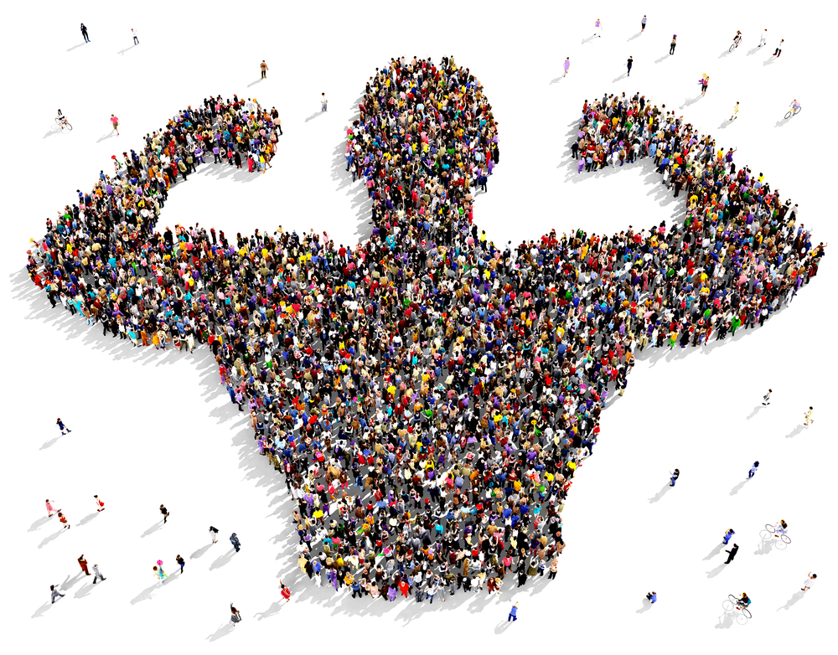


Social Change
Definition =
an alteration in the social order of a society.
The statistics show that sports participation inequalities exist when comparing women to men
It is very difficult for any social group to bring about change without having strong influence in the decision-making groups (e.g. local councils).
Social change occurs when institutions re-adjust to meet ‘new needs’ of groups in society such as women.
2 examples of using sport for social change

Slide 12

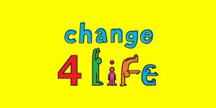



Independent Work
Research a group within society that may face barriers to participation in physical activity (e.g. women, ethnic minorities).
Investigate any initiatives that have been set up to try and change this.
How does this link to the idea of social change?

Slide 13
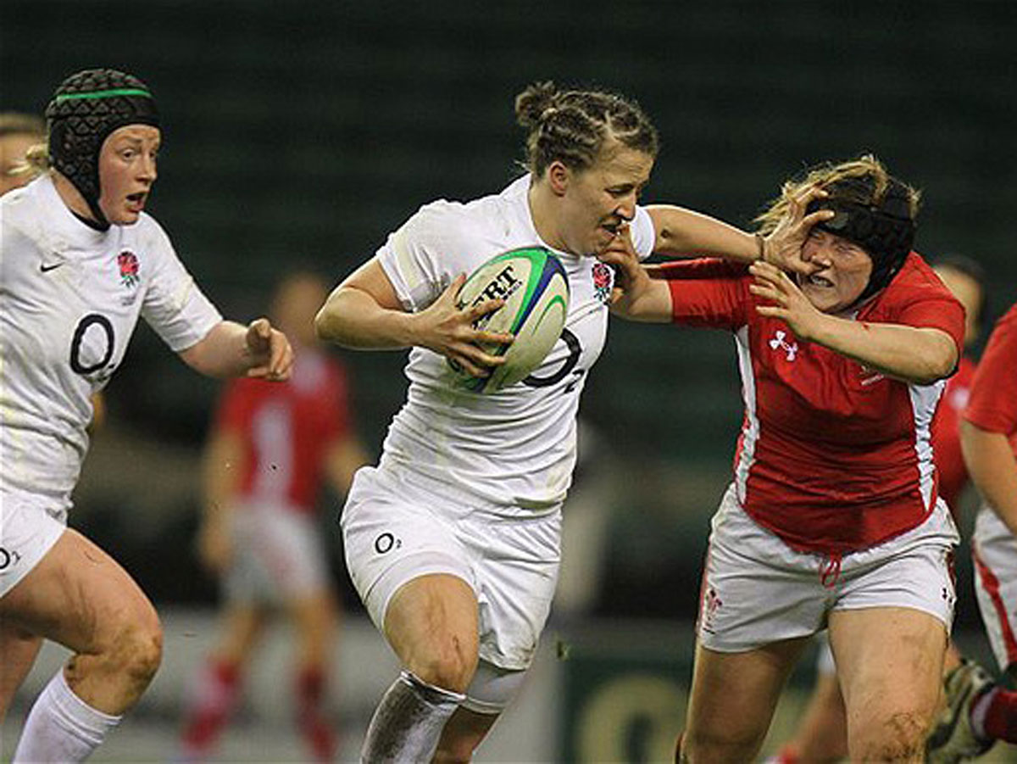
Starter
Identify any myths about women which may negatively affect their participation in sport or physical activity.

Slide 14
Today’s lesson
So far…
Today…
The Sociology of Sport – the academic discipline which considers the relationship between sport and society.
Society – an organised group of people with a shared common interest
Socialisation – the lifelong process where members of society learn its norms in order to take their place in society.
Social control – The way behaviour is regulated by social systems
Social change – an alteration in the social order of society.
YOUR TASK =
Identify and Analyse a number of possible causes of inequality in sport.

Slide 15
Social issues & Inequality
Social inequality occurs when resources in a society are unevenly distributed among socially defined categories of people.
There are many types of inequality that exist – we need to look at the areas that are directly related to participation in sport.
Define it – Social issues:
Problems that affect many people within a society.
Define it – Inequality:
The unfair situation where resources or opportunities are distributed unevenly within a society.
Main types of inequality:
Gender
Racial
Class
ACTIVITY – What are the causes of inequality in participation in sport?

Slide 16

Memory Tool
You can remember the key causes of inequality via MR MC!
Money
Role Models
Myths
Confidence

Slide 17
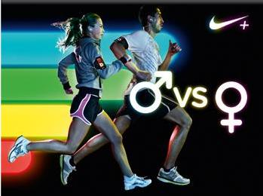
Activity
Watch the video below:
http://www.bbc.co.uk/sport/29786682
This relates to Gender-economic inequality
Why does this form of inequality exist?
What could be done to rectify it?? (think social change!)

Slide 18
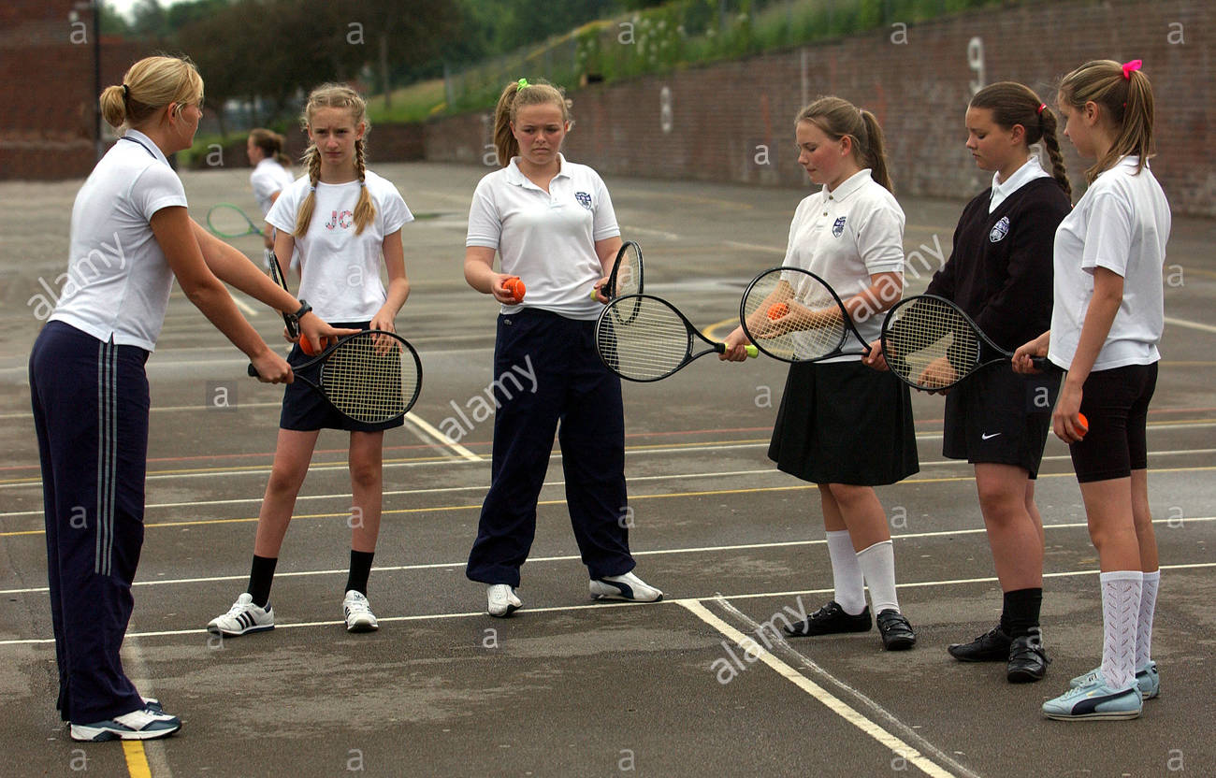
Starter Activity
Write on the board all the different sports you took part in (PE lessons & extra-curricular) during your time in secondary school.
What was your favourite? What was your least favourite?

Slide 19
Today’s lesson
Today…
Today…
What is social stratification?
How does it apply to sport?
What is social class?
Compare the differences in sports’ participation between different class groups
STRETCH & CHALLENGE:
Analyse reasons for different participation trends in a certain sport amongst the working class.
YOUR TASK =
Describe how social stratification & social class affect sporting participation.

Slide 20
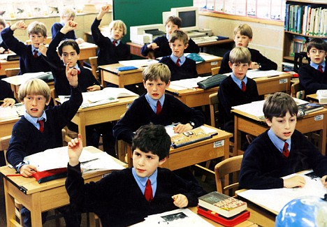

Social structures & Social Stratification
A number of different social structures exist which have an impact on an individual and their overall life chances e.g. schooling
What structures exist that affect an individuals participation in sport?
Definition – Social stratification
a type of social inequality where society is divided into different levels on the basis of a social characteristic, such as wealth or status.
Sport participation can, however, allow participants to leave behind their ‘normal lives’ & adopt a ‘new athletic identity’ in a sporting context!

Slide 21
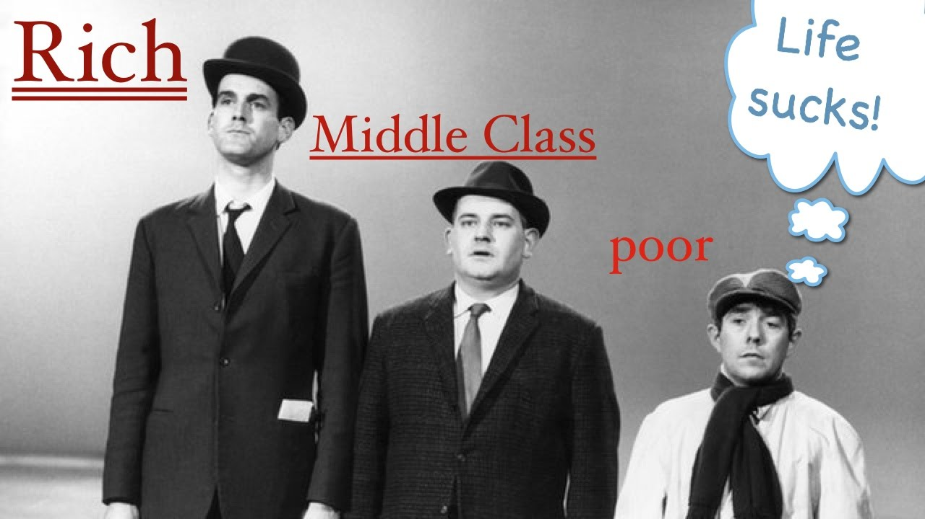
Social Class
A term used to define social inequalities. Included in somebody’s labelled class are the following areas;
A person’s job
Family background
Education
income

Slide 22
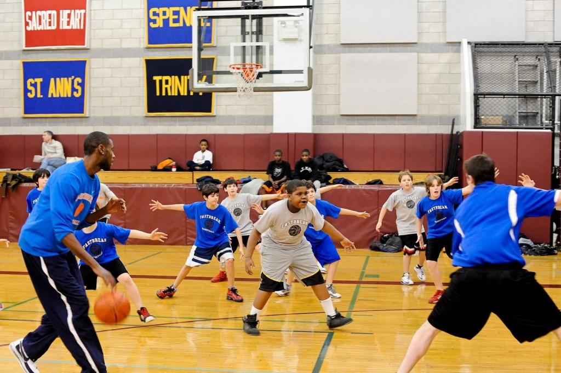
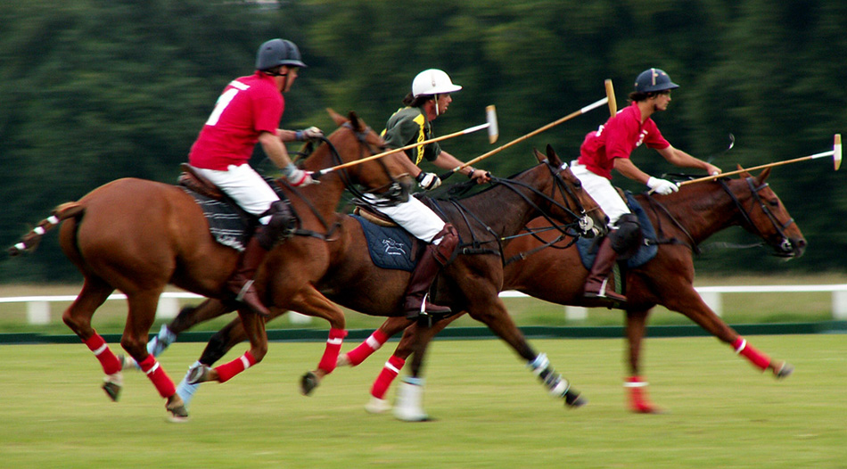
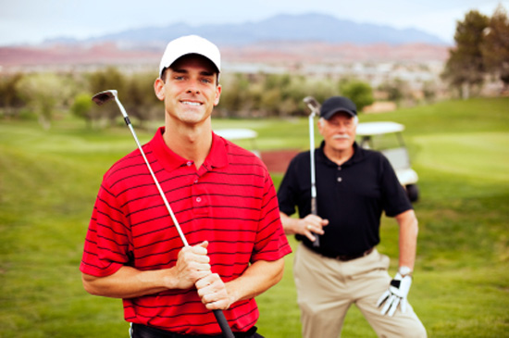
Independent Work
Research a sport that, similar to tennis, has a high difference in participation rate between upper-middle and lower class groups.
Why is this the case?
(see p.16)

Slide 23
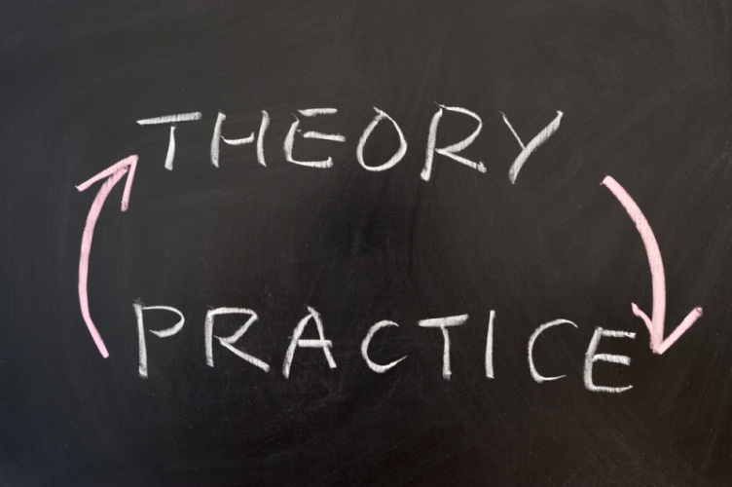
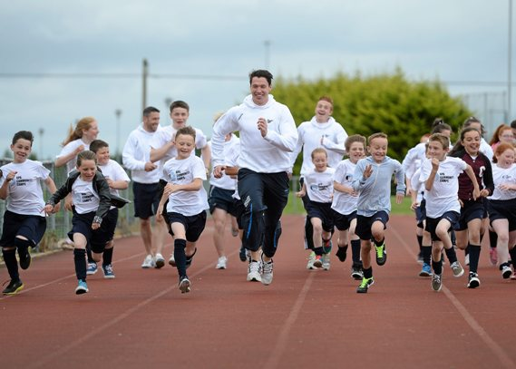
Social Action Theory
Its influence on physical activity and sport

Slide 24

Starter activity
Write a question on the board for a classmate to answer based on what you’ve learned so far in this topic.
E.g. What is social control and how does it apply to sport??

Slide 25
Social action theory
In summary – it is a theory that provides the foundation to how change can occur in sport!
What is social action theory?
How does it relate to sport?
A way of viewing socialisation, emphasising social action
Links between people and their social interdependence are the key ideas.
It stresses the fact that people can intervene in social processes and change them.
It helps us make sense of what we call sport
It accepts that sport is produced & developed at a particular time through the relationships and social networks of people who share similar views.
Sports involvement is therefore determined by the relationships between people based on the amounts of power they have in society.
Sport has therefore developed in a complex way alongside aspects of society such as class structure, education and family.

Slide 26
The interactionist approach
In summary – it is a theory that aims to make sense of how individuals shape society!
What is the interactionist approach?
How does it relate to sport?
The study of how individuals behave within society
Interactionism works from the individual towards society and stresses the fact that it is people who actually create society.
For interactionists, social institutions such as the sports club are seen not as separate from people, but as the product of various people involved.
In explaining sport, the theory is mainly concerned with the experiences of sports people & how they interact with each other in social groups & in turn how they affect external social factors.

Slide 27
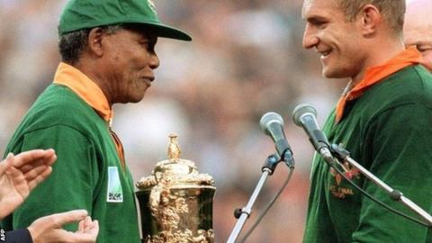
How is it helpful to sport?
It is helpful in understanding how to:
Change sports to match the perspectives and identities of those playing them.
Make sport organisations more democratic and less hierarchically organised.

Slide 28
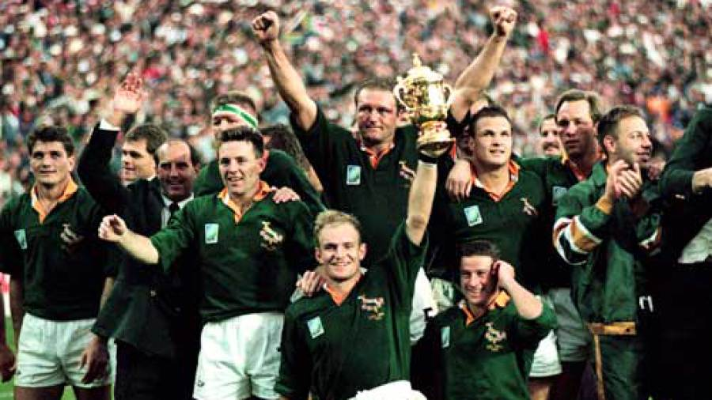
Activity
Watch the following video & discuss the story of the South African World Cup winning rugby team in 1995.
https://www.youtube.com/watch?v=TQhns5AwAkA
In what ways did the individuals involved in the team create change in their sport?
How does this relate to social action theory?
How does it relate to the interactionist approach?

Slide 29
Independent Work
Complete pp.19-20 in your workbook.
Define the key terms and complete the Sport England task.

