Slide 1
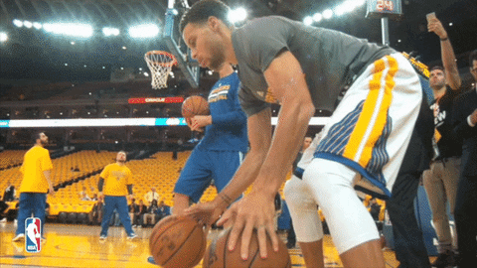
Skill Acquisition
Task 1:
What is a skill? (Knapp, 1963)
What are the characteristics of a skill?
What is the acronym to remember the characteristics of a skill?
Task 2:
What are the 6 factors that influence the classification of skills:
1.
2.
3.
4.
5.
6.
Skill Continuums

Slide 2
Skill Acquisition
Task 3:
Environmental Influence | Explanation | Sporting Example
Open
Closed
Control + Rate of Execution | Explanation | Sporting Example
Self Paced
Externally Paced
Extent of Muscles Used | Explanation | Sporting Example
Self Paced
Externally Paced
Skill Continuums

Slide 3
Skill Acquisition
Task 3:
Continuity | Explanation | Sporting Example
Discrete
Serial
Continuous
Degree of Difficulty | Explanation | Sporting Example
Simple
Complex
Organisation | Explanation | Sporting Example
Low
High
Skill Continuums

Slide 4
Skill Acquisition
Triple jump
Dance routine
100m sprint start
Penalty shot in netball
Task 4:
Tackle in rugby
Javelin throw
Backstroke swim
Dive from 10m platform
Triple jump
Dance routine
100m sprint start
Penalty shot in netball
Triple jump
Open
Closed
Triple jump
Self paced
Externally paced
Triple jump
Gross
Fine
Triple jump
Discrete
Serial
Continuous
Triple jump
Simple
Complex
Triple jump
Low organisation
High organisation
Skill Continuums

