Slide 1
Business –Session 2
Lesson title

Slide 2
Session 2
Investigate how businesses are organised

Slide 3
Key Terms
Please make a note of these
Subordinate - a person under the authority or control of another within an organisation.
Span of Control - refers to the number of subordinates that can be managed effectively and efficiently by supervisors or managers in an organisation.
Chain of command - how each member of a company reports to one another. At the top of the chart would be the founder, owner or CEO, and the people who report to them would appear directly below
Hierarchy - a system in which members of an organisation are ranked according to relative status or authority.

Slide 4
Organisational Structure
Organisations need structure to enable the business to operate effectively.
As a business grows, the structure will evolve but needs to be considered carefully so that:
  All jobs that need doing are identified
  Lines of communication are established
  Levels of responsibility are identified and allocated
  Levels of authority are attributed

Slide 5

Organisational Structure
Organisational structures : hierarchical, flat, matrix, holacratic.
Task: Using the worksheet provided - Research these organisational structures, and make suitable notes.
Make sure you have details of advantages and disadvantages of each structure and how they impact communication internally
Notes:
Businesses are organised into different structures. This is often dependant on the size or culture of the business. You will find diagrams on the next slide.
A hierarchical structure contains a direct chain of command from the top of the organization to the bottom. Senior management makes all critical decisions, which are then passed down through subsidiary levels of management.
A flat structure is an organisational structure with only a few layers of management. In a flat structure, managers have a wide span of control with more subordinates, and there is usually a short chain of command.
In a matrix structure, individuals work across teams and projects as well as within their own department or function. For example, a project or task team established to develop a new product might include engineers and design specialists as well as those with marketing, financial, personnel and production skills.
A holacracy is a system for managing a company where there are no assigned roles and employees have the flexibility to take on various tasks and move between teams freely. The organizational structure of a holacracy is rather flat, with there being little hierarchy.

Slide 6
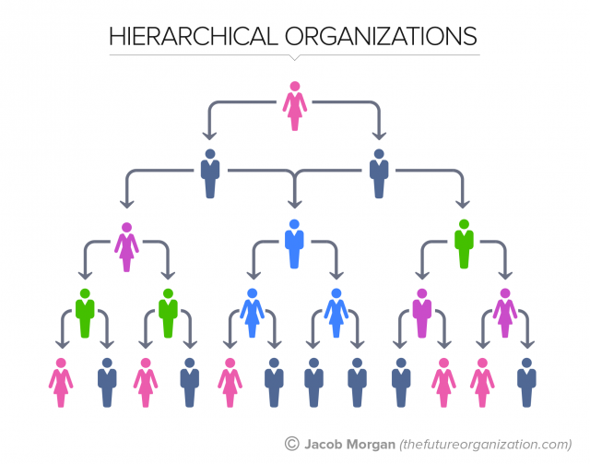
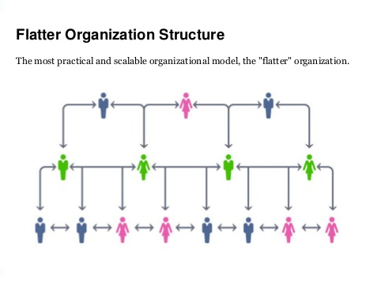
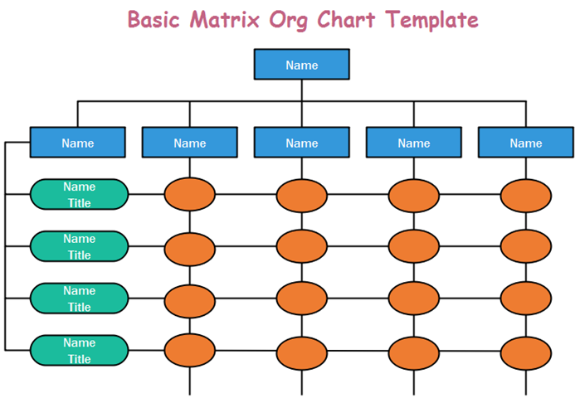
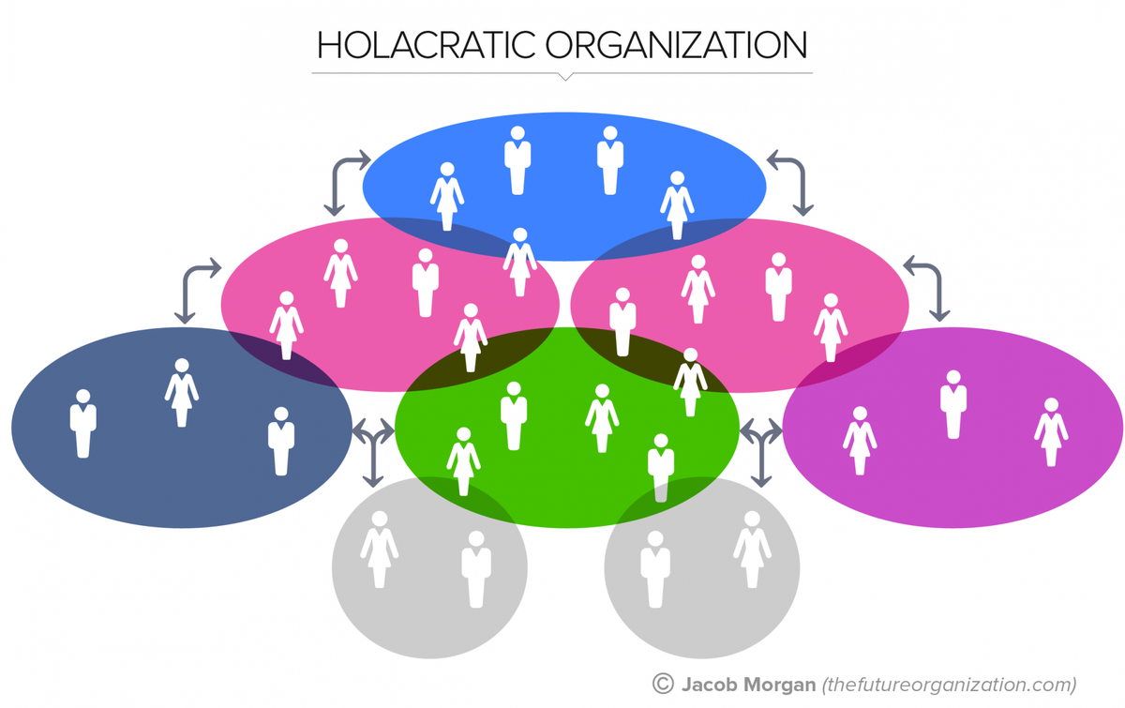

Slide 7
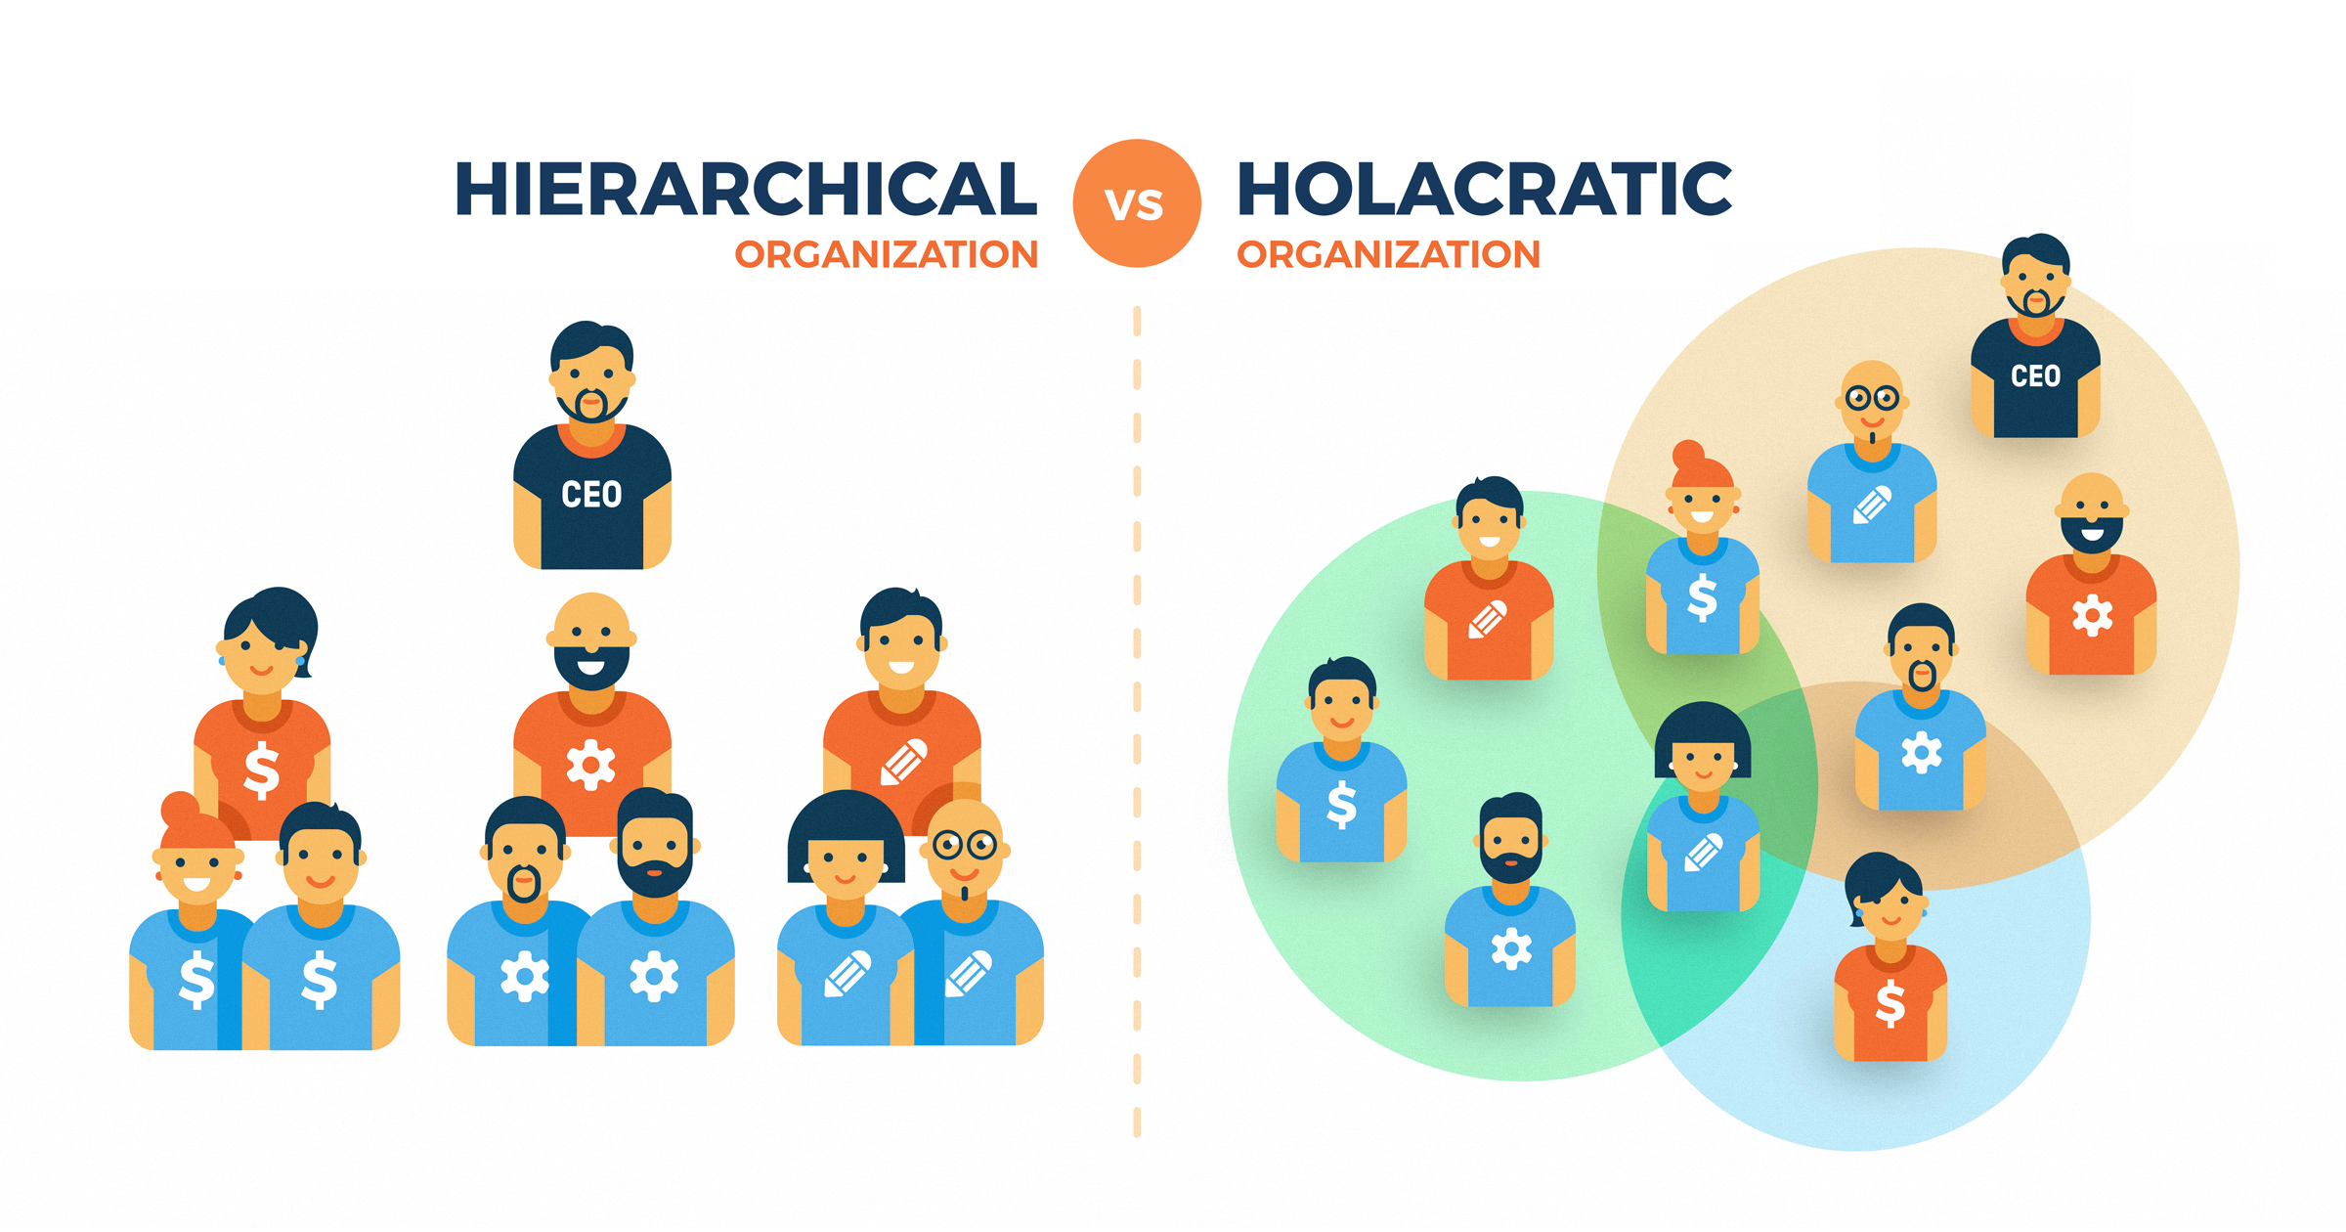

Slide 8
Functional/operational areas
What are the different functional areas and what do they do?
  Human resources (HR) (responsible for managing the people in the organisation to include their welfare, job roles, progression opportunities?
  Research and development (R&D) (of new products or concepts)
  Sales (selling products or services)
  Marketing (promotion of business)
  Procurement (supplies, products, stationery)
Make notes on all of the functional areas and how they communicate with each other
Notes:
Across the next few slides you will find details of the different functional areas within a business. A functional area or department, specialises in certain aspects of the business to support it to function properly.
It is important that you know what each of the areas do.
Most businesses will have most of these functional areas within them, although it may be that in smaller areas, one person is responsible for more than one functional area.
It is important that the functional areas communicate effectively to ensure that the business is successful. If, for example, HR have not successfully communicated pay rises to finance, then employees will not be paid properly and will become unhappy. This will lead to poor motivation and lack of productivity in the workforce.
If operations do not communicate effectively with procurement, supplies may not be delivered on time.
Make notes on all of the functional areas and how they communicate with each other

Slide 9
Functional/operational areas
What are the different functional areas and what do they do?
  Production and quality (manufacturing, undertaking checks that products meet specifications)
  Finance (accounting, raising invoices, paying bills, wages)
  Customer services (resolving customer queries and complaints, seeking feedback to improve products or service, or develop ideas)
  IT (telecommunications ad computer infrastructure such as website)
  Administration (the ongoing support for the business to function, such as following procedures, dealing with correspondence, organising meetings and any travel)

Slide 10
Aims and Objectives
What is the difference between aims and objectives?
  Aims = Main goal
  Objectives = Break down of large task/goal into smaller bite-sized chucks/how you will achieve your aim.
What does SMART stand for?
  Specific
  Measurable
  Achievable
  Realistic & Relevant
  Time constrained

Slide 11
Example SMART Objective
  To achieve a 10% increase in profit in the next 12 months
This objective is Measurable
This objective has a clear Time Frame
This objective is clear and Specific
The objective is Realistic and Achievable
It does not put too much pressure on the business, but is something that is will stretch the business

Slide 12
Aims of businesses in different sectors
Aims are built around three key areas:
  Mission: a promise of commitment to the business cause
  Vision: the direction the business aims to travel in the future, short or longer term
  Values: the philosophy and ethos of a business which underpins the vision
Task: Using the Worksheet provided - Research two companies, aim to find out their mission, vision and values.
Notes:
Example companies to research: Sainsbury, Avon, Coca Cola, British Gas, The Body Shop, Amazon

