Slide 1

Bridge the Gap
TASKS

Slide 2
Dear Y11 student,
The 4 units you will study in the first year of A level Chemistry are:
Module 1 – Development of practical skills in chemistry
Module 2 – Foundations in chemistry
Module 3 – Periodic table and energy
Module 4 – Core organic chemistry
You can find out more about the A level specification using the link below:
https://www.ocr.org.uk/Images/171750-specification-accredited-as-level-gce-chemistry-a-h032.pdf

Slide 3
Between now and the start of Sixth Form in September, you should aim to complete the pack of tasks below. After completing this pack you will have refreshed your knowledge and understanding of the basic concepts of Chemistry that you covered during your GCSE programme so you will be more confident tackling the Advanced course.

Slide 4
Assessment Objectives
You should be able to:
write balanced chemical equations for reactions
carry out mole calculations to work out relative atomic mass, molar volumes, concentrations
describe the arrangement of particles in the atom
describe the trends of reactions of groups in the periodic table
identify oxidation and reduction reactions
recognise simple organic molecules and be able to draw structures of alkanes and alkenes
describe chemical reactions as endothermic or exothermic and draw energy level diagrams
explain the difference between ionic and covalent bonding and draw dot and cross diagrams

Slide 5
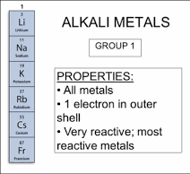
Group 1
Increase in reactivity
Why do they increase in reactivity?

Slide 6
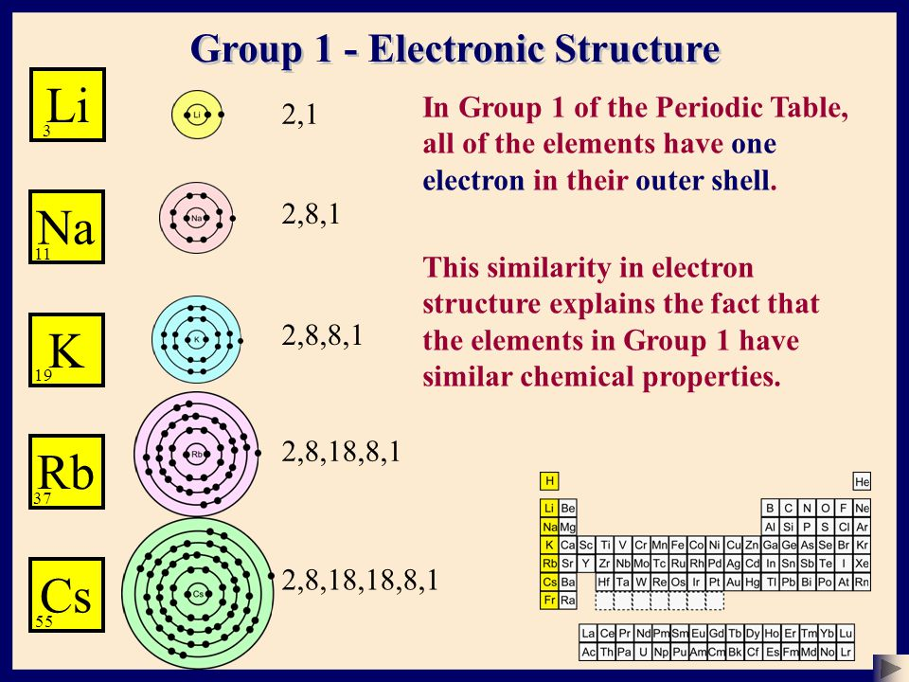
The larger the atom is the further the outer electron is from the nucleus
It is easier to lose the outer electron as the attraction between the positive nucleus and the outer electron is weaker (more shielding)

Slide 7
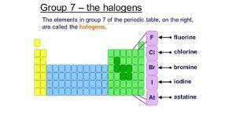

Group 7
Decrease in reactivity
Why do they decrease in reactivity
7 electrons in their outer shell
Highly reactive non-metals

Slide 8
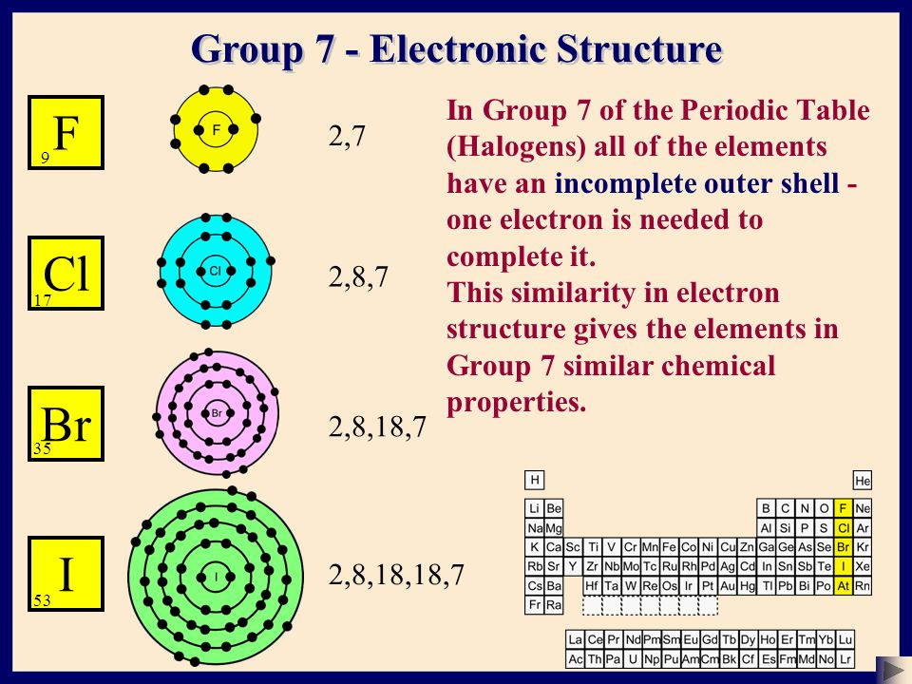
As the atoms get bigger the outer shell is further away from the nucleus
It is harder to pull in another electron as there is less pull from the positive nucleus

Slide 9
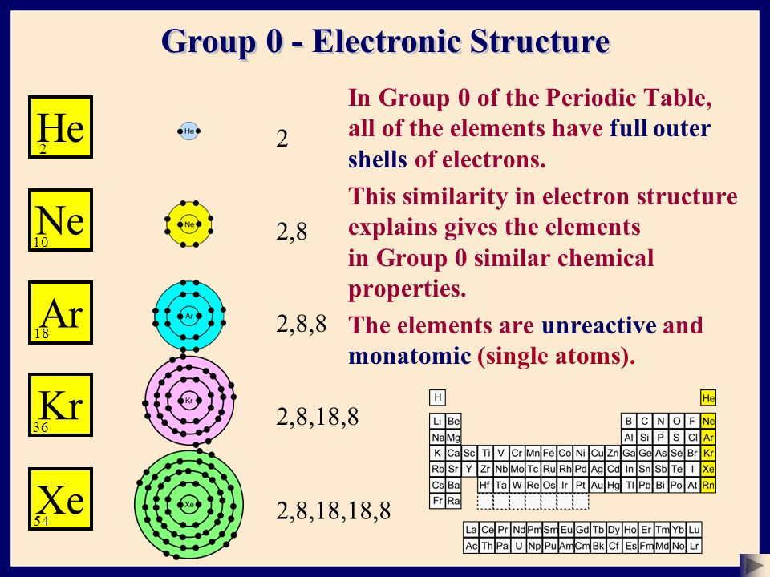

Slide 10
Task 7 - Reactivity of Group 1, 7 & 0 Elements
Describe how the reactivity of the elements in groups 1, 7 and 0 changes with atomic number. Use electronic structure/shielding and distance from the nucleus to help explain your answers.
RESOURCES
https://www.chemguide.co.uk/

Slide 11
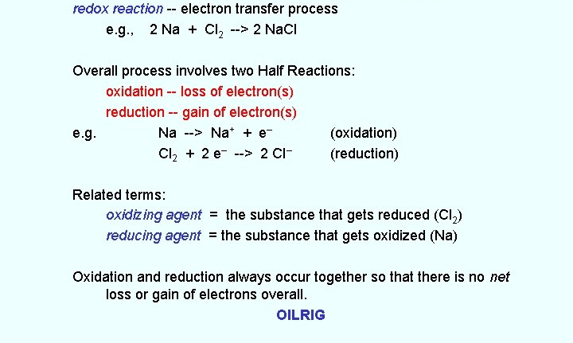
Redox reactions

Slide 12
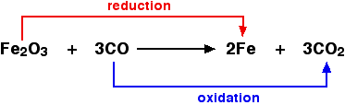

Slide 13
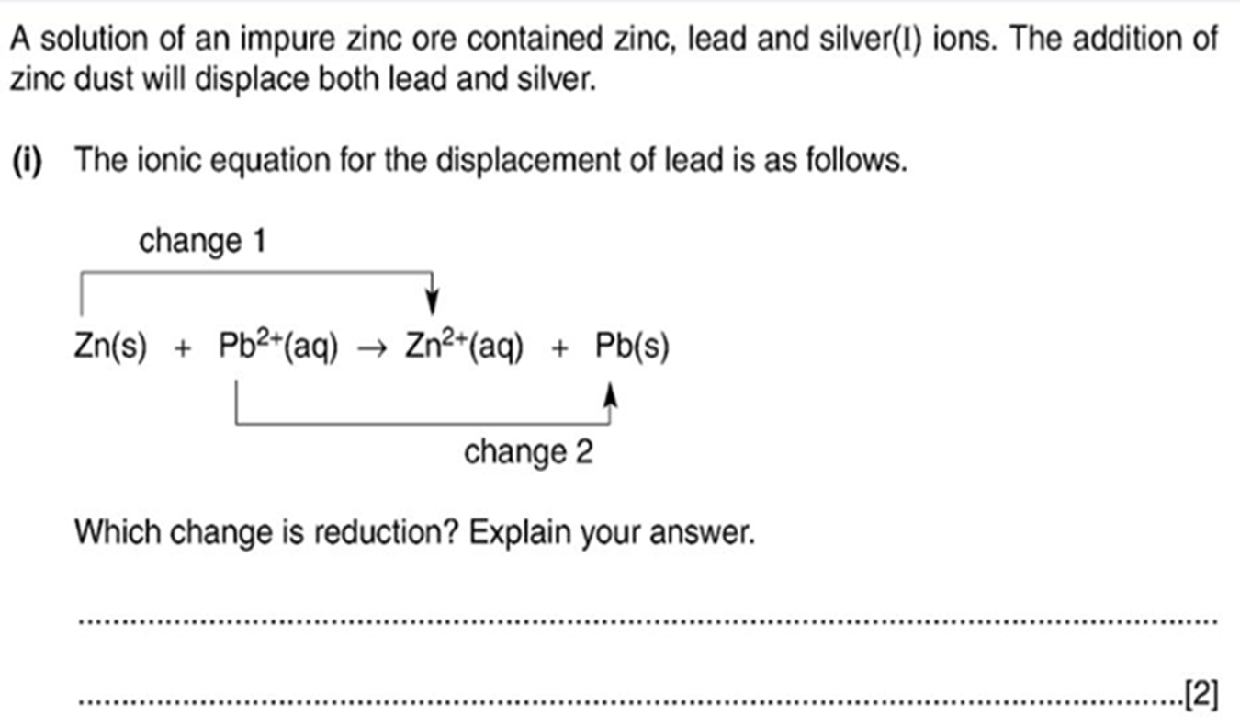

Slide 14
Task 8 - Oxidation & Reduction
Write a definition for the terms oxidation and reduction.
Complete the exercise to identify oxidising and reducing agents.
For each example below state;
the oxidising agent
the reducing agent
what has been reduced
what has been oxidised
a) the thermite reaction
aluminium + iron oxide → iron + aluminium oxide
b) roasting the ore tin sulphide in air
tin sulphide + oxygen → tin oxide + sulphur dioxide
c) smelting tin oxide with coke
tin oxide + carbon → tin + carbon monoxide
d) roasting the ore copper sulphide in air
2CuS(s) + 3O₂ → 2CuO(s) + 2SO₂(g)
RESOURCES
https://www.chemguide.co.uk/

