Slide 1

Bridge the Gap
TASKS

Slide 2
Dear Y11 student,
The 4 units you will study in the first year of A level Chemistry are:
Module 1 – Development of practical skills in chemistry
Module 2 – Foundations in chemistry
Module 3 – Periodic table and energy
Module 4 – Core organic chemistry
You can find out more about the A level specification using the link below:
https://www.ocr.org.uk/Images/171750-specification-accredited-as-level-gce-chemistry-a-h032.pdf

Slide 3
Between now and the start of Sixth Form in September, you should aim to complete the pack of tasks below. After completing this pack you will have refreshed your knowledge and understanding of the basic concepts of Chemistry that you covered during your GCSE programme so you will be more confident tackling the Advanced course.

Slide 4
Assessment Objectives
You should be able to:
write balanced chemical equations for reactions
carry out mole calculations to work out relative atomic mass, molar volumes, concentrations
describe the arrangement of particles in the atom
describe the trends of reactions of groups in the periodic table
identify oxidation and reduction reactions
recognise simple organic molecules and be able to draw structures of alkanes and alkenes
describe chemical reactions as endothermic or exothermic and draw energy level diagrams
explain the difference between ionic and covalent bonding and draw dot and cross diagrams

Slide 5
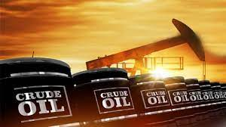
Hydrocarbons and energy

Slide 6
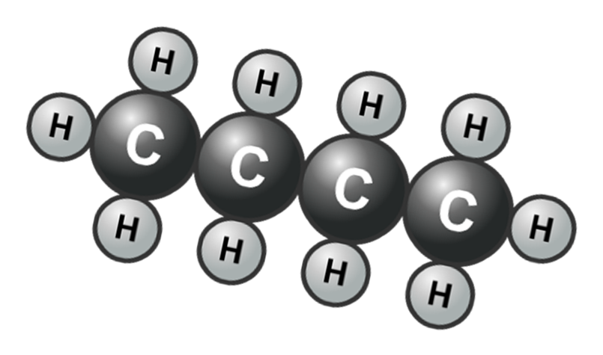
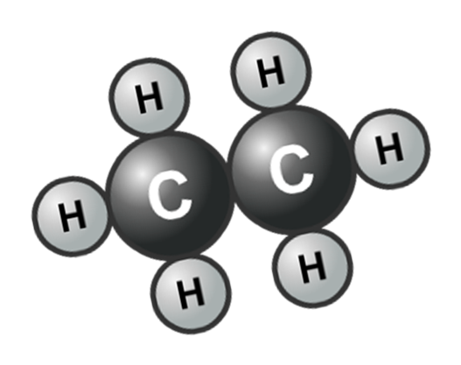
Crude Oil
Mixture of hydrocarbons
Molecules that only contain the elements carbon and hydrogen atoms

Slide 7
Alkanes
Alkanes are a group of hydrocarbons found in crude oil
You can tell they are alkanes from their names
They end in ‘ane’
E.g Methane, propane or octane
They also only have single bonds between all of the atoms

Slide 8
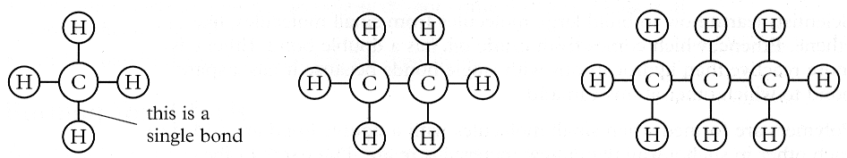
Naming hydrocarbons
General formula =
CnH(2n + 2)
Alkanes
Methane
Ethane
Propane
CH₄
C₂H₆
C₃H₈
Butane = 4 carbons
Pentane = 5 carbons
Hexane = 6 carbons
Heptane = ?
Octane = ?
These hydrocarbons are said to be saturated.
(They have single bonds between carbon atoms).

Slide 9
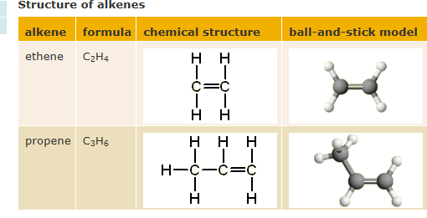
Alkenes
The alkenes are a family of hydrocarbons that share the same general formula.
This is C_{n}H_{2n} (for each carbon atom there are twice the number of hydrogen atoms)
Alkenes are unsaturated hydrocarbons. They contain a double bond, which is shown as two lines between two of the carbon atoms.

Slide 10

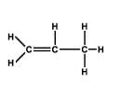
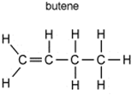
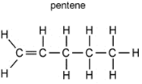
The first 4 alkenes
Name the second alkene
Write the chemical formula for each alkene
Draw the structure of C6H12 (hexene)

Slide 11
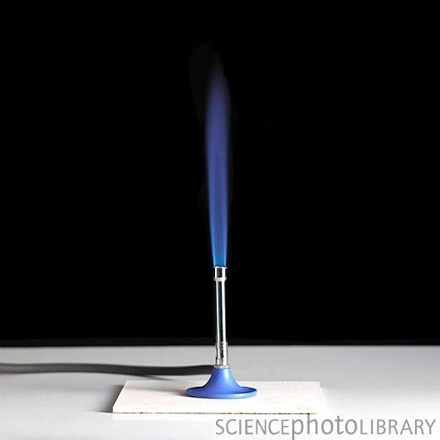
Complete combustion
Complete combustion occurs when there is plenty of oxygen – for example when the hole is open on a Bunsen burner.
The products of complete combustion are carbon dioxide and water.
methane + oxygen carbon dioxide + water

Slide 12
ethane (C₂H₆) + oxygen
2. propane (C₃H₈) + oxygen
3. butane (C₄H₁₀) + oxygen

Slide 13
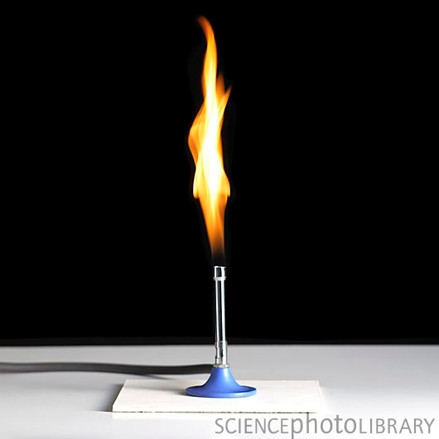
Incomplete combustion
Incomplete combustion occurs when there is not enough oxygen for complete combustion – for example when the hole is closed on a Bunsen burner.
The products of incomplete combustion include carbon monoxide and carbon (soot). It is often called a sooty flame.
Methane + oxygen carbon dioxide + carbon monoxide + carbon + water

Slide 14
Task 5 - Hydrocarbons
What is a hydrocarbon? Explain this in one sentence
Draw the structures of methane, ethane, ethene.
Explain which are saturated and which are unsaturated.
Describe the difference between complete and incomplete combustion
Write word and balanced symbol equations for the complete and incomplete combustion of methane and ethane
RESOURCES
https://www.chemguide.co.uk/

Slide 15
Energy change reactions
An Exothermic reaction - energy is given out to the surroundings, usually in the form of heat, light or sound.
The temperature usually increases.
e.g fireworks, combustion, oxidation
An Endothermic reaction - energy is taken in by the reaction from the surroundings, usually (but not always) means that the surroundings get colder.
e.g Photosynthesis, thermal decomposition

Slide 16
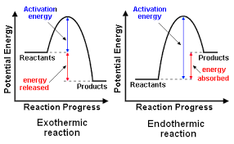
Energy profile diagrams
Activation energy = the amount of energy needed to start a reaction
In exothermic reactions the energy in the reactants is higher than in the products
This means energy is released to the surroundings

Slide 17

In an endothermic reaction the products have more energy than the reactants
This means that energy is absorbed from the surroundings

Slide 18
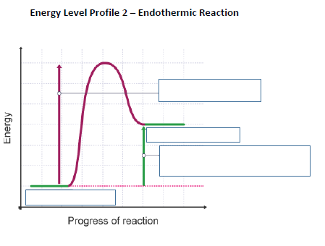
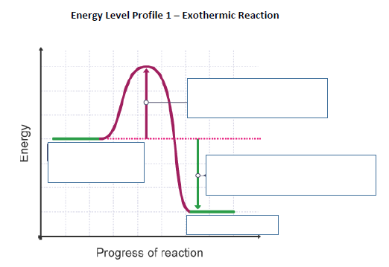

Slide 19
Bond energies
Calculate the overall energy change in the following:
Hydrogen bromide decomposes to form hydrogen and bromine:
2 HBr → H₂ + Br₂
Bond | Bond Energy (kJ/mole)
H−Br | 366
H−H | 436
Br−Br | 193

Slide 20
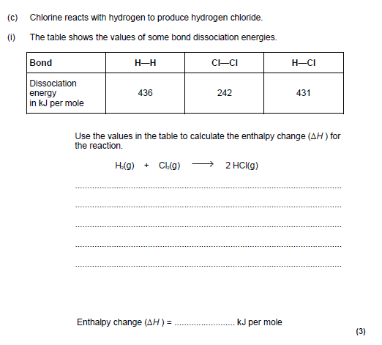

Slide 21
Task 6 – Energy
Give definitions and examples for exothermic and endothermic reactions.
Draw energy level diagrams for both endothermic and exothermic reactions making sure that they have been labelled correctly.
Label activation energy on your diagrams and explain this term.
Calculate the overall energy change in the example on the next slide.
RESOURCES
https://www.chemguide.co.uk/

Slide 22
