Slide 1

Bridge the Gap
TASKS

Slide 2
Dear Y11 student,
The 4 units you will study in the first year of A level Chemistry are:
Module 1 – Development of practical skills in chemistry
Module 2 – Foundations in chemistry
Module 3 – Periodic table and energy
Module 4 – Core organic chemistry
You can find out more about the A level specification using the link below:
https://www.ocr.org.uk/Images/171750-specification-accredited-as-level-gce-chemistry-a-h032.pdf

Slide 3
Between now and the start of Sixth Form in September, you should aim to complete the pack of tasks below. After completing this pack you will have refreshed your knowledge and understanding of the basic concepts of Chemistry that you covered during your GCSE programme so you will be more confident tackling the Advanced course.

Slide 4
Assessment Objectives
You should be able to:
write balanced chemical equations for reactions
carry out mole calculations to work out relative atomic mass, molar volumes, concentrations
describe the arrangement of particles in the atom
describe the trends of reactions of groups in the periodic table
identify oxidation and reduction reactions
recognise simple organic molecules and be able to draw structures of alkanes and alkenes
describe chemical reactions as endothermic or exothermic and draw energy level diagrams
explain the difference between ionic and covalent bonding and draw dot and cross diagrams

Slide 5
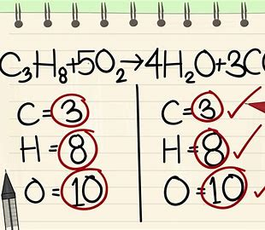
Equations and mole calculations

Slide 6
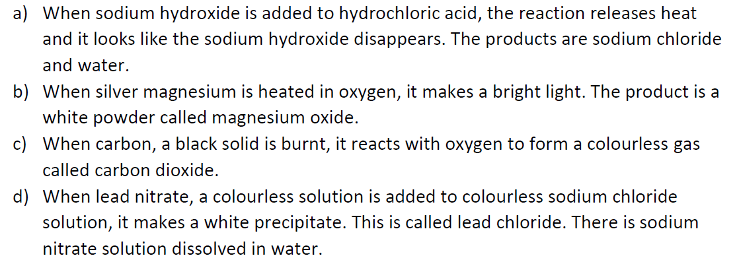
Word equations

Slide 7
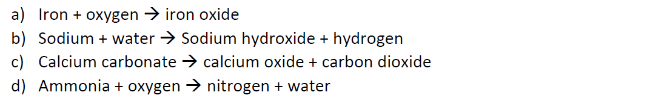
Writing and balancing symbol equations

Slide 8
Task 3 - Writing Balanced Chemical Equations
Work through this exercise to write and balance 12 chemical equations
a) zinc and sulphur combine to form zinc sulphide
b) copper reacts with oxygen to form copper oxide
c) sulphur and oxygen form sulphur dioxide
d) magnesium carbonate decomposes to form magnesium oxide and carbon dioxide
e) hydrogen and copper(II)oxide form copper and water
f) carbon and carbon dioxide react to form carbon monoxide
g) magnesium reacts with sulphuric acid to form hydrogen and magnesium sulphate
h) calcium reacts with water to form hydrogen and a solution of calcium hydroxide
i) zinc reacts with steam to form hydrogen and zinc oxide
j) aluminium and chlorine react to form aluminium chloride
k) copper and chlorine combine to form copper(II)chloride CuCl₂
RESOURCES
https://www.chemguide.co.uk/

Slide 9
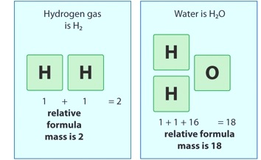
Relative formula mass (Mr)
The total mass of all elements in a molecule or compound

Slide 10
CO₂

Slide 11
H2SO4

Slide 12
Fe2(SO4)3

Slide 13
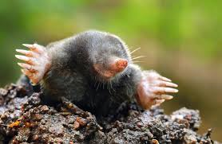
Moles
Mole = relative atomic mass in grams
1 mole of carbon = 12g
1 mole of oxygen = 16g
1 mole of hydrogen = 1g
A mole of any substance always contains the same number of atoms
This is a huge number (6.02 x10²³)
Or 602000000000000000000000
This is known as Avagadro’s constant

Slide 14
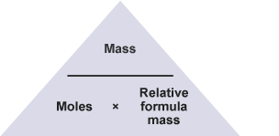
number of moles = mass ÷ relative formula mass
Calculate the number of moles of carbon dioxide molecules in 22 g
Calculate the mass of 6 moles of carbon dioxide (CO₂)

Slide 15
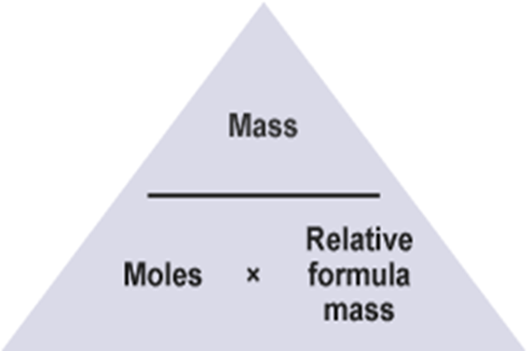
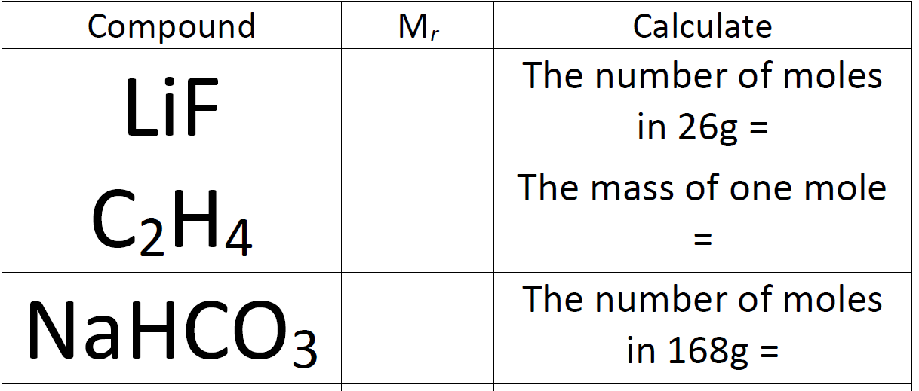
Practice

Slide 16
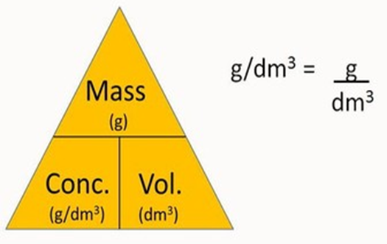
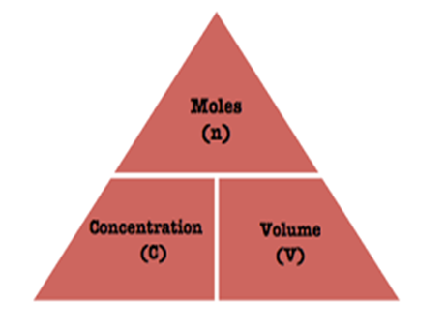
Calculating concentration
Measured in g/dm³ or mol/dm³
Concentration = mass or moles of solute
volume of solvent

Slide 17
Example 1
What is the concentration in g/dm³ of a solution of sodium chloride where 30g of sodium chloride is dissolved in 0.2dm³ of water?

Slide 18
Example 2
What is the concentration in mol/dm³ of a solution with 2.3 moles of sodium chloride in 500cm³ of water

Slide 19

Molar volume of gases
One mole of any gas has a volume of 24 dm³ or 24,000 cm³ at rtp (room temperature and pressure)
This volume is called the molar volume of a gas
Room temp = 20⁰C
Pressure = 1 atm

Slide 20
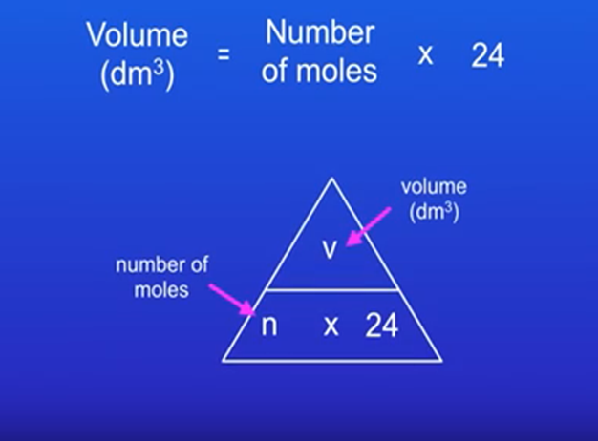
Calculate the volume of 0.5 mol of carbon dioxide at rtp.

Slide 21
Calculate the number of moles of hydrogen that occupy 6 dm³ at rtp.

Slide 22
Task 4 - Mole Calculations
Have a go at these differentiated mole calculations on the following 3 slides
RESOURCES
https://www.chemguide.co.uk/

Slide 23
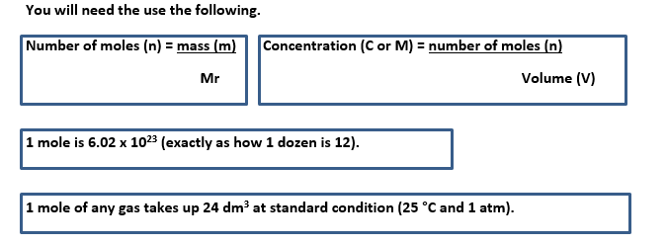
Easy
Write pyramids for the two equations
How many moles are there in 23 g of ²³Na?
How many atoms are there in 1 mole? ii) How many atoms are there in 0.5 moles?
How many moles are there in 120 g of Calcium?
What is the mass of 2 moles of ²³⁸U?
What is the volume of 4 moles of He_{(g)}?
A gas has a volume of 120 dm³, how many moles is this?
What is the Mr of a substance where 1 mole has a mass of 11 g?
What is the concentration of a solution with 2 moles dissolved in 1 dm³?
What would the concentration be if 3 moles where dissolved in 3 dm³?

Slide 24
Medium
How many moles are there in 44 g of CO₂? How many molecules is this?
How many molecules are there in 79 g of Fe₂O₃? How many atoms id this?
What is the mass of 2.5 moles of Na₂O?
What is mass of 2.34 moles of Platinum?
How many moles are there in 132 g of CO₂? How many dm³ would this be?
58.5 g of sodium chloride are dissolved in 1 dm³. What concentration would this be?
How many moles would needed to be dissolved in 1 dm³ to get a 3M solution? How many would be needed if only 0.1 dm³ were used?
92 dm³ of a gas dissolved in a solvent. How many moles is this? What is the concentration of the resulting solution?
48 dm³ of a gas has a mass of 262 grams. How many moles is this? What is the Mr? What must this element be?

Slide 25
Hard
How many molecules are there in 79 g of Fe₂O₃? How many atoms is this?
How many moles are there in 132 g of CO₂? How many dm³ would this be?
58.5 g of sodium iodide are dissolved in 0.5 dm³. What concentration would this be?
392 dm³ of a gas are dissolved in 2.65 dm³ of a solvent. What is the concentration of the resulting solution?
48 dm³ of a gas has a mass of 262 grams. How many moles is this? What is the Mr? What must this element be?
1.2 x 10²⁴ molecules are dissolved in 670 ml, what is the concentration?
A metal reacts with 8 g of oxygen molecules to form 15 g of a basic oxide. What is the metal? Remember metal oxides are M₂O, MO or M₂O₃ (M = Metal ion).
1.24 g of calcium carbonate is reacted with 15 ml of 1 M hydrochloric acid. How many dm³ of gas are formed? How many atoms are there in this gas?

