Slide 1
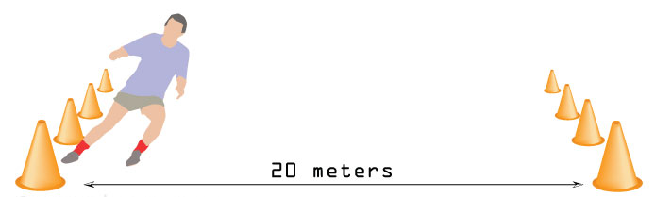
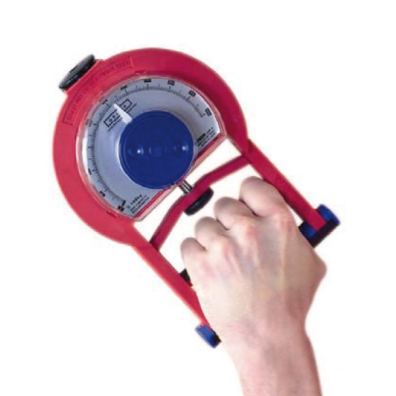
Session 3 Unit 5 – Application of Fitness Testing
Task 1 – Research and Complete the Table
For each of the five key Components of Fitness listed on the next slide, complete the table by providing the following information:
A clear definition of the fitness component
A commonly used fitness test that measures it
Typical normative values for males
Typical normative values for females
The source/reference where you found the data
An example has been provided
Task 2 – Fitness in Sport: Application and Analysis
For each of the Components of Fitness below, identify the sports or types of athletes who rely most heavily on them. Then explain why that component is essential to their performance:
Aerobic Endurance
Muscular Strength
Muscular Endurance
Flexibility
Speed
Why This Matters: These tasks are an essential foundation for Unit 5 of your course. Completing them now will give you a strong head start, especially when tackling a section of your coursework.

Slide 2
Session 3 Unit 5 – Application of Fitness Testing
Component | Definition | Fitness Test | Normative Data (Males 16–19 yrs) | Normative Data (Females 16–19 yrs) | Source
Aerobic Endurance | Ability of the heart and lungs to supply oxygen during sustained activity. | Multi-Stage Fitness Test (Beep Test) | Excellent: >13.7 Good: 11.4–13.7 Average: 8.3–9.9 Below Avg: 6.9–8.2 Poor: <6.8 | Excellent: >11.1 Good: 9.8–11.1 Average: 7.2–8.4 Below Avg: 5.7–7.1 Poor: <5.6 | SATPE
Muscular Strength
Muscular Endurance
Flexibility
Speed

