Slide 1
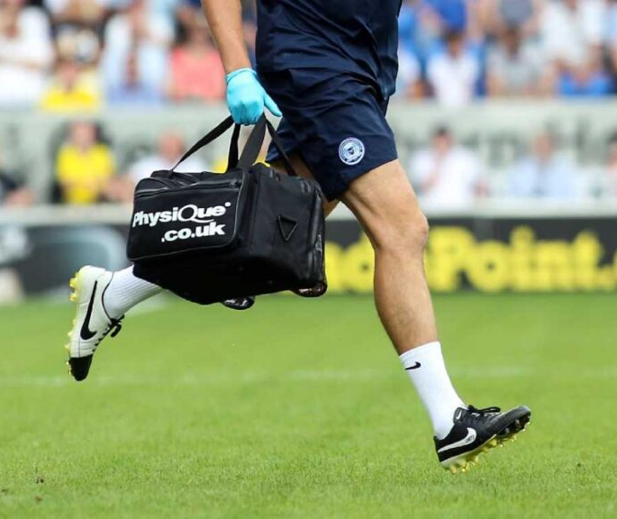
Session 2
Unit 3 - Professional Development in the Sports Industry
Task 1 – Explore potential careers in sport using the Prospects website - Leisure, sport and tourism | Prospects.ac.uk (or use next slide)
Task 2 – Locate a job advertisement related to your chosen sports career. Make sure it includes both a Job Description and Person Specification.
Task 3 – Develop a CV and Cover Letter tailored to the job opportunity you've selected, as if you were applying for the role.
Extension Task – Reflect on the qualifications required for your chosen career path. Explain how you intend to achieve them and identify any relevant timeframes or milestones.
These tasks form a key part of Unit 3 in your course. Completing them now will give you a head start on your coursework, specifically section 6.1, and help you build a strong foundation for your future career.

Slide 2
Examples of Jobs in Sport
Career Role | What You’d Do | Where You’d Work
Sports Coach | Train and develop athletes to improve performance | Schools, clubs, national teams
PE Teacher | Teach physical education, health, and fitness in schools | Primary or secondary schools
Sports Psychologist | Help athletes cope with pressure and improve mindset | Teams, universities, private practice
Physiotherapist (Sports) | Treat sports-related injuries and aid recovery | Clinics, clubs, sports centers
Sports Scientist | Analyse athletic performance and biomechanics | Labs, training centers, elite teams
Personal Trainer | Design fitness programs for individuals | Gyms, online, freelance
Referee or Official | Officiate matches and enforce rules | Matches, tournaments
Sports Journalist | Report on sporting events and athletes | Newspapers, websites, TV, social media
Event Manager | Plan and run sporting events | Arenas, clubs, freelance
Nutritionist | Advise athletes on diet to improve performance | Teams, clinics, private consulting

