Slide 1
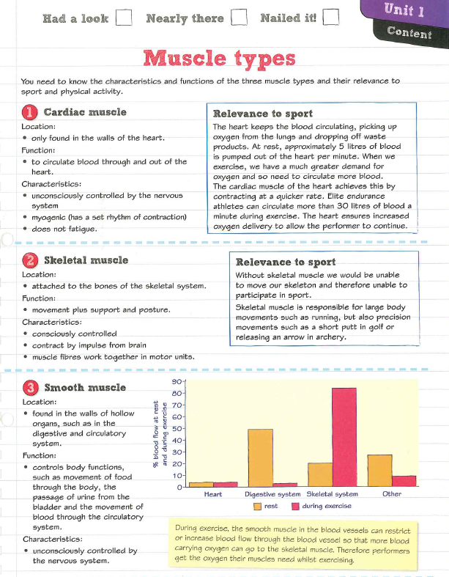
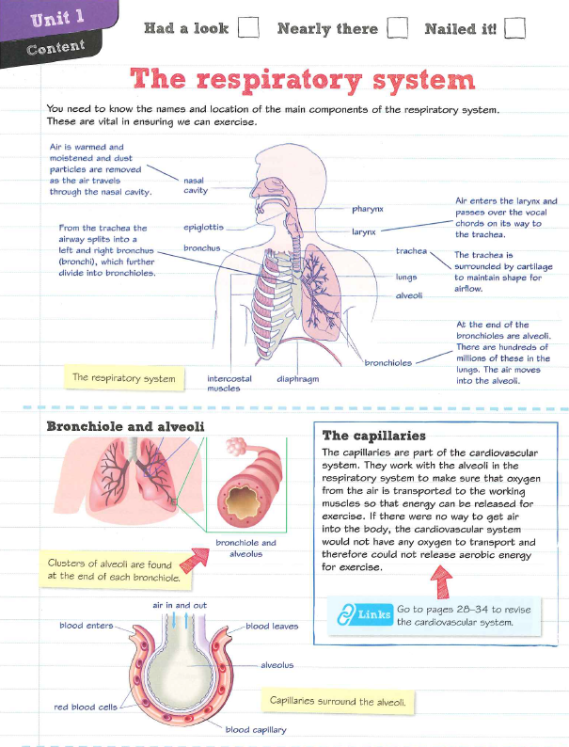
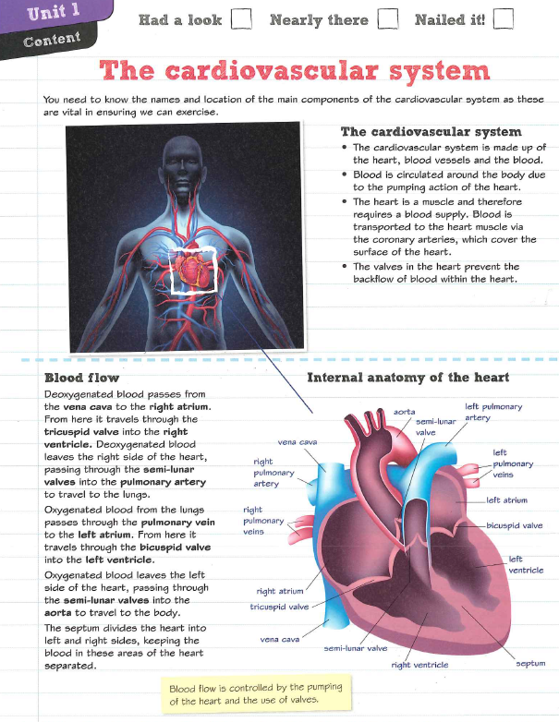
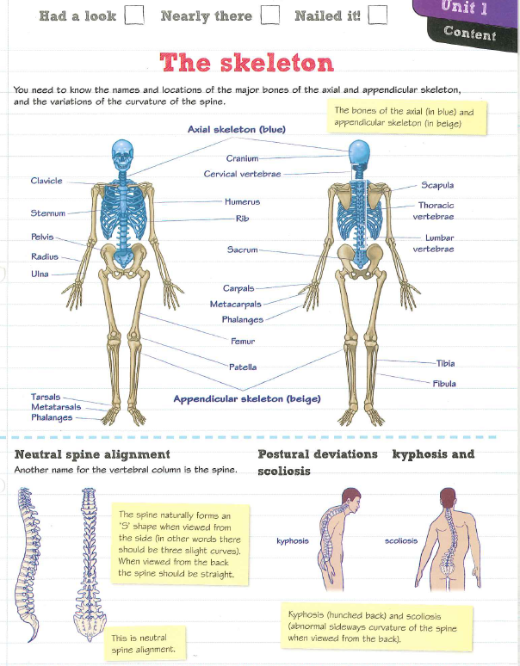
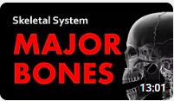
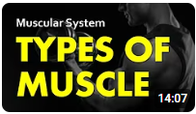
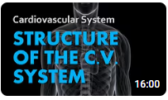
Session 1 Unit 1 - Anatomy & Physiology
Watch the following videos specific to Pearson Level 3 BTEC Sport – Anatomy & Physiology
- Major Bones | Skeletal System 01| Anatomy & Physiology – YouTube
- Types of Muscle | Muscular System 01 | Anatomy & Physiology
- Structure of the Heart & CV System | Cardiovascular System 01 | Anatomy & Physiology
Please complete the questions on the next slides to test your knowledge and understanding.
These video’s have been set to give you a good understanding of the key content that will appear in your Anatomy & Physiology exam in January. While your teacher will guide you through all content during your lessons, building up some foundation knowledge before September will give you a real head start.
This exam is a major component of your final grade in the BTEC Sport course, whether you're studying for the Extended Certificate (Single Award), Diploma (Double Award), or Extended Diploma (Triple Award).

Slide 2
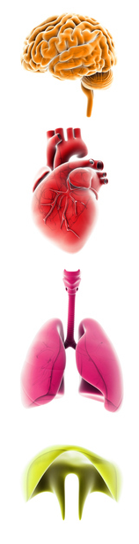
Quiz 1 – Skeletal System
Click for answers*
Which part of the skeletal system protects the lungs and heart?
Pelvis
Skull
Rib cage
Spine
Which bone is the longest in the human body?
Femur
Tibia
Humerus
Radius
Which bone is located in the upper arm?
Humerus
Ulna
Radius
Clavicle
What is the name of the bone that protects the brain?
Skull
Mandible
Sternum
Pelvis
Which bone is commonly referred to as the collarbone?
Clavicle
Scapula
Sternum
Rib
Which part of the skeletal system protects the lungs and heart?
Pelvis
Skull
Rib cage
Spine
Which bone is the longest in the human body?
Femur
Tibia
Humerus
Radius
Which bone is located in the upper arm?
Humerus
Ulna
Radius
Clavicle
What is the name of the bone that protects the brain?
Skull
Mandible
Sternum
Pelvis
Which bone is commonly referred to as the collarbone?
Clavicle
Scapula
Sternum
Rib

Slide 3
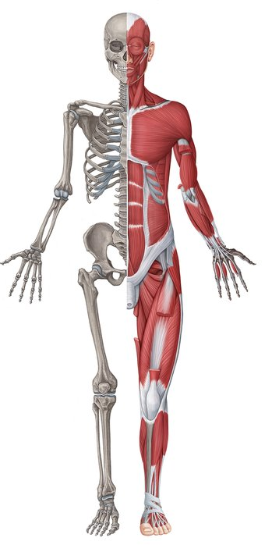
Quiz 2 – Muscular System
Click for answers*
Which type of muscle is responsible for voluntary movements?
Skeletal muscle
Smooth muscle
Cardiac muscle
Involuntary muscle
What type of muscle is found in the walls of internal organs such as the stomach?
Smooth muscle
Skeletal muscle
Cardiac muscle
Striated muscle
Which type of muscle is found exclusively in the heart?
Cardiac muscle
Skeletal muscle
Smooth muscle
Involuntary muscle
What is the primary characteristic of smooth muscle?
It is involuntary and non-striated
It is voluntary and striated
It is involuntary and striated
It is voluntary and non-striated
Which type of muscle is under conscious control?
Skeletal muscle
Smooth muscle
Cardiac muscle
Involuntary muscle
Which type of muscle is responsible for voluntary movements?
Skeletal muscle
Smooth muscle
Cardiac muscle
Involuntary muscle
What type of muscle is found in the walls of internal organs such as the stomach?
Smooth muscle
Skeletal muscle
Cardiac muscle
Striated muscle
Which type of muscle is found exclusively in the heart?
Cardiac muscle
Skeletal muscle
Smooth muscle
Involuntary muscle
What is the primary characteristic of smooth muscle?
It is involuntary and non-striated
It is voluntary and striated
It is involuntary and striated
It is voluntary and non-striated
Which type of muscle is under conscious control?
Skeletal muscle
Smooth muscle
Cardiac muscle
Involuntary muscle

Slide 4
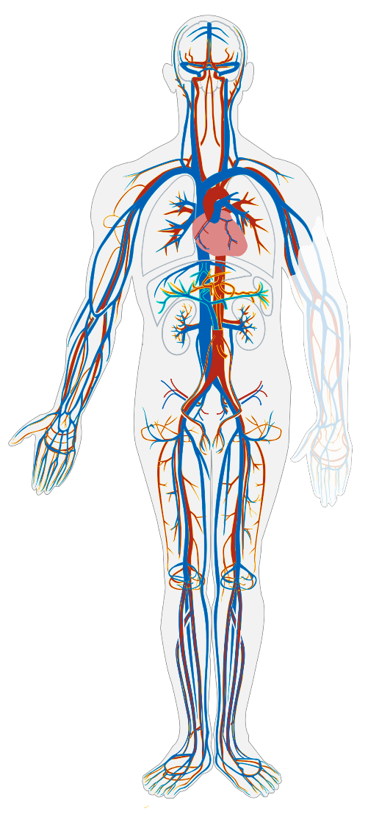
Quiz 3 – Cardiovascular System
Click for answers*
What is the main function of the cardiovascular system?
To transport oxygen and nutrients throughout the body
To produce hormones
To regulate body temperature
To protect against infections
Which blood vessel carries oxygenated blood away from the heart?
Arteries
Veins
Capillaries
Venules
What is the name of the upper chambers of the heart?
Atria
Ventricles
Septum
Valves
What is the role of capillaries in the cardiovascular system?
To exchange oxygen, nutrients, and waste products between blood and tissues
To carry blood back to the heart
To pump blood out of the heart
To regulate blood pressure
Which component of blood is responsible for transporting oxygen?
Red blood cells
White blood cells
Platelets
Plasma
What is the main function of the cardiovascular system?
To transport oxygen and nutrients throughout the body
To produce hormones
To regulate body temperature
To protect against infections
Which blood vessel carries oxygenated blood away from the heart?
Arteries
Veins
Capillaries
Venules
What is the name of the upper chambers of the heart?
Atria
Ventricles
Septum
Valves
What is the role of capillaries in the cardiovascular system?
To exchange oxygen, nutrients, and waste products between blood and tissues
To carry blood back to the heart
To pump blood out of the heart
To regulate blood pressure
Which component of blood is responsible for transporting oxygen?
Red blood cells
White blood cells
Platelets
Plasma

