Slide 1
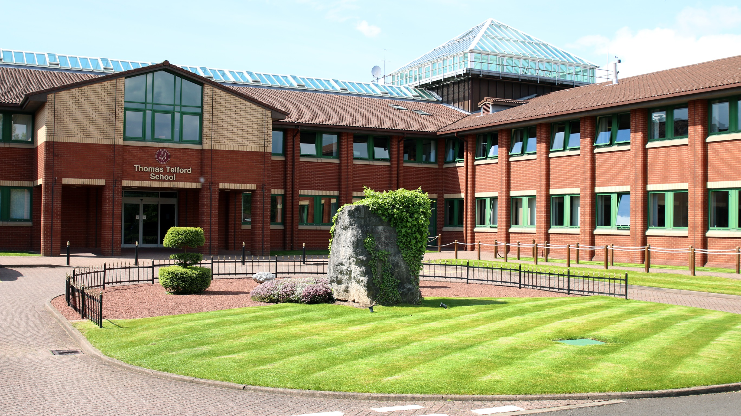
Year 11 to 6.1 Bridging Work
BTEC SPORT
Mr Kitchenham (ABK)

Slide 2

Bridging Work
The bridging work for BTEC Sport (Level 3) will take place across three sessions over a three-week period.
Its purpose is to help students make a smooth transition from GCSEs to BTEC Sport by providing essential preparation and support.
This work is compulsory and will cover key elements from several BTEC Sport units.
Specifically, it will focus on three main units that you’ll study over the next two years at Thomas Telford School.
The tasks are relevant to all BTEC Sport pathways, including the Extended Certificate (Single), Diploma (Double), and Extended Diploma (Triple).
There are 3 elements to complete over the next three-week period
  Session 1 – Unit 1 (Anatomy & Physiology)
  Session 2 – Unit 3 (Professional Development in Sports Industry)
  Session 3 – Unit 5 (Application of Fitness Testing)
If you have any questions or concerns, please contact Mr Kitchenham at akitchenham@ttsonline.net.

