Slide 1
A level music
Composition

Slide 2
Overview
Composing music is the creative process by which most of the music we experience came into being.
During the course you will be encouraged to explore a range of compositional starting points, investigate a range of techniques for developing and manipulating ideas. You will then turn your ideas into completed pieces of music. You can also explore the skills needed to compose for different musical forces.
You will learn more about the processes involved in creating music through developing the technical and expressive skills needed by a composer.

Slide 3
Overview
Composing music is the creative process by which most of the music we experience came into being.
During the course you will be encouraged to explore a range of compositional starting points, investigate a range of techniques for developing and manipulating ideas. You will then turn your ideas into completed pieces of music. You can also explore the skills needed to compose for different musical forces.
You will learn more about the processes involved in creating music through developing the technical and expressive skills needed by a composer.

Slide 4
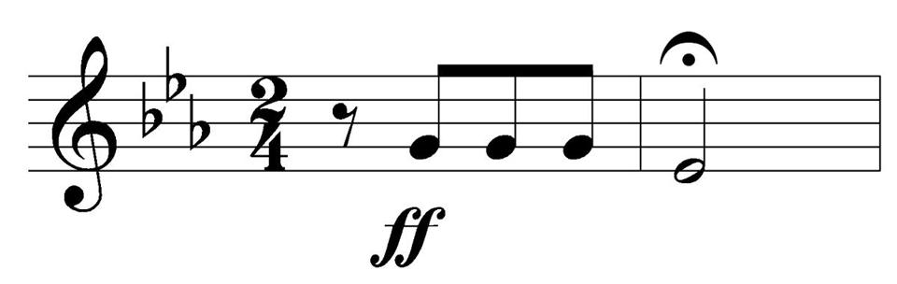

Composition Practice Tasks: Task 1
Compose a melody based on a motif: A motif is usually a small melodic fragment. This is obviously a more intricate way of working but it can provide a melody with a great feeling of unity and strength.
Compose a riff: A riff is a short melodic phrase in a pop or jazz composition. Usually repeated as an ostinato it can appear either in the lead part or in the bass or the backing instruments. Riffs are repeated rather than building up like melodies with contrasting or varied ideas, and that makes them easy to work with. Try out different combinations of notes, and then start to develop it by adding a rhythm. The best riffs are simple and catchy.
Notate your responses and bring them to your first composition lesson in September. You will find manuscript paper to download and print here: https://www.music-for-music-teachers.com/staff-paper-pdf.html
You can find an example of this here: https://www.youtube.com/watch?v=fOk8Tm815lE
You can find an example of this here: https://www.youtube.com/watch?v=nrIPxlFzDi0

Slide 5
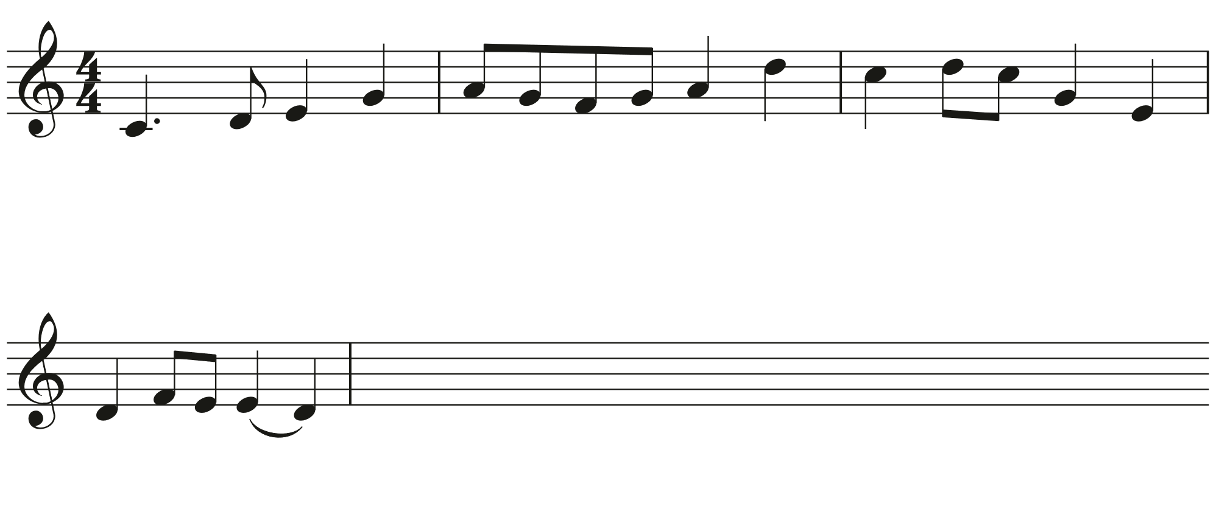
Composing task two: melody
Here is a four-bar melody. Compose another four bars, developing the melody using melodic devices. Some of the ways that you could do this include:
Repeating the melody (or part of it) in sequence
Repeat the melody, adding ornaments or other decoration; or
Compose a completely new, but contrasting melody, that can act as an answer in a question and answer format.
Notate your response and bring it to your first composition lesson in September. You will find manuscript paper to download and print here: https://www.music-for-music-teachers.com/staff-paper-pdf.html

Slide 6
Music theory
It is essential that you build up a good understanding of music theory throughout the course. So that we can assess your current level of knowledge on this, please complete test 1 on the document Grade-5-ten-tests-2020-10.pdf
Please print out this document and fill in your responses and then bring this into school for your first lesson.

