Slide 1
A-Level Biology Bridging Work
Session 1 - Microscopy & Cell Ultrastructure
The use of microscopy to observe and investigate different types of cell and cell structure in a range of eukaryotic organisms, to include an appreciation of the images produced by a range of microscopes: light microscope, transmission electron microscope, scanning electron microscope and laser scanning confocal microscope
The preparation and examination of microscope slides for use in light microscopy, including the use of an eyepiece graticule and stage micrometer
The use of staining in light microscopy, to include the use of differential staining to identify different cellular components and cell types
The representation of cell structure as seen under the light microscope using drawings and annotated diagrams of whole cells or cells in sections of tissue
The use and manipulation of the magnification formula
The difference between magnification and resolution, to include an appreciation of the differences in resolution and magnification that can be achieved by a light microscope, a transmission electron microscope and a scanning electron microscope
The ultrastructure of eukaryotic cells and the functions of the different cellular components, including the following: nucleus, nucleolus, nuclear envelope, rough and smooth endoplasmic reticulum (ER), Golgi apparatus, ribosomes, mitochondria, lysosomes, chloroplasts, plasma membrane, centrioles, cell wall, flagella and cilia
Photomicrographs of cellular components in a range of eukaryotic cells, to include interpretation of transmission and scanning electron microscope images
The interrelationship between the organelles involved in the production and secretion of proteins
The importance of the cytoskeleton, to include providing mechanical strength to cells, aiding transport within cells and enabling cell movement
The similarities and differences in the structure and ultrastructure of prokaryotic and eukaryotic cells

Slide 2
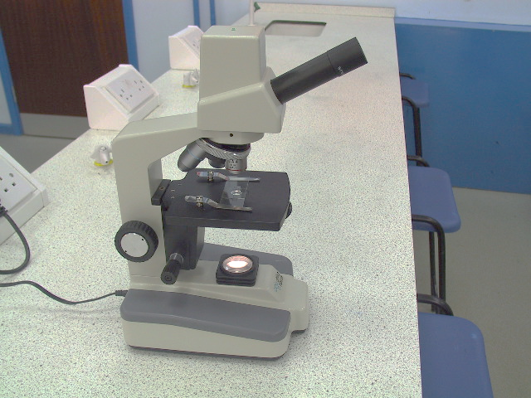
Microscopy
Task: Label the parts of a light microscope
Lenses
Our school light microscopes have three objective lenses, x4, x10 and x40
However, the eyepiece also has a x10 lens inside, so to work out the total magnification used we must remember to multiply the value of the objective lens by 10
When focusing you should always start off using the lowest-power objective lens (shortest), then gradually move up to the higher-powered lenses
Task: Define the terms “magnification” and “resolution”
What is the magnification calculation equation?

Slide 3
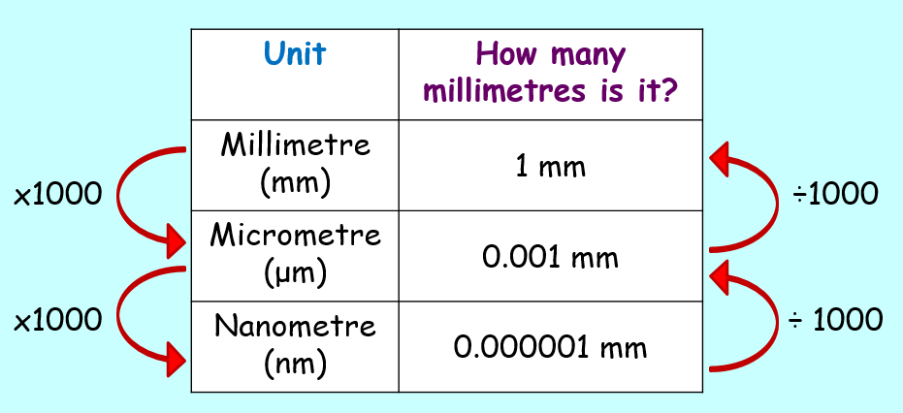
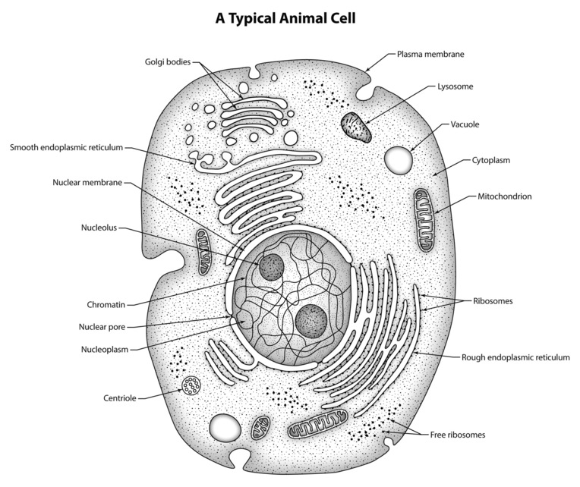
Units in microscopy
Unit | Symbol | Equivalent in metres | Also written as | Fraction of a metre
Metre | m | 1 |  | One
Decimetre | dm | 0.1 |  | One tenth
Centimetre | cm | 0.01 |  | One hundredth
Millimetre | mm | 0.001 | 1x10⁻³ | One thousandth
Micrometre | μm | 0.000,001 | 1x10⁻⁶ | One millionth
Nanometre | nm | 0.000,000,001 | 1x10⁻⁹ | One thousand millionth
When completing calculations using magnification, it is vital that all measurements have the same units – usually micrometres (μm)
Typical sizes in microscopy
Length of animal cell – 20-40μm
Diameter of a nucleus – 9-10μm
Length of a mitochondrion – 2-5μm
Diameter of a lysosome - 1μm
Diameter of a ribosome – 22nm
Width of a cell membrane – 7nm

Slide 4
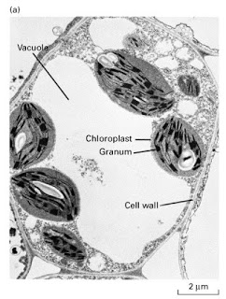
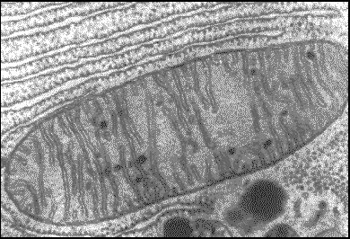
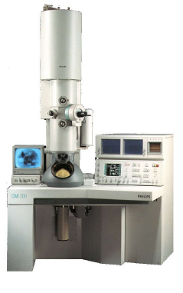
Task: Why can’t we see organelles like ribosomes using light microscopes?
General rule: If the object is smaller than half the wavelength of radiation used to view it, the object cannot be seen
Electron microscopes
In the early 1930's there was a scientific desire to see the fine details of the interior structures of cells (nucleus, mitochondria...etc.). This required x10,000 plus magnification which was just not possible using light microscopes
Electrons are used to overcome the problem of poor resolution using light microscopes. When electrons are free from their nucleus they are very energetic and have a very short wavelength
Transmission electron microscopes (TEM)
The TEM was the first type of EM to be developed, and is patterned exactly on the light microscope except that a focused beam of electrons is used instead of light to "see through" the specimen
The electrons pass ____________ a very thinly prepared specimen to produce a ____ image
TEM has a magnification up to x ___________ (higher than SEM) and a resolution of _______ nm

Slide 5
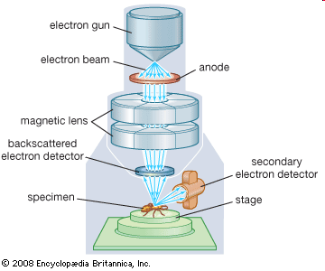
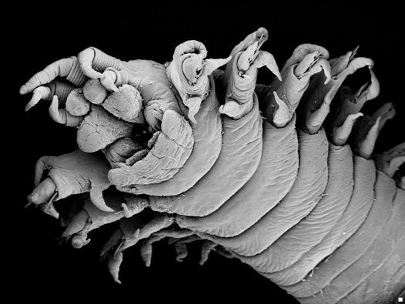
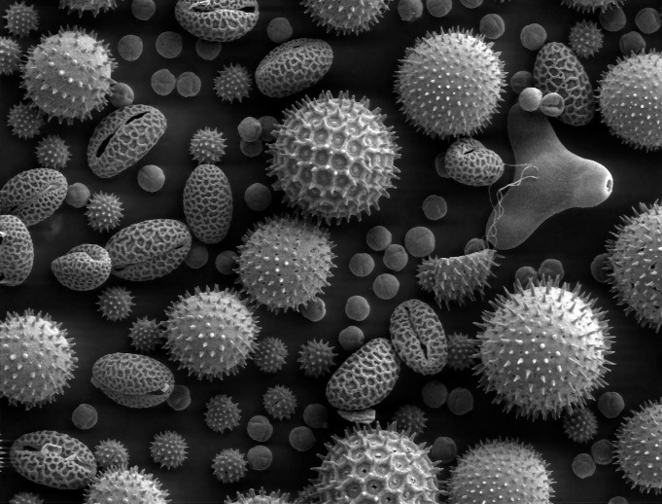
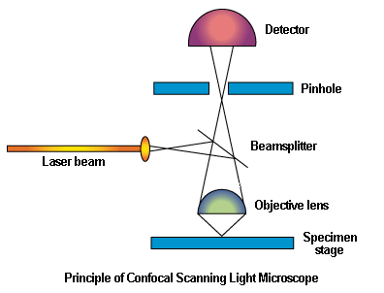
Scanning electron microscopes (SEM)
The electron beam is directed onto the specimen through a ______________ . The condenser and objective lenses focus the beam
The electrons bounce off the ______________ of the specimen and are sensed by a detector, which produces a ____ image
SEM has a magnification up to x __________ and a resolution of _____ nm
Laser scanning confocal microscopes
A microscope which uses _________ _________ instead of light to produce an image. The specimen being scanned is tagged with _________________ dye
The laser beam is focused through a lens onto a beam splitter, which directs some of the laser beam onto the specimen. When the laser hits the dyes they __________ fluorescent light, which is sensed by a detector. A pinhole just before the detector ensures a very clear and ___________ image
Task: Name three advantages of LSCM

Slide 6
 | Magnification | Resolution
Light microscope
SEM
TEM
Preparing tissues for light microscopy
You can view some biological specimens directly. However, a lot of biological material is not _________________ , so you can’t see the details
Also, samples must be cut very ______________ to allow light to pass through. However, some material ________________ when you try to cut it into thin sections
Staining
Any process that helps to reveal or distinguish different features. In light microscopy , stains may be colours or fluorescent dyes. In electron microscopy, stains are metal particles or metal salts
Task: Name three benefits of staining tissues for microscopy
Sectioning
After staining, specimens are embedded in _________ . Thin sections can then be cut (using a microtome) without distorting the structure of the specimen. This is particularly useful for making sections of soft tissue, such as brain.
Task: What are artefacts?

Slide 7
Task: Define the terms "eukaryotic" and "prokaryotic"
Features of prokaryotes
No nucleus (region where DNA is located is called the nucleiod)
Only one membrane (cell surface)
No membrane-bound organelles (e.g. mitochondria)
Cell wall is made of _______________________ (not cellulose as in plants)
Smaller _______________ then eukaryotes (18 nm)
DNA is in a single loop called a ______________ or bacterial chromosome (eukaryotes have linear chromosomes)
DNA is "__________" – not associated with histone proteins
Smaller loops of DNA called _______________ carry additional genes
ATP production (respiration) occurs in infolded parts of the membrane called ___________
Some species have ______________ for movement – these are similar to eukaryotic undulipodia but with a different structure
Prokaryotes | Eukaryotes
Cell diameter 1-10μm
 | Distinct nucleus surrounded by envelope of two membranes
DNA is circular
DNA is “naked”
 | Ribosomes are around 22nm in diameter
 | Ribosomes are attached to an endoplasmic reticulum
Cell wall present (made of peptidoglycan or murein)
No membrane-bound organelles
 | ATP production takes place in mitochondria
 | Flagella have 9 + 2 arrangement of microtubules

Slide 8
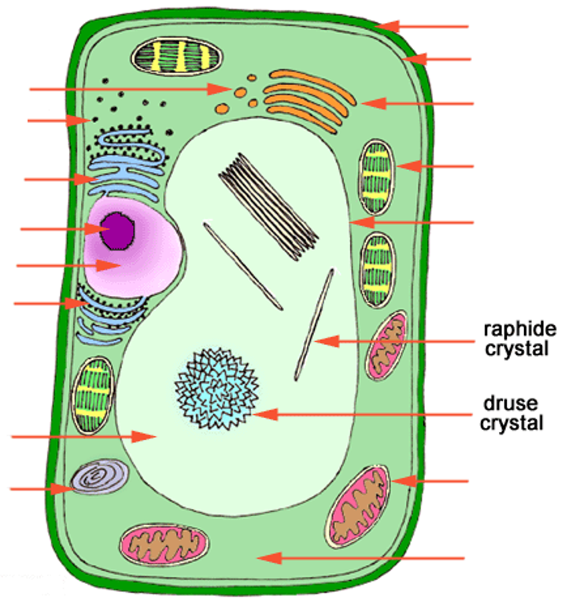
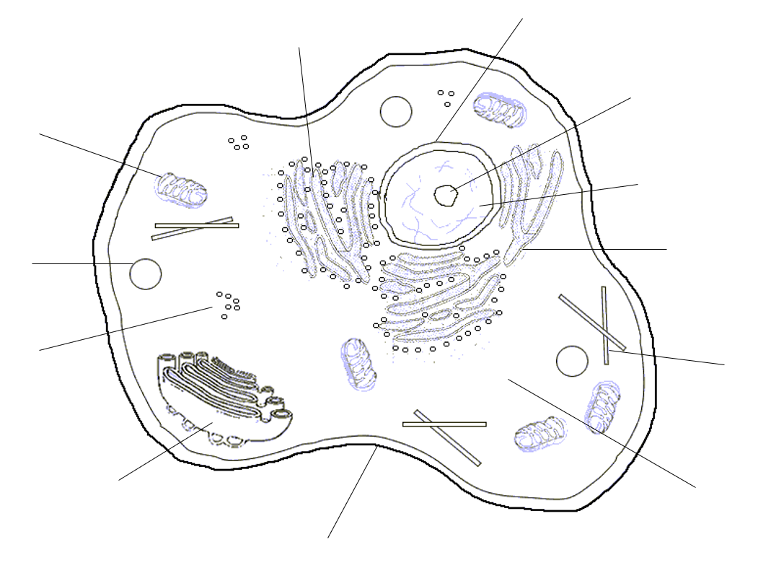
Cell structure
Task: State four differences between animal and plant cell structure

