Slide 1
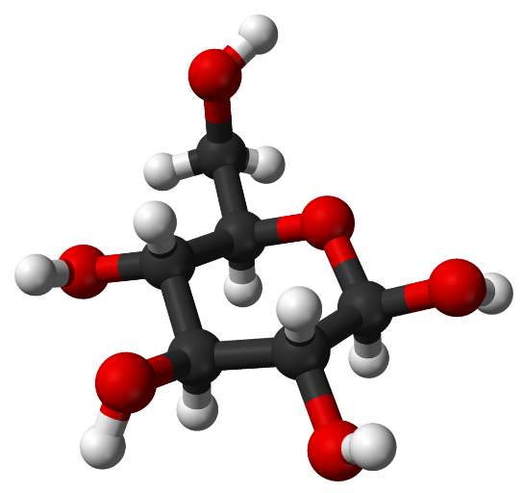
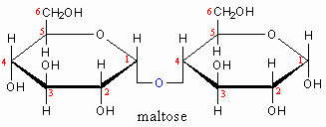

A-level Biology Bridging Work
Bonding in Biological Molecules

Slide 2
A-level Biology Specification: 2.1.2
Learners should be able to demonstrate and apply their knowledge and understanding of:
The concept of monomers and polymers and the importance of condensation and hydrolysis reactions in a range of biological molecules
The chemical elements that make up biological molecules
The ring structure and properties of glucose as an example of a hexose monosaccharide and the structure of ribose as an example of a pentose monosaccharide (including the structural difference between α and β glucose molecules)
The synthesis and breakdown of a disaccharide by the formation and breakage of glycosidic bonds, including the disaccharide maltose

Slide 3
Learning purpose:
MUST (C):
Name the four main groups of biological molecules and state the elements found in each
Define the terms “monomer” and “polymer” and give examples of each
Define the terms “hexose” and “pentose” and give examples of each
Distinguish between diagrams of alpha and beta glucose
Name the bond formed when two monosaccharides join
Represent condensation and hydrolysis reactions in diagrams
SHOULD (B):
Describe with the aid of diagrams how bonds are formed in condensation reactions and broken in hydrolysis reactions
Define the terms “monosaccharide”, “disaccharide” and “polysaccharide” and give examples of each
Explain why the two isomers of glucose are important in biology
Draw diagrams to show the formation and breakage of disaccharides
COULD (A/A*):
Draw the molecular structures of ribose and alpha and beta glucose
Links to prior learning:
GCSE Chemistry – Bonding
GCSE 4.4.1.3 Uses of glucose in plants
GCSE 4.4.2.1 Aerobic respiration
Links to future learning:
Polysaccharides
Lipids
Proteins
Nucleic acids
Biochemical testing
Lesson vocab
Monomer
Polymer
Condensation
Hydrolysis
Monosaccharide
Disaccharide
Polysaccharide
Hexose
Pentose
Isomer
Alpha-glucose
Beta-glucose
Glycosidic bond
Maltose

Slide 4
Biological molecules
Carbohydrates – C, H and O in the ratio C_{x}(H₂O)_{x}
Proteins – C, H, O and N (some also contain sulphur)
Lipids (fats) – C, H and O
Nucleic acids (DNA and RNA) – C, H, O, N and P
What are monomers and polymers?

Slide 5
Monomers and polymers
Monomers are small basic molecules that are the “building blocks” for larger molecules
E.g. glucose, amino acids, nucleotides
Polymers are large, complex molecules made of chains of many monomers joined together
E.g. starch, proteins, DNA
NOTE: Lipids are described as “macromolecules” rather than as polymers because they are not made up of repeating monomers – more on this later!

Slide 6
Forming bonds in polymers
Monomers are joined together through condensation reactions. A molecule of water is eliminated (removed) as the bond is formed
HO
OH
HO
OH
HO
O
OH
+H₂O
Covalent bond
It is important to show the water molecule being removed

Slide 7
Breaking bonds in polymers
Polymers are broken down into monomers through hydrolysis reactions – the opposite of condensation reactions
A molecule of water must be added to break the bond (hydro = water and lysis = to break/split)
+H₂O
HO
O
OH
HO
OH
HO
OH
It is important to show the water molecule being added

Slide 8
Task:
Make notes on how bonds between monomers are formed and broken, using diagrams in your explanations

Slide 9
Mini-plenary:
Do the following examples describe condensation or hydrolysis reactions?
Conversion of glucose to glycogen in muscle cells
The breakdown of proteins into amino acids
Two glucose molecules bonding to form maltose
Digestion of starch by amylase

Slide 10
Carbohydrates
Contain the elements C, H and O
For every carbon atom there are two hydrogen atoms and one oxygen atom - ratio of C_{x}(H₂O)_{x}
Names of carbohydrates usually end in “-ose”
Three roles in organisms:
Act as an energy source for respiration (e.g. glucose)
Act as an energy store (e.g. starch, glycogen)
Structural role (e.g. cellulose in plant cell walls and chitin in insect exoskeletons)

Slide 11
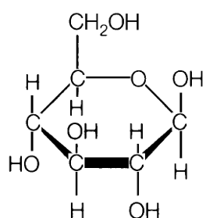
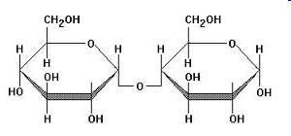
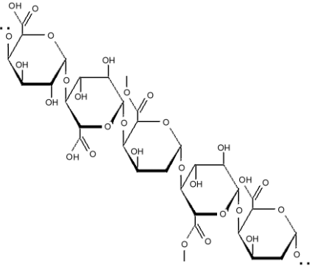
Key terms:
Monosaccharide – A simple sugar (the simplest form of carbohydrate); cannot be broken down to simpler sugars by hydrolysis. Examples: glucose, fructose, ribose
Disaccharide – A sugar composed of two monosaccharides (broken down by hydrolysis into two monosaccharide molecules). Examples: sucrose, lactose, maltose
Polysaccharide - A complex carbohydrate composed of a chain of monosaccharides joined together by glycosidic bonds. Examples: cellulose, starch, glycogen

Slide 12
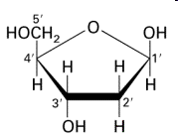
Key terms:
Monosaccharides are classified by the number of carbon atoms they contain:
Triose - 3 carbon atoms
Tetrose - 4 carbon atoms
Pentose - 5 carbon atoms
Hexose - 6 carbon atoms
Heptose - 7 carbon atoms
Octose - 8 carbon atoms
Nonose - 9 carbon atoms
Decose - 10 carbon atoms

Slide 13
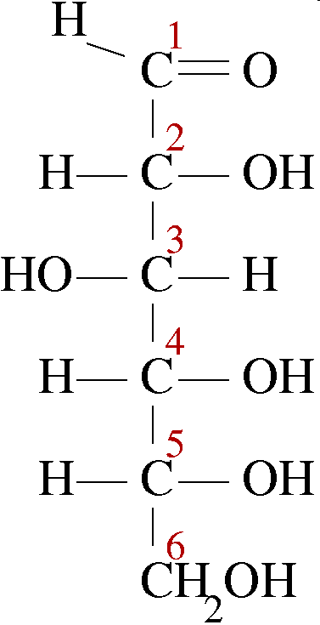
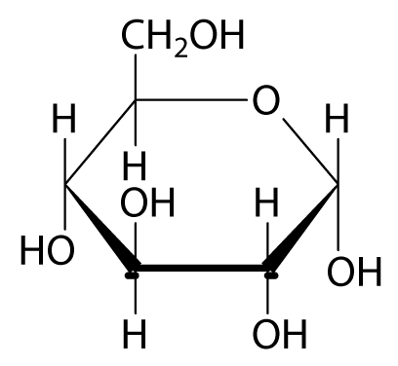
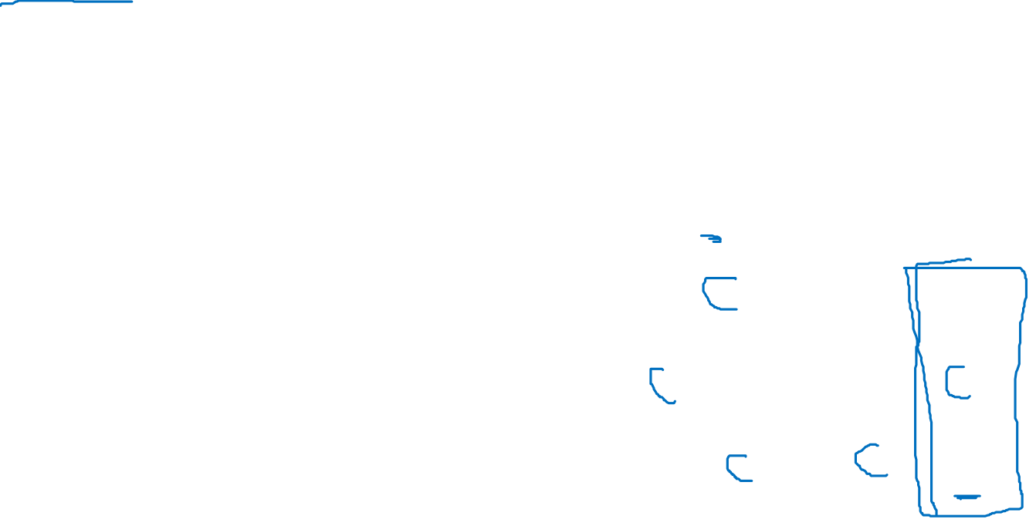
Glucose (alpha)
Glucose can exist in a variety of different molecular shapes, each one having unique properties (isomers)
However, regardless of shape, all glucose molecules have six carbon atoms (hexoses), and are monosaccharides
6
Glucose is sometimes drawn as a chain – to form the ring the groups on carbon atoms 1 and 5 interact
5
4
1
3
2
Chain form
Ring form

Slide 14
Glucose as an energy source
Glucose is adapted to its function in the following ways:
Soluble – easily transported around organisms (e.g. in the blood of animals)
Small molecule – can enter cells easily by diffusing across the cell surface membrane
Readily respired to release energy
Molecules can be joined together (polymerised) through condensation reactions to form starch or glycogen for storage

Slide 15
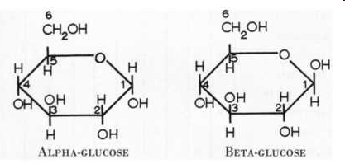
Alpha- and beta-glucose
Both forms of glucose have the same chemical formulae (C₆H₁₂O₆). The important difference is the arrangement of molecules around the first carbon atom in the ring
The alpha form is defined by the -OH (hydroxyl) group on C1 being on the opposite side of the ring as the C6 group. The beta form is defined by the -OH group on C1 being on the same side of the ring as the C6 group
This slight difference affects the bonding between monomers
α-glucose molecules form starch or glycogen, while β-glucose molecules form cellulose

Slide 16
Tasks:
How is glucose adapted for its function as an energy source?
Draw the ring form of alpha-glucose and number the carbon atoms
Use a diagram to show how the structure of beta-glucose differs to that of alpha-glucose (number the carbon atoms again)
Explain why the difference between the two glucose isomers is important in biology
Extension: What properties do all monosaccharides share? How might this differ to the properties of polysaccharides such as starch and cellulose?

Slide 17
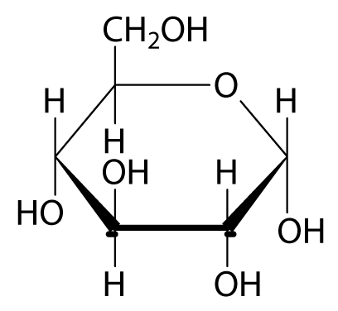
Disaccharides
Key term: A sugar composed of two monosaccharides (broken down by hydrolysis into two monosaccharide molecules). Examples: sucrose, lactose, maltose
Maltose is a disaccharide formed of two alpha-glucose molecules bonded together
What happens to the glucose units to form the bond?

Slide 18
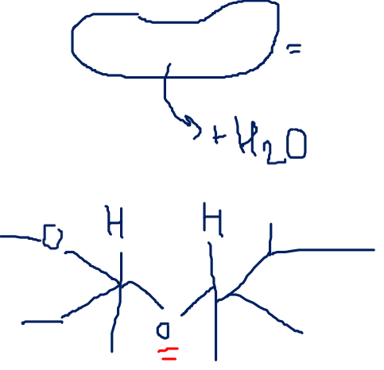
Forming a disaccharide (maltose)

Slide 19
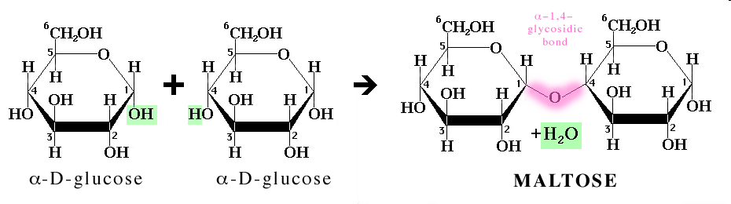
Condensation reactions in carbohydrates
To produce a disaccharide, a condensation reaction takes place to form a covalent bond between the two alpha-glucose molecules (at C1 and C4)
A water molecule is removed in the process (in green)
In carbohydrates, the bond formed is called a glycosidic bond (highlighted in pink)

Slide 20
Hydrolysis reactions in carbohydrates
To split a disaccharide back into two monosaccharide molecules, a water molecule must be added (reverse of condensation reaction)
The addition of water breaks the glycosidic bond
Hydrolysis and condensation reactions are controlled by enzymes

Slide 21
Tasks:
What is a glycosidic bond? How are they formed?
Draw a diagram to show how two molecules of alpha-glucose (monosaccharides) join together to make a molecule of maltose (a disaccharide)
Remember to show the resulting water molecule and label the bond
Extension: Write word and chemical equations to show the formation of maltose by a condensation reaction

Slide 22
Plenary:
To summarise the key points on bonding and carbohydrates, complete the summary booklet pages and have a go at applying your knowledge to the exam-style questions at the end

