Slide 1
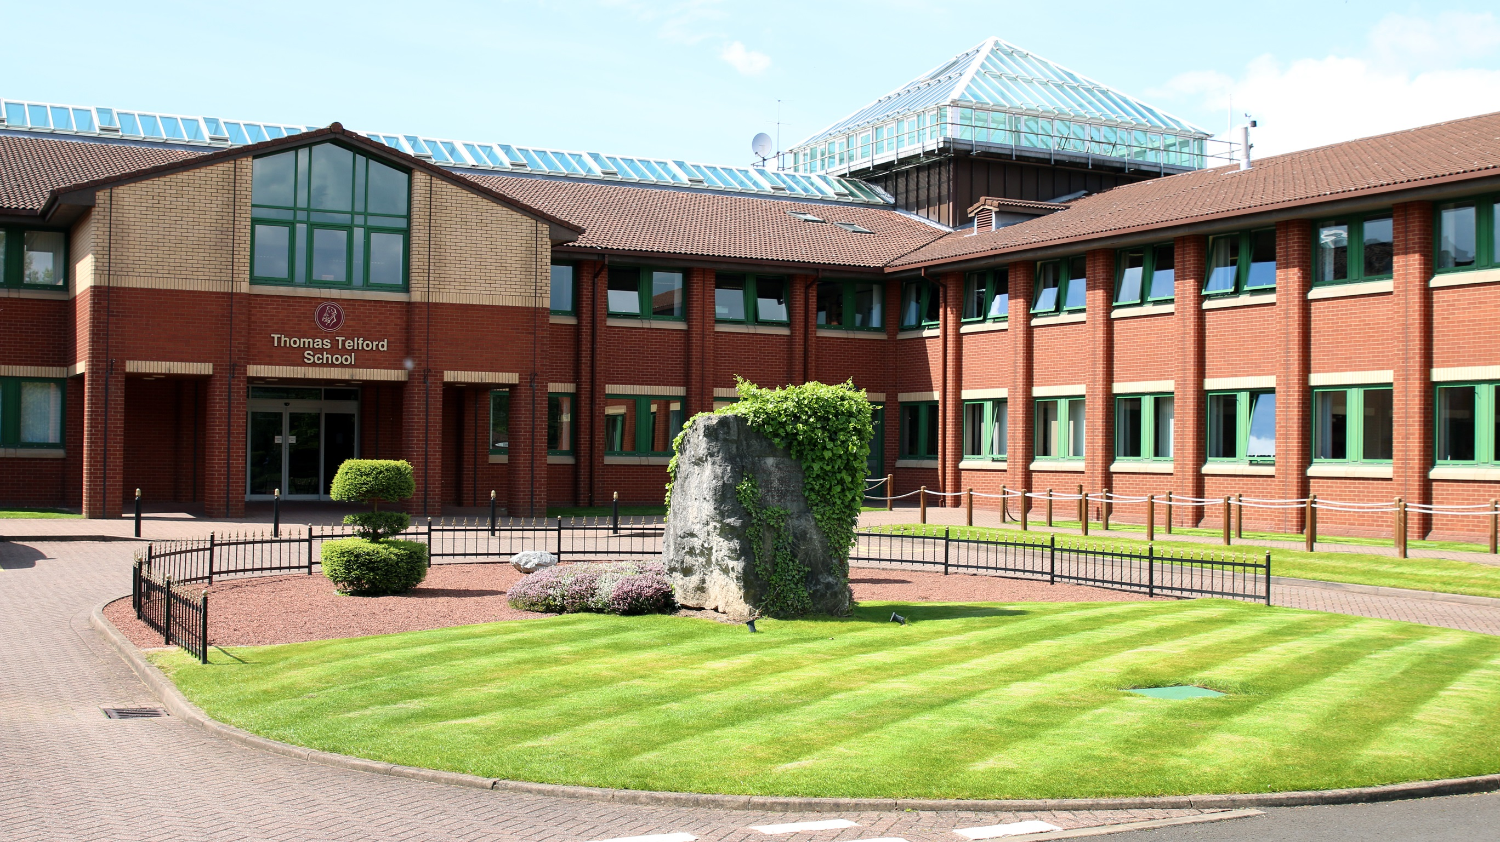
A-Level PE Bridging Course
Skill Acquisition:
Skill Continuums
Miss Law

Slide 2
Skill Continua
1
Context:
Students need to be aware of the characteristics of a skill and how they can be classified onto different continua.
What do you think is the most important thing to remember from today’s lesson?
Prior Learning:
Through completion GCSE PE and BTEC Sport in KS3, students will have some understanding of skill continua.
Knowledge of different skills required in sport.
By the end of this lesson I will:
1: To be able to understand the characteristics of skill
2: To be able to explain how skill can be classified using continua.
3: To be able to attempt to identify and classify skills used in sporting activities.
Future Learning:
Students can apply this knowledge to transfers of learning.
To answer exam style questions.
RECAP: what is a skill? Why do we need different skills? Why do different skills have different characteristics? What are the characteristics of a skill?
Subject specific vocabulary – choose 5 key words from this lesson that you think are important:

Slide 3
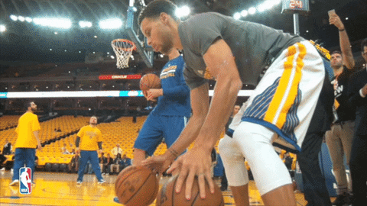
Characteristics of Skill
Use this information to complete Task 1 on the work sheet
What is a skill:
“Learned ability to bring about predetermined results with the maximum certainty and minimum outlay of time, energy or both” Knapp (1963)
Characteristics of a skill:
Aesthetically pleasing
Consistency/repeatable success
Efficiency/minimisation of time/ quick
Fluency/flowing/smooth/Adaptable
Accurate/Correct/Precise.
Controlled/Coordinated
Economic/effortless Minimal outlay of energy
You can remember this by using the acronym ACEFACE

Slide 4
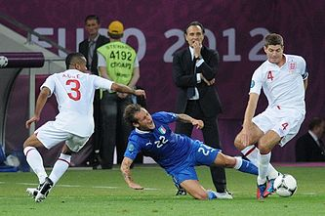
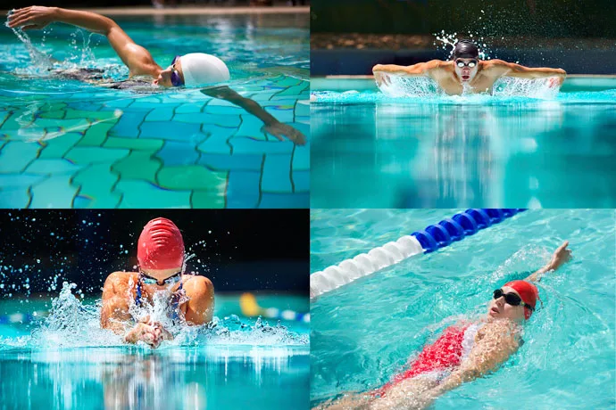
Skill Continua
Use this information to complete Task 2 on the work sheet
Skills can be classified based on the following 6 factors:
Environmental influence → open and closed
Continuity → discrete, serial and continuous
Extent of muscles used → gross and fine
Control and rate of execution → self paced and externally paced
Degree of difficulty → simple and complex
Organisation → high and low

Slide 5
Environmental Influence
Use this information to complete Task 3 on the work sheet
An open skill:
Is affected by the environment, or performed in a dynamic changing situation or environment. This skill is directly affected by changing factors such as the movement of the ball, the movement of your team mate, the surface of the pitch, wind and other weather, positions of opposing players etc.
e.g. passing to a team mate in football.
A closed skill:
Is performed in a stable, unchanging environment, where the environment has little or no impact on the performance of the skill
e.g. throwing a dart - the position of the board, type of dart etc. are all fixed and will not vary from one throw to the next.

Slide 6
Control and Rate of Execution
Use this information to complete Task 3 on the work sheet
A self paced skill:
Is when the performer decides when the movement is begun and the pace at which the movement is performed.
e.g. throwing a javelin
An externally paced skill:
Is initiated by something other than the performer. The pace at which the skill is performed is dictated by factors other than the performer.
e.g. timing a rugby tackle correctly to hit a moving opponent

Slide 7
Extent of Muscles Used
Use this information to complete Task 3 on the work sheet
A gross skill:
Involves strong powerful movement requiring the use of major muscle groups. Where fine control is not possible or required.
e.g. Such as the leg and arm movements found in running.
A fine skill:
Involves small, precise movement showing high levels of accuracy and coordination, using small muscle groups.
e.g. Such as the fine adjustments of the wrist when aiming a putt in golf.

Slide 8
Continuity
Use this information to complete Task 3 on the work sheet
Discrete skills:
Have a definite beginning and definite end
e.g. a handstand. Start balanced on feet, end balanced on hands.
Serial skills:
Are discrete skills linked together in a sequence
e.g. triple jump links a hop, a step & a jump
Continuous skills:
Have no clear beginning and end, one end phase of the movement blends into the start phase of the next cycle.
e.g. pedalling a bike.

Slide 9
Degree Of Difficulty
Use this information to complete Task 3 on the work sheet
Simple skill:
Is one that is straight forward, requires little concentration and cognitive ability.
e.g. chest pass, push pass, straight jump
Complex skill:
involves a large attention span because they are complicated and are practiced in training repeatedly to make it easier to perform in competition.
e.g. handspring, lay up, overhead kick

Slide 10
Organisation
Use this information to complete Task 3 on the work sheet
Low organisation skill:
is very easy and uncomplicated like riding a bike. The phases that make up the skill are usually discrete and might be practiced separately to make your technique better.
e.g. Swimming stroke, Cycling
High organisation skill:
has a complex amount of phases involved which cannot be broken down and practiced separately as they are linked closely together. They require large amounts of attention.
e.g. gymnastics move, pole vault

Slide 11
Task 4
Use this information to complete Task 4 on the work sheet
For each sporting example listed, place the skill onto each continua line to show the classification:
Tackle in rugby
Javelin throw
Backstroke swim
Dive from 10m platform
Triple jump – this has been completed for you as an example
Dance routine
100m sprint start
Penalty shot in netball

Slide 12
Skill Continua
1
Context:
Students need to be aware of the characteristics of a skill and how they can be classified onto different continua.
What do you think is the most important thing to remember from today’s lesson?
Prior Learning:
Through completion GCSE PE and BTEC Sport in KS3, students will have some understanding of skill continua.
Knowledge of different skills required in sport.
By the end of this lesson I will:
1: To be able to understand the characteristics of skill
2: To be able to explain how skill can be classified using continua.
3: To be able to attempt to identify and classify skills used in sporting activities.
Future Learning:
Students can apply this knowledge to transfers of learning.
To answer exam style questions.
RECAP: what is a skill? Why do we need different skills? Why do different skills have different characteristics? What are the characteristics of a skill?
Subject specific vocabulary – choose 5 key words from this lesson that you think are important:

