Slide 1





Slide 2
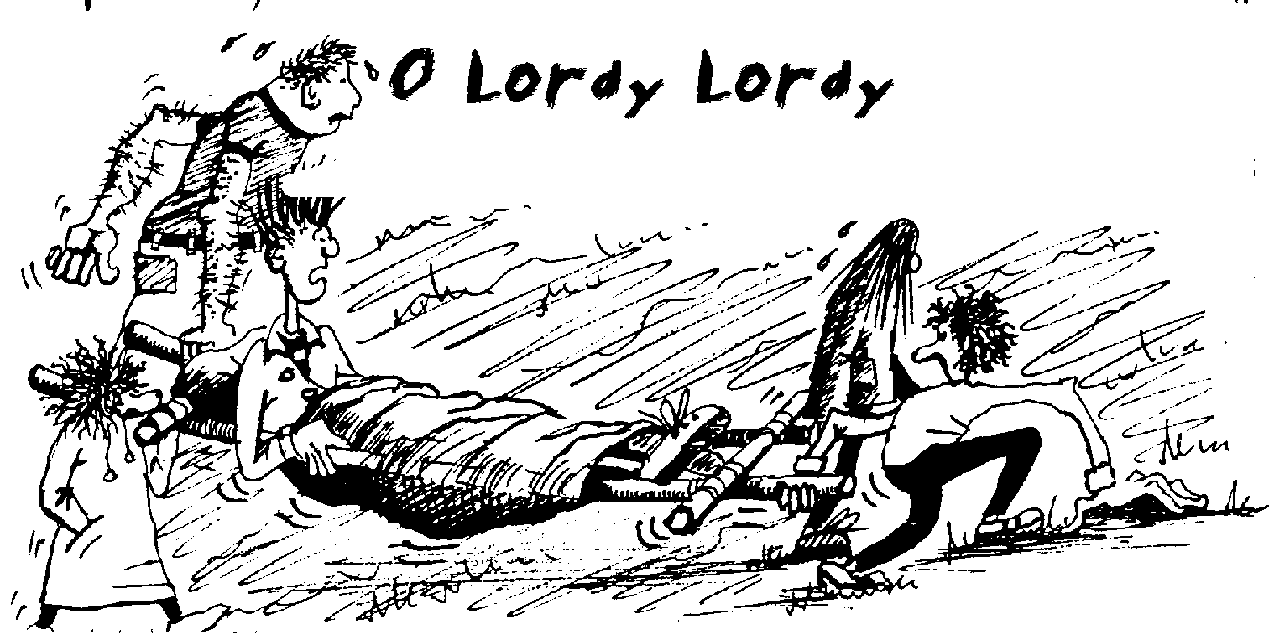
Crisis and Problem Solving
On your Expedition

Slide 3





Does it need some first aid?
NO
Try to sort it logically. Some of the most common problems are:- Fear of cows! Too many stops – try to set a target then all stop. Tired – are you snacking enough to keep your energy up. Splitting up – this is a big NO except for emergencies.
Don’t reach for your phone for these sort of things – SORT IT !
Are you lost?

Slide 4

Does it need some first aid?
NO
Are you lost?
YES
Use OS locate to
check your position.
Can you get back to your last known position?
YES

Slide 5
This may take a bit of effort but is always the best and fastest option. Go back then try again, but this time:- check your direction with a compass, decide what big feature you are aiming for, work out roughly how long it should take without stopping then time it, thumb the map checking every feature.

Slide 6
Does it need some first aid?
Then you must have been clucking about like a bunch of headless chickens!!
Try to decide on a catching feature; that’s something that will catch you if you head in one direction such as a road, river or forest.
NO
Are you lost?
YES
Can you get back to your last known position?
Use OS locate to
check your position.
NO

Slide 7


Does it need some first aid?
Can you cope with it using your training and carry on?
YES
Great, sort it, carry on then use your contact
number to let us know.

Slide 8


Can you cope with it using your training and carry on?
Does it need some first aid?
YES
NO
Does it require medical aid, e.g. an Ambulance or Mountain Rescue.
YES

Slide 9


Stop. Give First Aid. Reassess after waiting for ten minutes. After the initial shock or pain things will usually feel better. A twist of the ankle is typical of this. Consider the comfort of the whole group.
Use the contact number given to you. Be prepared to leave a clear calm message on voicemail first then text. State clearly: -who you are, where you are, check using OS Locate, noting any features around you, the time and the problem.
Try to get two members of your group to navigate to the nearest road – no more than 30 minutes away at Bronze, or if you are in a remote area or the Mountains use your Wild Country and Emergency Procedures training. Stay calm, what is a big problem to you now will probably be a very small problem later.

Slide 10

Can you cope with it using your training and carry on?
Does it need some first aid?
YES
NO
Does it require medical aid, e.g. an Ambulance or Mountain Rescue.
YES

Slide 11
Stop & Reassess. Can you wait a few minutes to see if it’s really that bad? If you have, or think you can’t, and you are still sure then:-
- Dial 999 first. If in a remote area or Mountains use your Wild Country and Emergency Procedures training.
- Then if possible, dial the contact number given to you – be prepared to leave a clear message, on voicemail first then text.
- If possible, try to get two members of your group to a road. Give your position clearly, check it using OS Locate. Are you near a house or people who can help? If so show them this card and your contact number.
- Give first aid whilst waiting and setup a temporary camp.
- Make yourselves very visible e.g. whistle/torch, until help arrives.

Slide 12
Remember this:-
an expedition is supposed to challenge you. It will be normal to feel outside your comfort zone. Try to solve problems calmly, they’re never as bad as they seem. Don’t reach for a mobile phone straight away, they should be sealed up inside your rucksack and used only as a last resort. Never Never Never call home with a problem, you will just worry everyone – use your contact number if you really need to and leave a message. If necessary, staff will contact home.

Slide 13

Remember, the only thing that is likely to really really harm you is getting run over!

Slide 14
Now look at the sheet titled –
Problem Solving On Your Bronze Expedition –
An Examination of Problems
Use the pictures and text boxes to guide you to the answer contained in the flow diagram. Work in pairs and write down your responses.

